Slide 1
Gittin to Know Github
With Mohit Dubey and Drew Einhorn

Slide 2
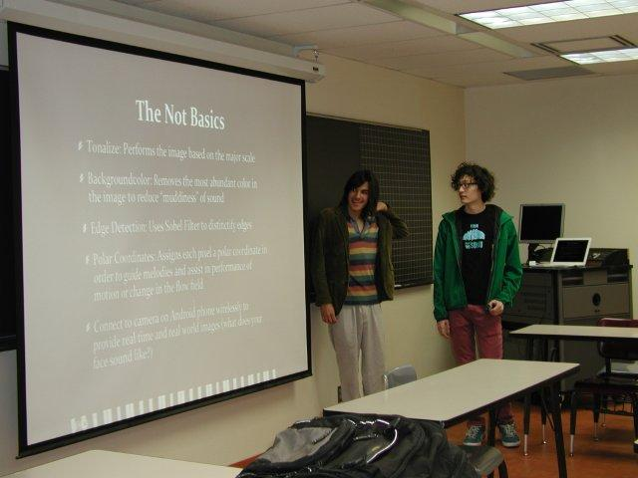
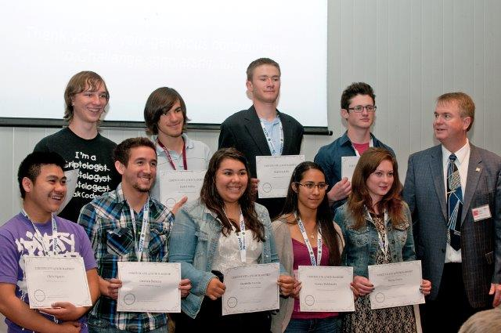
A Bit About Me
Former Challenger (2008-2014)
Oberlin College Graduate
Classical Guitar and Physics
Chemistry/Physics Teacher at NMSA
Interned at LANL and co-founded a startup
(you can check it out at subtonic.io)

Slide 4
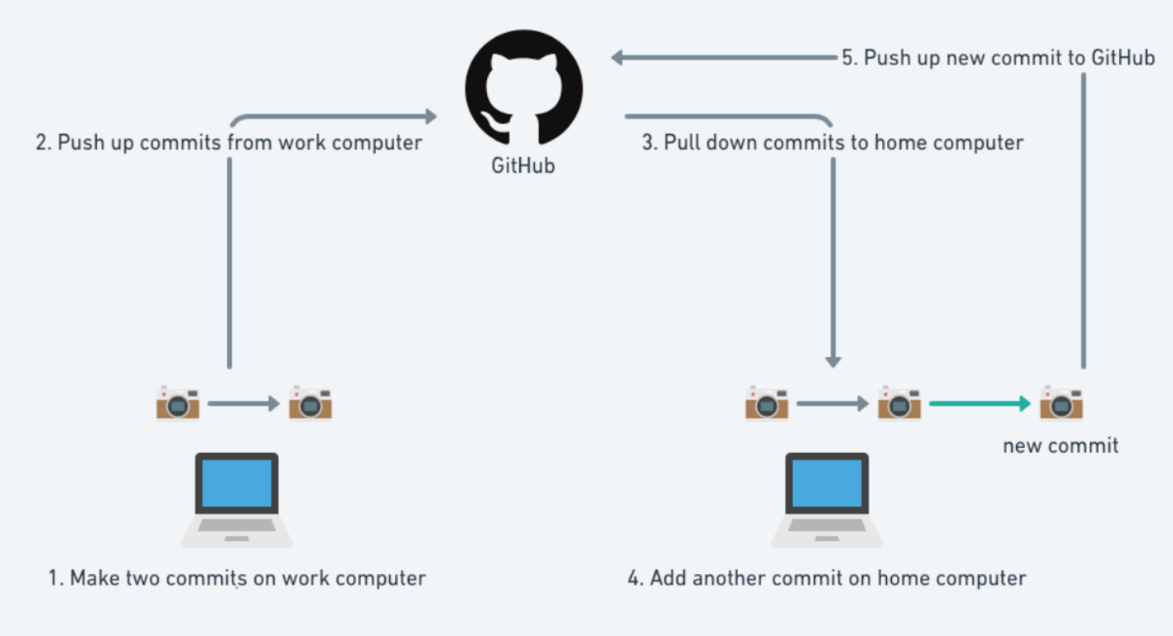

Slide 5
Why Should I Learn To Use This…?
And many many more… Git has become the standard version control system throughout all of tech and science

Slide 6
Today We Will...
Learn how to add files to your team’s Github repository in the browser
Setup Git on your personal computer
Learn the four basic Git commands
Adding files: git add
Making a commit: git commit
Pushing your commit: git push
Pulling your changes: git pull
Make your first commit using the command line!

Slide 7
Setting Up Github Account
Make sure you make a Github account. You should have received an email from Github inviting you to join a team: click the link in that email!
If you did not receive an email yet, make sure to register for the Challenge on the website: https://supercomputingchallenge.org/
You can also send me an email with your name and team number at mdubey@nmschoolforthearts.org

Slide 8
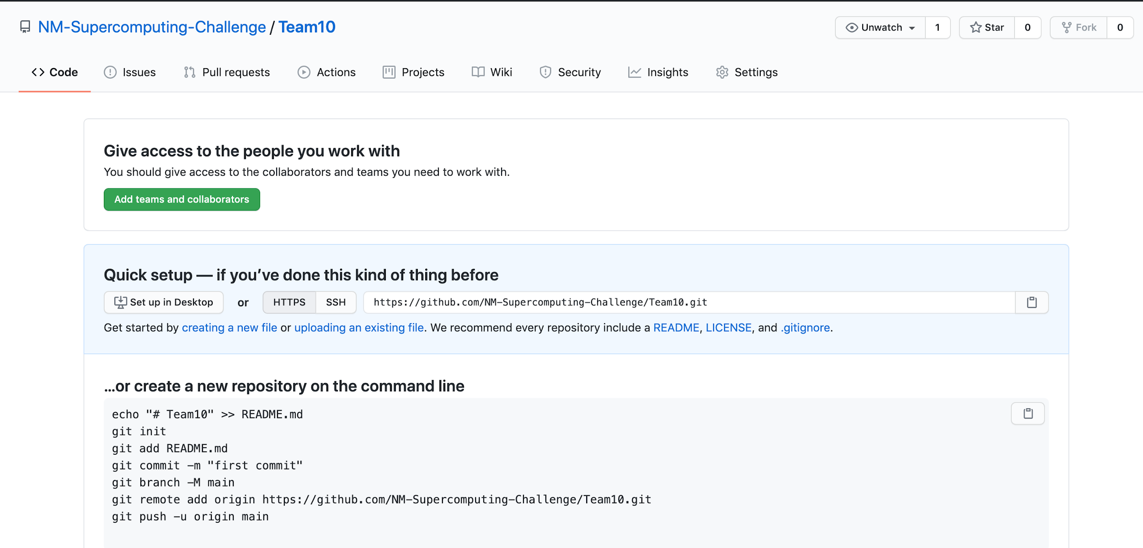
Gittin Stuff Into Your Repository
Go to https://github.com/NM-Supercomputing-Challenge
Find the Repository which matches your team number (i.e. “Team10”)
Click on your repository, it should look like this:

Slide 9
Gittin Stuff Into Your Repository
One way to add files to your repository is to upload them, like on Google Drive
Click “uploading an existing file”, find a file on your computer and upload it!

Slide 10
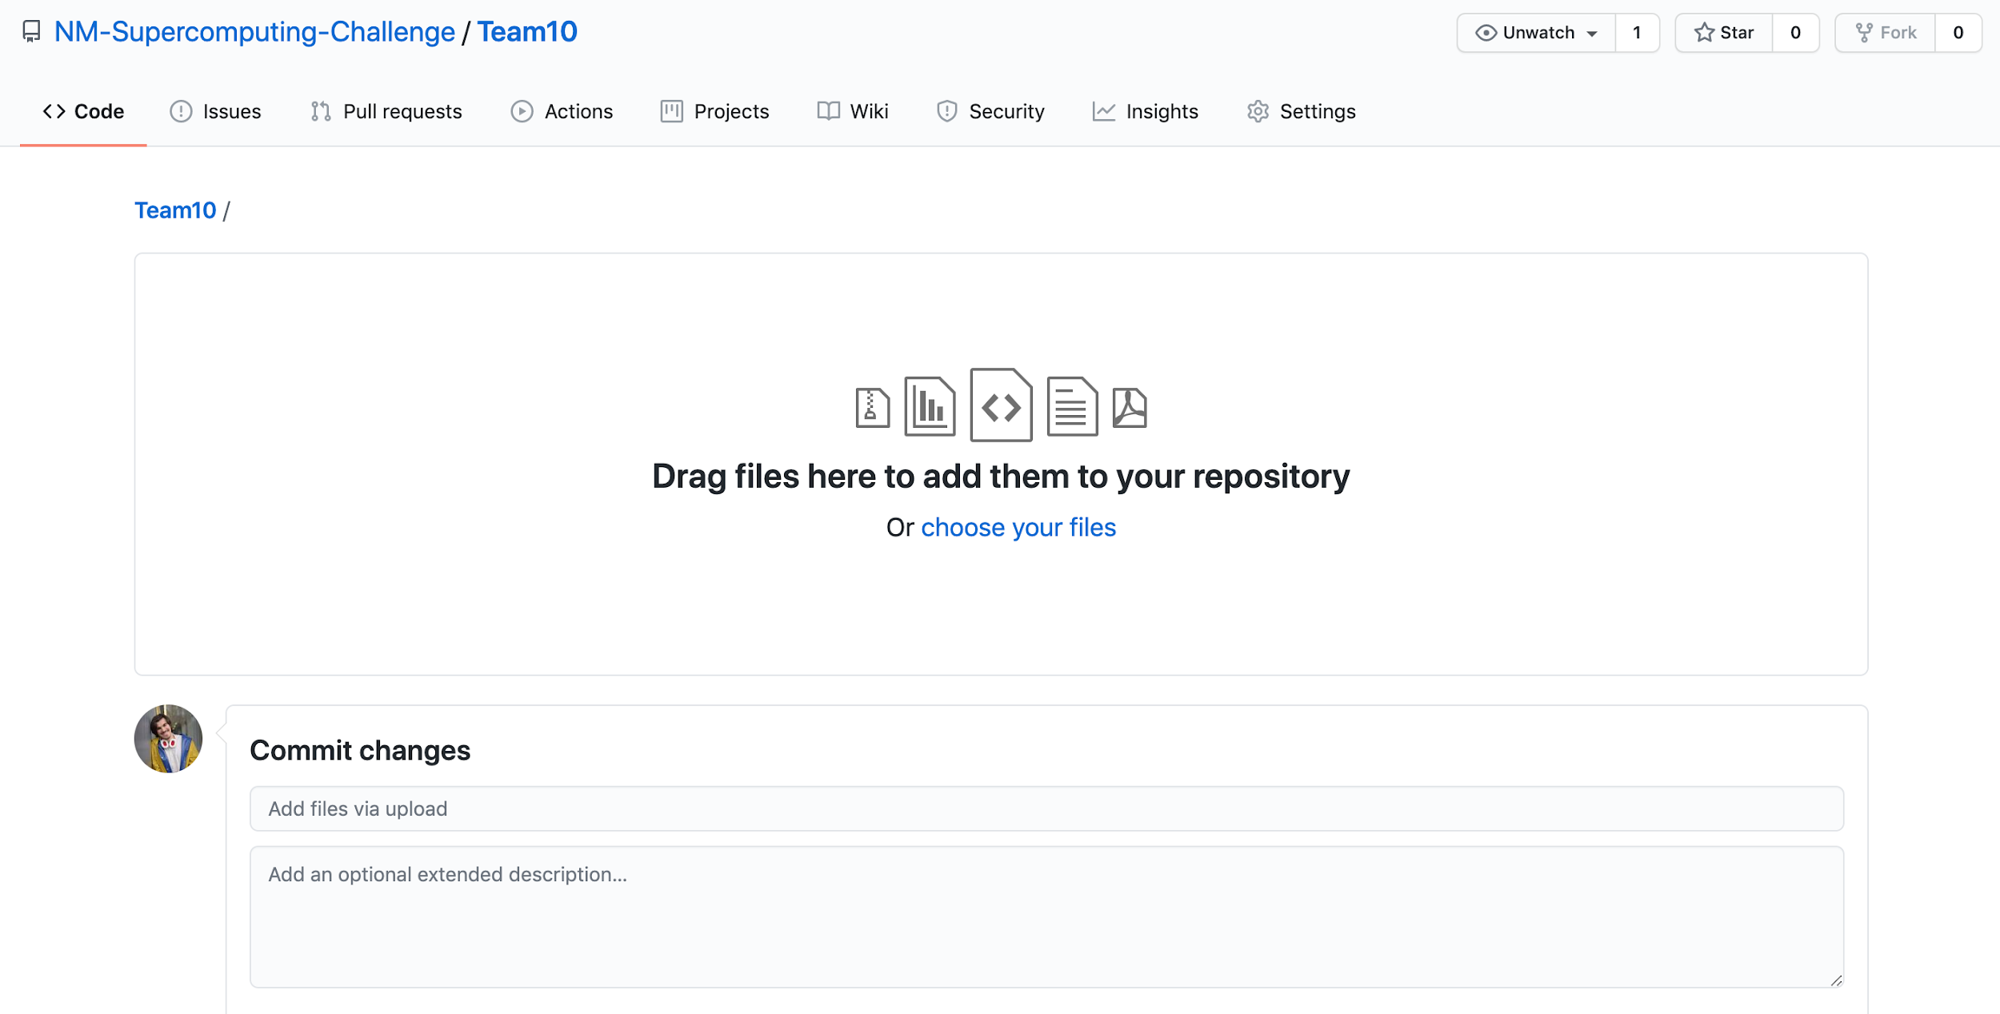
Upload your file here and write a commit message, then click “commit changes”

Slide 11
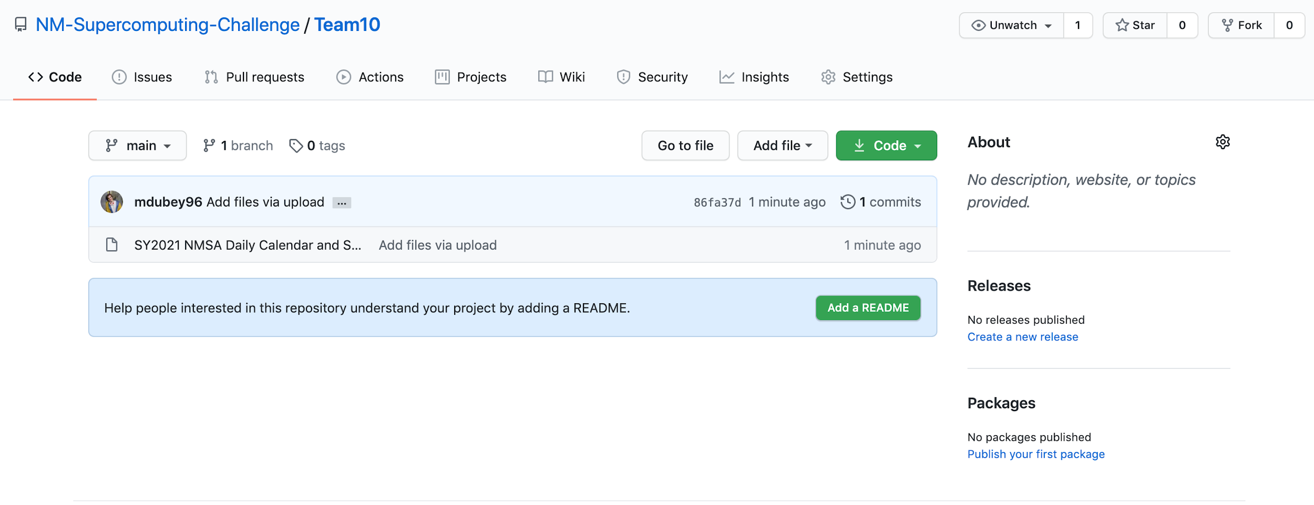
Success! Your file is now in the repository!

Slide 12
Setting Up Git
Next, we need to install Git onto your computer.
Go to this site and click the download that matched your OS: https://git-scm.com/downloads

Slide 13
Installing Git (More Details)
Go to https://git-scm.com/downloads:
Mac: Download the “dmg” and follow install instructions
Windows: Once you have downloaded the “exe” file, Follow instructions here:
https://phoenixnap.com/kb/how-to-install-git-windows
***Make sure to select “Git from command line and also from 3rd party software”
Linux: Follow the instructions relevant to your OS

Slide 14
Check To Make Sure It Worked
Open “Terminal” (Mac/Linux) or “Git Bash” (Windows):
Type “git --version”
You should see something like this:
If not, Drew will help you in a breakout room so you can get set up

Slide 15
Now, for the fun stuff :)
Open “Terminal” (Mac/Linux) or “Git Bash” (Windows):
Type “cd” (This will put us in your home directory)
Type “mkdir SCC2020” (This will make a folder on your computer)
Type “cd SCC2020” (Now you are inside of the folder you just made)
Now go back to the browser and click this guy,
Copy the link that pops up to your clipboard
Type “git clone (paste link here)” and hit enter!
Now you should have a folder named with your team number
Type “cd (Team#)” (This will take you into that folder)
Type “ls” (Now you should see all the files you added!)

Slide 16
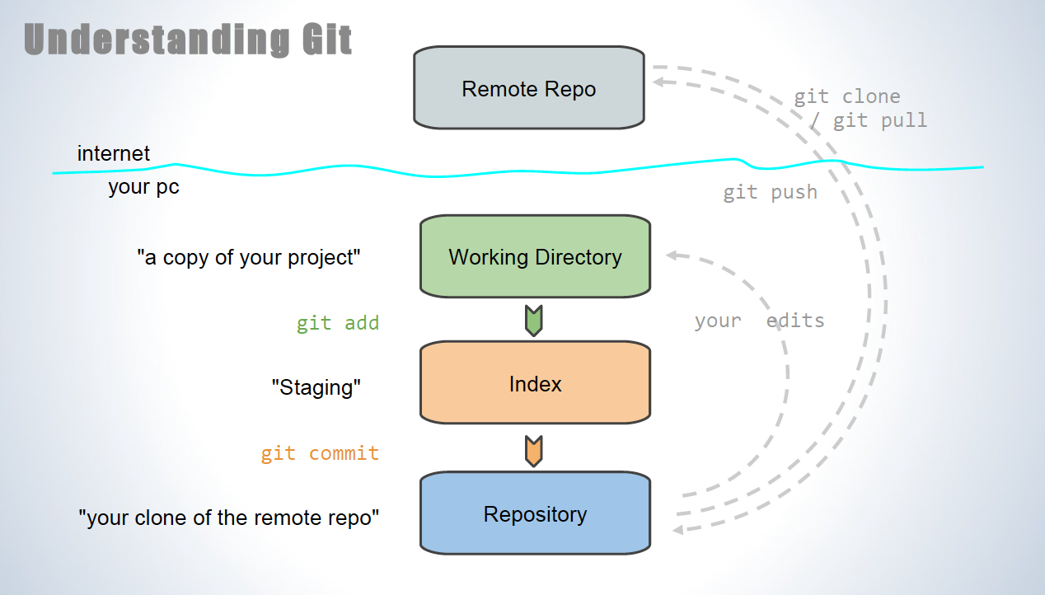

Slide 17
Step 1) Git “Add”
First, we want to put something in our folder. We can make a file that says the name of each team member. In the instructions below, replace (your name) with your actual name.
Open “Terminal” (Mac/Linux) or “Git Bash” (Windows):
Type echo “(your name)” >> (your name).md
Type ls (this shows the folder contents, including the new file you just made)
Type git status (your new file should show up in red)
Type git add (your name).md
Type git status (your new file should show up in green!)
Now, our file has been added to our local “staging” repository

Slide 18
1

Slide 19
Step 2) Git “Commit”
Now, we want to move the files in “staging” to our local repository.
Whenever we make a commit, we always add a message to say what we added or changed. Below, replace (your message) with a description of the new file.
In the “Terminal” (Mac/Linux) or “Git Bash” (Windows):
Type git commit -m “(your message)”
Now, our file has been added to our clone of the remote repository

Slide 20
1
2

Slide 21
Step 3) Git “Push”
Now, we are ready to send our changes out into the remote repository!
It’s as easy as typing one thing…. “git push”
In the “Terminal” (Mac/Linux) or “Git Bash” (Windows):
Type git push
Now, the remote repository should have been updated with our local changes
Check for yourself by going to: https://github.com/NM-Supercomputing-Challenge/Team(your team number)

Slide 22
3
1
2

Slide 23
Step 4) Git “Pull”
Now, all of your individual local files have been added to the remote repository
But, how do we get those files to our local folders?
It’s another simple one liner: “git pull”
In the “Terminal” (Mac/Linux) or “Git Bash” (Windows):
Type git pull
Type ls (remember, this shows the contents of your folder)
Now you should see the names of all your team members!!!

Slide 24
4
3
1
2

Slide 25
Summary
When you are working on your projects this year, you can easily share your code with one another using Git/Github. Follow these simple steps:
Make sure all your code is kept in the folder we created today
Before you start working, type “git pull” to make sure you are up to date
If you add new files or make changes to an existing file you want to share, follow steps 1-3 (git add, git commit, git push)
Send a message to your teammates letting them know what changes you made, and remind them to “git pull” next time they work
Happy Gitting!!!

Slide 26
Extra Links
Another good basic tutorial:
https://www.coderomeos.org/how-to-use-github-simple-github-tutorial-for-beginners
Git Documentation on managing files:
https://docs.github.com/en/free-pro-team@latest/github/managing-files-in-a-repository/managing-files-on-github
More advanced Git Usage:
https://docs.github.com/en/free-pro-team@latest/github/using-git

