Slide 1
CREATING A MODEL
IN NETLOGO

Slide 2
NETLOGO BASICS
Tabs - Interface, Info, Code
World agent
Turtles
Patches
Interface characteristics - size of world & patch size
x & y coordinate grid with 0,0 at center
ability to wrap

Slide 3
START A NEW PROJECT & SET-UP WORLD
Open NetLogo
Click on File
Choose New
Name your new project with your name and “Fish & Plankton”
Save (if Netlogo Web we will export later)
Use the ADD button to create two buttons:
Setup
Go, when creating Go, check the forever box.
In Web version, click to unlock the lock, then right click on green area to create buttons.

Slide 4
START CODING - GO TO THE CODE TAB
You can add any “comments” that the computer will not read by first putting a semicolon ;; (notice that makes the text gray)
Put a ; or two ;; then name your project again here (your name and something about fish & plankton)
Next, create two breeds, fish and plankton. Don’t forget to use both singular & plural forms of the breed names.
breed [ planktons plankton ]
breed [ fishes fish ]
This tells the computer what you are going to call your turtles (agents).

Slide 5
NETLOGO TEXT COLORS
Notice the colors of the text in Netlogo
;; Title (after semicolons) is gray - computer doesn’t read any of this text - you will want comments in your finished code
breed, to, and end are green - NetLogo understands those words (primitives)
When we add clear-all and set they will be blue ; size, shape, color are purple, the colors themselves and numbers are red - this means these all have a specific meaning to Netlogo, and so you shouldn’t use those words (without at least a dash to another word) to mean anything else in the program.
Any words in black are words you’ve used to name things that the computer can use, but only after you explain what they mean.

Slide 6
GIVE THE FISHES AN ENERGY VARIABLE
Next, give the fish their own trait called “energy”. This will let us set and change the energy level of the fish as the model runs, and let things happen based on the energy level of the fish. You can give turtles, patches, specific breeds, or links specific traits, called “agents-own” variables in Netlogo.

Slide 7
GIVE THE FISHES AN ENERGY VARIABLE
Next, give the fish their own trait called “energy”. This will let us set and change the energy level of the fish as the model runs, and let things happen based on the energy level of the fish. You can give turtles, patches, specific breeds, or links specific traits, called “agents-own” variables in Netlogo.
Your code should be on the next line under the breeds, and read:
fishes-own [ energy ] ;; gives fish the trait of "energy"

Slide 8
CREATE CODE FOR THE SETUP BUTTON
All Netlogo procedures start with to and a name (here the name is setup) and end with end. We want this procedure to work when we push the setup button, so the spelling and capitalization of the word setup here needs to match exactly with the button you created on the Interface.

Slide 9
CREATE CODE FOR THE SETUP BUTTON
All Netlogo procedures start with to and a name (here the name is setup) and end with end. We want this procedure to work when we push the setup button, so the spelling and capitalization of the word here needs to match exactly with the button you created on the Interface. Your code should read:
to setup
end
The rest of the code will go between those two commands.
First, you always want to clear away everything that happened the last time you ran the model, so on the first line below to setup type:
clear-all

Slide 10
CHANGE THE BACKGROUND
We want our world to look like the agents are underwater, so first let’s make the background a light blue color. Inside the setup code (between the to setup and the end), we want to ask the patches to set their color (since they are patches, we call this “pcolor”) to cyan.

Slide 11
CHANGE THE BACKGROUND
We want our world to look like the agents are underwater, so first let’s make the background a light blue color. Inside the setup code (between the to setup and the end), we want to ask the patches to set their color (since they are patches, we call this “pcolor”) to cyan.
Your setup command so far should look like this:
to setup
clear-all
ask patches
[ set pcolor cyan ]
end

Slide 12
CREATE AGENTS
We want to create some fishes and some planktons and tell the computer what they should look like, where they should start out, and what direction they should face.
Let’s start with 500 planktons, that have a random heading and random x and y coordinates, are green circles, and are size 0.75.
If you are using the downloaded version of Netlogo, you can choose other shapes by going to the top of the screen and clicking on Tools and the Turtle Shapes Editor. Use the exact name of the shape you want.
If you are using the web version, you need to see the document with the shapes names to change them.

Slide 13
CREATE AGENTS - PLANKTONS
We want to create some planktons and tell the computer what they should look like, where they should start out, and what direction they should face. Let’s start with 500 planktons, that have a random heading and random x and y coordinates, are green, are circles, and are size 0.75. Here is the code for plankton (inside the setup code):
create-planktons 500 ;; Create 500 planktons
[
set heading random 360
setxy random-xcor random-ycor ;; random place
set color green
set shape "circle"
set size .75
]

Slide 14
CREATE AGENTS - FISHES
We also want to create some fish and tell the computer what they should look like, where they should start out, and what direction they should face. Create 20 fishes, with the shape of a fish, size 2, and the same random coordinates and headings as the plankton.

Slide 15
CREATE AGENTS - FISHES
We want to create some fish and tell the computer what they should look like, where they should start out, and what direction they should face. Create 20 fishes, with the shape of a fish, size 2, and the same random coordinates and headings as the plankton.
Here is the code for our fish (also inside the setup code):
create-fishes 20 ;; Create 20 fish placed randomly
[
set heading random 360
setxy random-xcor random-ycor
set shape "fish"
set size 2
set energy 50
]

Slide 16
NETLOGO TEXT COLORS
Netlogo text colors help check your spelling - make sure:
;; Title (after semi-colons) is gray - computer doesn’t read any of this text
breed, to, and end are green - NetLogo understands those words (primitives)
clear-all and set are blue ; size, shape, color are purple, the colors themselves and numbers are red - this means these all have a specific meaning to Netlogo, and so you shouldn’t use those words (without at least a dash to another word) to mean anything else in the program.
Any words in black are words you’ve used to name things that the computer can use, but only after you explain what they mean.

Slide 17
CHECK SETUP CODE
At the end of the setup code, we always want the computer to keep track of “time” or “ticks” (each run of the whole code is a “tick” and it can be a substitute for keeping time in the model)
At the end of your setup code (the last line before end), type reset-ticks
Be sure to SAVE your model frequently in the download version
Push the “check” button on the upper left of the coding window (or the Recompile Code button in the web version) - see if the computer identifies any errors in your code so far.
If not, go to the Interface screen and push the setup button. Do you get the agents you expect to see?

Slide 18
CONGRATULATIONS!
You are finished with the setup code.
Review:
Concepts | Types | NetLogo commands
agents | turtle patch world | ask-turtles ask-patches
procedures |  | to end
Tabs | Interface Info Code

Slide 19
NEW PROCEDURES - GO BUTTON
You have already created a go button on the Interface. This is a “forever” button - it will call all the procedures, in the order you place them, repeatedly until you click the button again. After the end of your setup procedure, type:
to go
tick
end
Inside the procedure (just above end), we have added the command, tick so the computer will count the ticks as the program runs - in other words, it will count how many times it runs through the commands listed in the “go” button.
Next, think about what we want the agents to do when we push go.

Slide 20
GO PROCEDURES
First, the agents need to move around. Let’s call this command “wiggle”, so between the to go and the end commands, type
ask planktons
[ wiggle ]
That’s all the planktons need to do for now.
Start a similar procedure to ask fishes, and list wiggle as the first command in the brackets. Leave some empty lines inside the brackets for the fishes, because we will need them to have other behaviors also.

Slide 21
DEFINE THE WIGGLE PROCEDURE
We told the computer to wiggle, but now we need to explain what that means (the word appears in black in the code, which means we need to teach it to the program).
Create a new procedure by starting with to wiggle and ending with end. Inside, we want to tell the agents to walk with a little bit of random movement (so they don’t march in a straight line). Tell them to move left and right a random 10 degrees.

Slide 22
DEFINE THE WIGGLE PROCEDURE
Now that the agents are turning, they are ready to move forward.
Since we are going to have them interact with other agents (the fish with the plankton), they should move forward 1 step at a time.
More than 1 step can cause the agents to “jump” over each other rather than colliding, so 1 step forward is best. If you need some agents to move faster than others, make the slow agents move less than 1 step - like 0.5 steps - at a time.

Slide 23
WIGGLE PROCEDURE
Your finished “wiggle” procedure might look like this:
to wiggle ;; Turn randomly right & left, and forward
right random 10
left random 10
forward 1
end
Add a comment after semicolons ;; so the computer doesn’t read them), then save and check your model (green checkmark in download, Recompile Code in Web). Go to the Interface to see if your agents are moving the way you want.
The fishes & the plankton should be wiggling when you push go.

Slide 24
OTHER PROCEDURES
We need to create several more procedures. Each procedure must start with to and end with end.
We also need to call each procedure (write the exact name of the procedure, like wiggle) inside the ask fishes brackets.
First, create a procedure that imposes an energy cost on the fishes’s movement - with every step, they should lose 1 unit of energy. Name this procedure move-cost.

Slide 25
OTHER PROCEDURES
Your finished procedure might look like this:
to move-cost ;; Fish lose energy when they move
set energy energy - 1
end

Slide 26
EAT PROCEDURE
We want the fishes to “eat” the plankton and gain energy.
First, tell the fishes to look for planktons on the same patch, then ask them to choose one of the planktons (there might be more than one). This requires us to use a LOCAL VARIABLE (using let). The procedure must tell that plankton to die, and add 10 units of energy to the fish. Your finished procedure might look like this:
to eat
if any? planktons-here
[
let target one-of planktons-here
ask target [ die ]
set energy energy + 10
]
end

Slide 27
FISH REPRODUCE PROCEDURE
We want fish to create another fish if they gain enough energy. But, we want them to only create one fish, and then continue moving and eating and changing their energy until they gain enough to reproduce again (in other words, there is an energy cost to reproduction - this is true in science and important in modeling).

Slide 28
FISH REPRODUCE PROCEDURE
We want fish to create another fish if they gain enough energy. But, we want them to only create one fish, and then continue moving and eating and changing their energy until they gain enough to reproduce again (in other words, there is an energy cost to reproduction - this is true in science and important in modeling). Your fish reproduction code might look like this:
to more-fishes ;; With enough energy, fish reproduce
if energy > 100
[
set energy energy - 50 ;; energy cost to parent
hatch 1 [ set energy 40 ] ;; new fish energy
]
end

Slide 29
ONE MORE FISH PROCEDURE
Finally, we want the fish to die if they lose all their energy. Netlogo already knows the word die, so write a procedure with a different name (like check-death) that tells the fish to die if it has 0 or less energy.

Slide 30
ONE MORE FISH PROCEDURE
Finally, we want the fish to die if they lose all their energy. Netlogo already knows the word die, so write a procedure with a different name (like check-death) that tells the fish to die if it has 0 or less energy.
Your finished procedure might look like this:
to check-death ;; Too little energy, fish dies
if energy <= 0
[ die ]
end

Slide 31
TIME TO CHECK
First, check that you have called each procedure (listed it by exact name) inside the brackets for ask fishes inside the go procedure.
If you told the computer what to do (how to wiggle, for example) but not when to do it (in the go), it won’t work.
If you have called all procedures and saved your model, use the green checkmark or the Recompile Code to check your code. If no error message happens, go to the Interface tab and see if your model is working.
We are almost finished - just a few more procedures and other things to add.

Slide 32
WE NEED MORE PLANKTONS!
We want to write a procedure which allows the model to create planktons as it runs, at a fairly slow rate.
Write a procedure that gives the model a 1/10 chance of creating a plankton (at each tick), and give the new plankton all the same characteristics as the original ones (copy & paste from the setup code).
When you have finished writing this procedure, be sure to call it in the go procedure, but not within the brackets for either the fishes or the plankton - this is something the program itself will do (the observer).

Slide 33
WE NEED MORE PLANKTONS!
Your finished plankton code might look like this:
to more-planktons
if (random 10 < 1)
[
create-planktons 1
[
setxy random-xcor random-ycor
set heading random 360
set color green
set size 0.75
set shape "circle"
]
]
end

Slide 34
WE NEED A STOP-CODE!
Our last procedure will be to make the model stop if all the fish die, so that we can easily record data (the # of ticks, or time it took for that to happen) because the goal of our model is to run experiments.
So, add this code as the first statement of the go procedure:
if not any? fishes [ stop ]
You can tell by the colors of the text that Netlogo already knows all these words except “fishes” which is what we named this breed.
Now, the model will run (or go) only as long as there are fish, and will stop as soon as the last fish dies.

Slide 35
One example of a finished go code:
to go
if not any? fishes [ stop ]
ask planktons [ wiggle ]
ask fishes
[
wiggle
move-cost
eat
more-fishes
check-death
]
more-planktons
tick
end

Slide 36
TIME TO CHECK AGAIN
If your go-code looks right (you have called all your procedures by name, and included the instruction “tick” at the end) save your model, use the green checkmark (Recompile Code) to check your code, and if no error message happens, go to the Interface tab and see if your model is working.
You should see plankton wiggling, getting eaten, and sometimes new ones appearing, and you should see fishes wiggling, eating plankton, reproducing, and dying.
YAY! You made a working model.

Slide 37
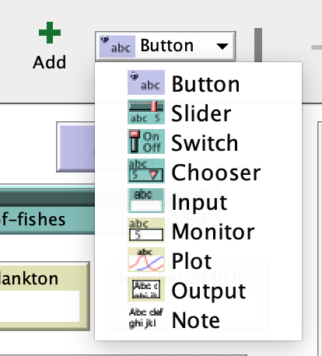
CREATE SLIDER in Downloaded version
To run experiments with your model, we need an easy way to change some settings from the Interface window.
To change the initial number of fishes created, make a slider on the Interface tab:
Choose “slider” from the drop down arrow on the upper left
Hit the green plus sign ADD button
Use your mouse to click on the Interface to the put the button where you want it

Slide 38
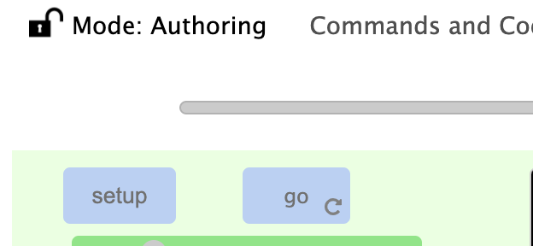
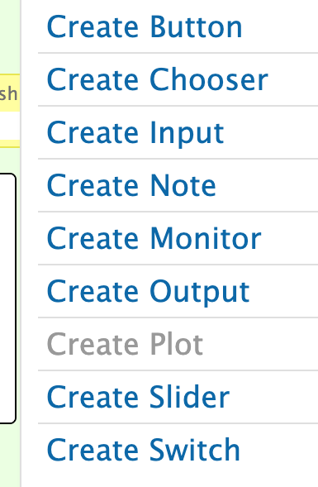
CREATE SLIDER in Netlogo Web
To run experiments with your model, we need an easy way to change some settings from the Interface window.
Make a slider on the Interface tab:
Click on the lock on the upper left to unlock the interface
Right click on the green background to bring up the drop-down menu
Choose slider, use mouse to place it on the interface
Lock the lock to go back to Interactive Mode

Slide 39
SLIDER - Download version
When you have created the slider on the Interface, a window will open letting you name it and set the parameters. Since this will set the number of fish we get at the beginning of the model, name the slider something like initial-fish (don’t use a word we are using somewhere else, or a word Netlogo already knows). Set the minimum to be 0 and the maximum to be 100. The value is where the slider will be set when you open the model, so make that 20. When your slider has these settings, click OK.

Slide 40
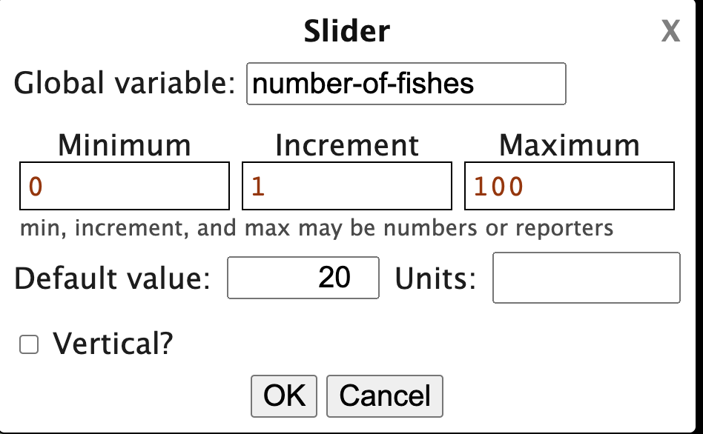
SLIDER - Web version
When you have created the slider on the Interface, a window will open letting you name it and set the parameters. Since this will set the number of fish we get at the beginning of the model, name the slider something like initial-fish (don’t use a word we are using somewhere else, or a word Netlogo already knows). Set the minimum to be 0 and the maximum to be 100. The value is where the slider will be set when you open the model, so make that 20. When your slider has these settings, click OK.

Slide 41
CODE THE SLIDER
We have a slider, but we haven’t explained to the computer how to use it. Think of a slider as replacing a number in your code -- where is the number for how many fish are created on setup? When you find that number, replace it with the exact name of your slider.
Then save and check your code, and go to the Interface to run experiments - move the slider to the top and hit setup, and then to the bottom and hit setup again.
Are you creating the number of fish shown in the slider setting?

Slide 42
DATA - COUNT THE PLANKTONS
You have a model that behaves as you want it to, but you can’t collect any data yet. Let’s create some data boxes to see how the number of fish and plankton change.
To create a data box, make a monitor on the Interface tab. Follow the same instructions as the slider to find the list of interface buttons, and this time choose monitor.
To count plankton, type in count planktons (notice the plural)
In the Reporter area. The name of the button on the interface will be the same as this code, unless we change it in the Display name area. You can change the displayed name if you like, to make it show Number of plankton if you’d like.

Slide 43
MORE DATA - COUNT THE FISHES
Push setup, and see that the number of plankton monitor shows the number of plankton created. Push go, and the monitor should show the changing number of plankton.
Once this monitor is working, save the model and then follow the same steps to make a monitor to count the number of fish.
Test the model to see if the numbers change to show what’s happening with the agents.

Slide 44
STILL MORE DATA!
Monitors (data boxes) are nice, but plots (graphs) allow you to see what’s happening as the model runs. For now, you cannot create a plot in Netlogo Web. In the downloaded version:
Follow the same steps to create a monitor or slider
Name it Population over Time
Use one pen to plot count planktons
Add another pen to plot count fishes
Choose pen colors that make sense and are visible in the plot.
When you have finished, click “Apply” and then OK, and test to see if your plot works. It might be easier to follow the lines of instead of counting all the planktons, you ask this plot to count the planktons / 5 (divided by 5). If you do, be sure to put this in the name of the pen.

Slide 45
EXPERIMENT!
Now that you have a working model with monitors and a stop code, think about what this model can tell us. The basic experiment we can run asks:
How will the initial number of fish change the result of the model (how long it takes before the last fish dies)?
What is your prediction about how the number of fish at the beginning of the model will affect the outcome?
How can we test your prediction?

Slide 46
MODIFY!
What else could our model test? We could change any number in the code (that is “hard-coded” in to the model) to be a slider instead, and experiment with that number. For example, we could change how much energy the fishes gain by eating a plankton. How might this change the outcome of the model? What else could we change about the model to make it more realistic? What could we change about the behavior of the agents that would more closely fit reality? What could we add to the model? Do we need more or different agents, patches, monitors, behaviors? What is an interesting question we could modify our model to answer? Thanks for your participation in the Supercomputing Challenge 2020-21! See you in April!

Slide 47
CHANGE THE BACKGROUND
IF WE WANT ALAN’S BACKGROUND, WE SHOULD PUT THE CODE HERE FOR THE STUDENTS TO COPY

