Slide 1
Computational Science, Agent Based and Mathematical Modeling
Adapted from a presentation by Richard Allen, 2011

Slide 2
Computational Science?
Computational science seeks to gain an
understanding of science through the use of
mathematical models on supercomputers.
Computational Science involves teamwork
Notes:
Science?
Computational Science is a multidisciplinary activity, brings together people from a variety of disciplines.

Slide 3
Computational Science
Complements, but does not replace, theory and experimentation in scientific research.
Experiment
Theory
Computation
Notes:
Validation

Slide 4
Computational Science
Is often used in place of experiments when experiments are too large, too expensive, too dangerous, or too time consuming.
Can be useful in “what if” studies; e.g. to investigate the use of pathogens (viruses, bacteria, fungi) to control an insect population.
Is a modern tool for scientific investigation.

Slide 5
Computational Science
Has emerged as a powerful, indispensable tool for studying a variety of problems in scientific research, product and process development, and manufacturing.
Seismology
Climate modeling
Economics
Environment
Material research
Drug design
Manufacturing
Medicine
Biology
Analyze - Predict
Notes:
Seismology: oil exploration, earthquake prediction (Parallel computation reduced compute time from weeks to hours)
Global ocean/ climate modeling: global warming, weather prediction
Economics: growth of a local or national economy (Agent-based modeling), management of resources, analysis of tax strategies
Environmental: utilization of resources, population modeling, insect control
Materials research: design of new materials, smart materials; shape driven by temperature materials; materials aging issues (Stockpile stewardship)
Drug design: design of anti-cancer drugs, etc.
Manufacturing: optimization of manufacturing processes, automation
Medicine: Medical imaging, MRIs
Human genome: applications to understanding and treating disease

Slide 6
Example: Industry →
First jetliner to be digitally designed, "pre-assembled" on computer, eliminating need for costly, full-scale mockup.
Computational modeling improved the quality of work and reduced changes, errors, and rework.
www.boeing.com/commercial/
777family/index.html
Notes:
!00% digitally designed using 3D computer graphics.
Bottom line: Reduced cost/Reduced time to market.

Slide 7
Example: Roadmaps of the Human Brain
Cortical regions activated as a subject remembers the letters x and r.
Real-time MRI techno-logy may soon be incor-porated into dedicated hardware bundled with MRI scanners allowing the use of MRI in drug evaluation, psychiatry, & neurosurgical planning.
www.itrd.gov/pubs/blue00/hecc.html

Slide 8
Example: Climate Modeling
3-D shaded relief representation of a portion of PA using color to show max daily temperatures.
Displaying multiple data sets at once helps users quickly explore and analyze their data.
www.itrd.gov/pubs/blue00/hecc.html
Notes:
Other examples at this site:
Model of a red giant star
Protein folding problem
Impact of an astroid

Slide 9
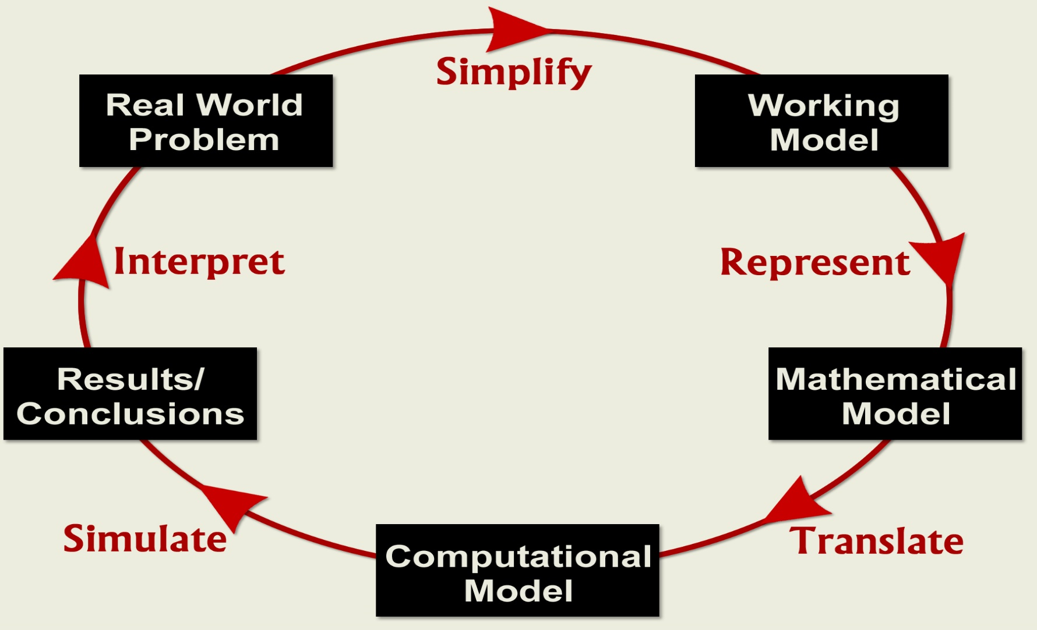
Computational Science Process

Slide 10
Real World Problem
Identify Real-World Problem:
Perform background research, focus on a workable problem.
Conduct investigations (Labs), if if appropriate.
Learn the use of a computational tool: C++, Java, StarLogo, NetLogo, Excel, Stella, and Mathematica.
Understand current activity and predict future behavior.

Slide 11
Working Model
Simplify → Working Model: Identify and select factors to describe important aspects of Real World Problem; determine those factors that can be neglected.
State simplifying assumptions.
Determine governing principles, physical laws.
Identify model variables and inter-relationships.
Notes:
Simplify: Purpose is to eliminate unnecessary information and to simplify that which is retained as much as possible.
Simplifying assumptions: no friction in the system (physics), no immigration or emigration (population), constant growth rate (biology), etc.
Governing principles: laws/relationships from physics, biology, engineering economics, etc.; balance equations.
Key variables and relationships
Variables types include input variables, output variables, and parameters.

Slide 12
Mathematical Model
Represent → Mathematical Model: Express the Working Model in mathematical terms; write down mathematical equations or an algorithm whose solution describes the Working Model.
In general, the success of a mathematical model depends on how easy it is to use and how accurately it predicts.
Notes:
A mathematical model or algorithm is an important step in formalizing a problem for solution on a computer.

Slide 13
Computational Model
Translate → Computational Model: Change Mathema- tical Model into a form suitable for computational solution.
Computational models include languages, such as C++ or Java, or software, such as StarLogo, Stella, Excel, or Mathematica.

Slide 14
Results/Conclusions
Simulate → Results/ Conclusions: Run “Computational Model” to obtain Results; draw Conclusions.
Verify your computer program; use check cases; explore ranges of validity.
Graphs, charts, and other visualization tools are useful in summarizing results and drawing conclusions.
Notes:
Evaluate results; Draw conclusions; Make recommendations.
Falling Rock: Explore approximations.
What is the difference between xcontinuous (exact solution to simplified problem) and xdiscrete (approximate solution to simplified problem)?
Neither xcontinuous nor xdiscrete are necessarily solutions to the real-world problem.

Slide 15
Real World Problem
Interpret Conclusions: Compare with Real World Problem behavior.
If model results do not “agree” with physical reality or experimental data, reexamine the Working Model (relax assumptions) and repeat modeling steps.
Often, the modeling process proceeds through several “cycles” until model is “acceptable”.
Notes:
If model solution is acceptable, communicate results: technical paper, oral presentation, etc. If not, repeat the modeling steps.

Slide 16
Computational Science Process
Notes:
Emphasize the various approximations involved in the modeling process:
RWP→ WM → MM
MM → CM
CM → R/C

Slide 17
Computational Science Investigations
A Computational science investigation should include
An application - a scientific problem of interest and the components of that problem that we wish to study and/or include.
Algorithm - the numerical/mathematical repre-sentation of that problem, including any numerical methods or recipes used to solve the algorithm.
Architecture – a computing platform and software tool(s) used to compute a solution set for the algorithm.

Slide 18
Example: A Falling Rock
Determine the motion of a rock dropped from a height H, above the ground with initial velocity V.
Notes:
Models of time-dependent processes may be split into two categories, discrete and continuous, depending on how the time variable is treated.
Key point: x and v remain constant between time points. How accurate is this?
When implemented on a computer, many continuous models become discrete; also rounding error issues.

Slide 19
Working Model
Governing principles: d = v*t and v = a*t.
Simplifying assumptions:
Gravity is the only force acting on the body.
Flat earth.
No drag (air resistance).
Model variables are H,V, g; t, s, and v.

Slide 20
Working Model (cont.)
Form a discrete-in-time model to determine the position and velocity of the rock above the ground at equally spaced times, t₀, t₁, t₂, …, t_{n}; e.g. t₀ = 0 sec, t₁ = 1 sec; t₂ = 2 sec, etc.
v₀ v₁ v₂ … v_{n}
s₀ s₁ s₂ … s_{n}
|______|______|____________|_____
t₀ t₁ t₂ … t_{n}
Notes:
Models of time-dependent processes may be split into two categories, discrete and continuous, depending on how the time variable is treated.
Key point: s and v remain constant between time points. How accurate is this?
When implemented on a computer, many continuous models become discrete; also rounding error issues.

Slide 21
An Illustration
0
t = time (in seconds)
1
2
3
4
100
90
80
70
60
s = Displacement (in meters)
50
40
30
20
10
0

Slide 22
An Illustration (cont.)
0
t = time (in seconds)
1
2
3
4
100
90
80
70
60
s = Displacement (in meters)
50
40
30
20
10
0

Slide 23
An Illustration (cont.)
0
t = time (in seconds)
1
2
3
4
100
90
80
70
60
s = Displacement (in meters)
50
40
30
20
10
0

Slide 24
An Illustration (cont.)
0
t = time (in seconds)
1
2
3
4
100
90
80
70
60
s = Displacement (in meters)
50
40
30
20
10
0

Slide 25
An Illustration (cont.)
0
t = time (in seconds)
1
2
3
4
100
90
80
70
60
s = Displacement (in meters)
50
40
30
20
10
0

Slide 26
Mathmatical Model
Given an initial time, t₀, an initial height, H, and an initial velocity, V, generate the time history of heights, sn, and velocities, v, by the formulas

Slide 27
Computational Model
Pseudo Code
Input
t0, initial time; V, initial velocity; H, initial height
g, acceleration due to gravity; Δt, time step;
imax, maximum number of steps
Output
ti, t-value at time step i
si, height at time ti
vi, velocity at time ti

Slide 28
Example: Falling Rock
Initialize
set ti = t0 = 0; vi = v0 = V; si = s0 = H
print ti, si, vi
Time stepping: i = 1, imax
set ti = ti + Δt
set si = si + vi*Δt
set vi = vi - g*Δt
print ti, si, vi
if (si <= 0), quit Excel Model
Notes:
Explain the meaning of “ti = ti + Δt” etc.

Slide 29
Interpretation
To create a more more realistic model of a falling rock, some of the simplifying assumptions could be dropped; e.g., incor-porate drag - depends on shape of the rock, is proportional to velocity.
Improve discrete model:
Approximate velocities in the midpoint of time intervals instead of the beginning.
Reduce the size of Δt.
Notes:
Drag: proportional to v for low velocities, proportional to v^2 for large velocities.

Slide 30
A Virtual Science Laboratory
The site below is a virtual library to visualize science. It has projects in mechanics, electricity and magnetism, life sciences, waves, astrophysics, and optics. It can be used to motivate the development of mathematical models for computational science projects.
explorelearning
Notes:
→: www.explorescience.com
Bring up: Mechanics/golf range, 2D collisions, freefall-terminal velocity

Slide 31
Referenced URLs
SC Challenge Archive site
www.supercomputingchallenge.org/archive/
Explorescience site
www.explorelearning.com
Boeing example
www.boeing.com/commercial/777family/index.html
Road maps for the human brain and climate modeling examples
www.itrd.gov/pubs/blue00/hecc.html

Slide 32
An interesting modeling site
Formulating models
www.cnr.colostate.edu/class_info/nr575/webfiles/L05_Formulating_Continuous_Time_Models.pdf
Falling bodies
http://hypertextbook.com/physics/mechanics/falling/
Master tools
http://www.shodor.org/master/

