Slide 1
Modeling, Coding and good research
What is a model?
How can we code it?

Slide 2
Boids: Bird Flocking behaviors A Good Model
3:46

Slide 3
What makes the Boids Model a good one?
The Bird was abstracted to a simple triangular shape
Boids have variables like :
Number of birds
Number of obstacles
Rules on or off
Data is validated (do real birds act like this)
Data Collection and Verification(though he did not show it)
Changed variable one at a time
Ran the model at least 30 times for each variable
Data Analysis (what does your data tell you)

Slide 4
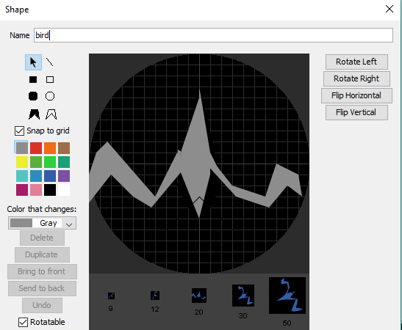
Abstraction – no need for intricate agent shapes
Do you need to spend time and energy creating the most perfect looking birds for our model, or will a simple shape work just as well. Remember your job is to get to the experiment/behavior, not to make them look life-like.
That’s called OR
Abstraction! OR ?
If I tell you before you see my bird model that green triangles are healthy birds and red triangles are unhealthy, can you get the idea of the difference? The time it takes to create exact replicas of your agents takes up too much of your coding time.

Slide 5
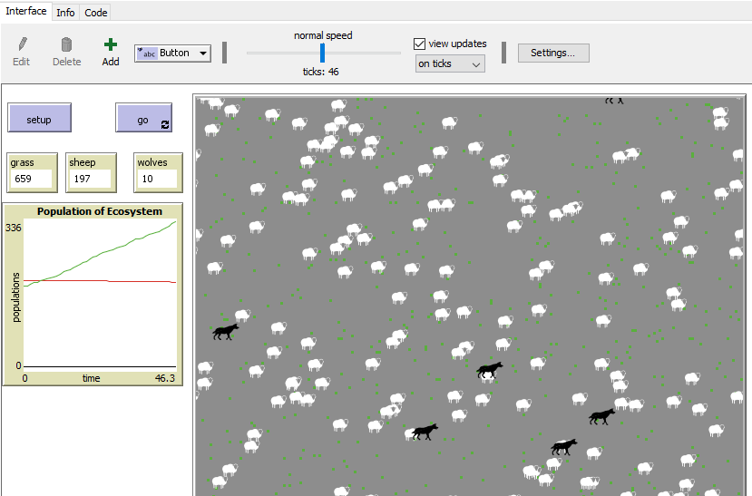
Wolf and sheep model – What do you think it does?
5 min

Slide 6
So what do we See?
What/Who are the agents?
What question can you ask from this model ?
Can you collect data from this model?
Can you answer your question with this model?

Slide 7
What things can we add so that we can collect some “good” data from it?
5 min

Slide 8
manipulate the variables
If we have some variables to change, then we can ask a question and then use our model to generate data in which to answer our question.
What did we add to our model to be able to change variables?
SLIDERS!!!

Slide 9
Good projects Validate their data
How do we know our model is like the real world?
How can we prove our model is a model that would work in the real world? This is called Validation.
We would use some real event data and see if our model predicts accurately what really happens.

Slide 10
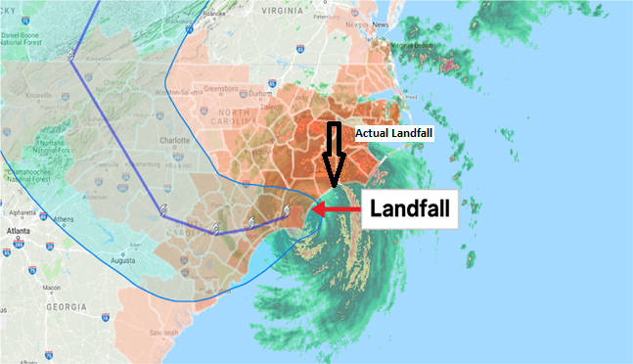
Did we validate our model?
(My model)
For example. If I create a model that predicts where hurricanes will come ashore, we can use real hurricane data and see if our model predicted where it really came ashore.

Slide 11
Graph Paper Programming
Start here
Model 1

Slide 12
Graph Paper computer code blocks
Use this code to program the next picture on your graph paper

Slide 13
Graph Paper Programming activity
Each person will need:
a graph paper programming assessment worksheet
Pen or pencil
10 min

Slide 14
Solution

Slide 15
Graph paper programming
Start here
Model 2

Slide 16
Solution

Slide 17
Reverse Programming What is the code doing?

Slide 18
Solution to Reverse Programming

Slide 19
Netlogo code - what does it do?
to make pattern
fd 1
set pcolor black
fd 1
set pcolor black
fd 1
rt 90
fd 1
rt 90
set pcolor black
fd 3
set pcolor black
end

Slide 20
Solution
to make pattern
fd 1
set pcolor black
fd 1
set pcolor black
fd 1
rt 90
fd 1
rt 90
set pcolor black
fd 3
set pcolor black
end

Slide 21
Time to work on your project
Really think about What you plan to Study
Do you have a question your model will answer? (Your question should have your variable in it)
Is this a question you or researchers already know the answer to?
Do you know what research has already been done on your question? Who will research it?(Rethink a new one)
Do you have variables to manipulate? What are they?
How will you show your model verifies real world behavior?
How you show that your data changes when you manipulate your variables? This is called verifying your model.
How will you analyze your data?
15-30 min

