Slide 1
creating a ecosystems model in net logo

Slide 2
NETLOGO BASICS
Tabs - Interface, Info, Code
World agent
Turtles
Patches
Interface characteristics - size of world & patch size
x & y coordinate grid with 0,0 at center
ability to wrap

Slide 3
START A NEW PROJECT & SET-UP WORLD
Open NetLogo, click on File and choose New. Name your new project with your name and Ecosystems Model and Save (to your flash drive).
Click on Settings, change:
min pxcor to -50 (negative 50) and the
max pxcor to 50.
change the “patch size” to 4
Be sure “world wraps horizontally” and “world wraps vertically boxes are checked, and click OK.
Use the ADD button to create two buttons: setup, and go. When creating go, check the forever box.

Slide 4
START CODING
Go to the CODE tab
You can add any “comments” that the computer will not read by first putting a semi-colon ;; (notice that makes the text gray)
So, put a ; or two, then name your project again here
Next, type
BREED [ SHEEP A-SHEEP ]
This tells the computer you are going to call your turtles “sheep” and give them specific commands (you need a singular and a plural name for your breed)

Slide 5
CREATE A “TURTLES-OWN” VARIABLE
Next, tell the computer you want your turtles (for right now, your sheep) to have a variable (like a trait or characteristic” of “energy”
Type turtles-own
[ energy ]
Notice the colors of your text:
;; Title (after semi-colons) is gray
breeds and turtles-own are green, - NetLogo understands those words (primitives)
“sheep” “a-sheep” and “energy” are black - words you’ve used to name things that the computer will use, but you will have to explain what they mean

Slide 6
CREATE CODE FOR THE SETUP BUTTON
Start with TO SETUP, end with END.
First command is to clear out whatever happened when we last ran the program: CLEAR-ALL
Next, we want to write procedures to setup the grass: The grass will be the patches, so we ask them to have a random chance of turning green, and otherwise to be brown.
Conditional logic - “IFELSE” asks a true/false question, if the answer is true the computer does one thing, if it is false, it does another.
Our true-false question is: if else random 100 < 5
In other words, when the computer rolls a dice with 100 sides, does it get a 0, 1, 2, 3, or 4? If so, the answer is true, if not (if it rolls any other # 6-99) its false.
If the answer is true (5% of the time), we want the patches to be green (grass)
If the answer is false (95% of the time) we want the patches to be brown (dirt)

Slide 7
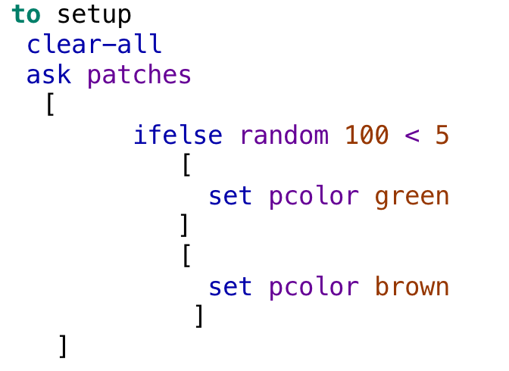
SETUP CODE SO FAR
Notice the beginning and ending brackets [ ]

Slide 8
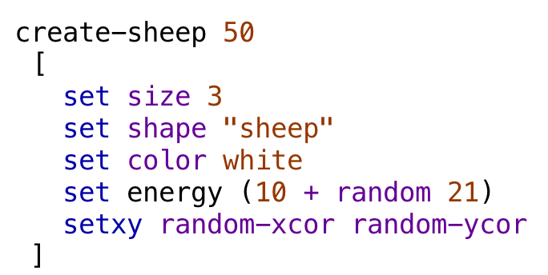
create sheep in setup code
Next, we want to create 50 sheep, set their size to 3, their shape to “sheep”, their color to white, and give them some initial energy, plus a random amount of energy. We also want to scatter them through space land.
Notice the colors of the code

Slide 9
Finish Setup CODE
Because we are going to add a graph later, we want the computer to keep track of “time” or “ticks”
At the end of your setup code, type “reset-ticks”
then type “end”
Be sure to SAVE your model frequently
Push the “check” button on the upper left of the coding window - see if the computer identifies any errors in your code so far. If not, go to the Interface screen and push the setup button. Do you get the sheep and grass you expect to see?

Slide 10
CONGRATULATIONS!
You are finished with the setup code.
Review:
Concepts | Types | NetLogo commands
agents | turtle patch world | ask-turtles ask-patches
variables | agent (turtle)
conditionals |  | if ifelse
procedures |  | to end
Tabs | Interface Info Code

Slide 11
new procedures - GO Button
Create a go procedure - everything that should happen when you push the go button on the interface. This is a “forever” button - it will call all the procedures, in the order you place them, repeatedly until you click the button again. Under your setup procedure, type:
to go
end
Inside the procedure, type “tick” so the computer will count the ticks as the program runs.
Next, think about everything we want the sheep to do.

Slide 12
Go procedures
The sheep need to:
walk around (and lose a little bit of energy)
eat the grass (and gain energy)
reproduce (if they get enough energy)
die (if they lose all their energy)
We also want the grass to grow as the model runs

Slide 13
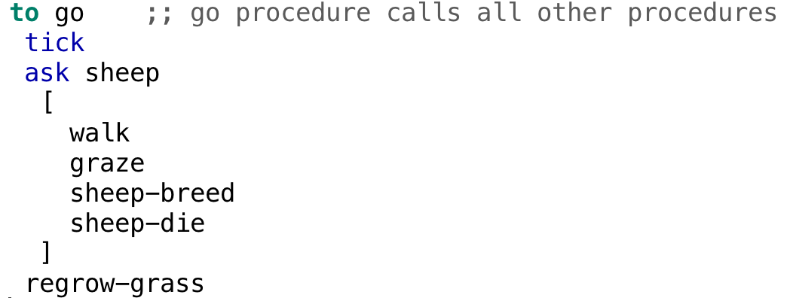
Sheep procedures
Your “go” procedure should look like this so far:
Notice I have put a comment after ;; to explain to myself what I’m doing here
Finally, be sure your go ends with “end”

Slide 14
define procedures
We told the computer the names of all the procedures we want the sheep to follow (the words are all black in this list) but we haven’t been specific about what each procedure is.
Walk procedure - start with “to walk” and end with “end”, and make the sheep walk with a random wiggle (left 45, right 45, forward 1). The sheep also need to lose 1/2 unit of energy (.5) at each step.

Slide 15
Sheep procedures
Your “walk” procedure should look like this:
Notice I have put a comment after ;; to explain to myself what I’m doing here about the energy

Slide 16
“Graze” procedure
We want the sheep to eat the grass. For this, we need a simple conditional, “if” rather than “ifelse”. The sheep should ask if they are on a green patch pcolor (means patch color) = green, and if so, change the patch color to brown and gain 10 units of energy.
Don’t forget to start with “to graze” and end with “end”

Slide 17
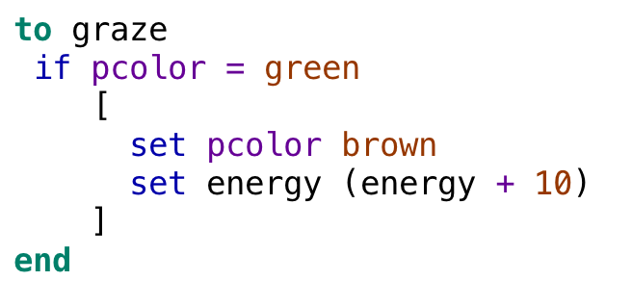
Sheep procedures
Your “graze” procedure should look like this:

Slide 18
SAVE AND TEST
Save your model, and hit the “check” button in the upper left. You will likely get an error message, saying the computer doesn’t know how to execute all the procedures, because we haven’t written the “sheep-breed” “sheep-die” and “regrow-grass” procedures. If you want to test whether your model works, put a semi-colon in front of those procedures in the “go” procedure, check again, and go to the Interface to see if your sheep are walking around and eating grass.

Slide 19
“sheep-breed” procedure
We want the sheep to reproduce if it gains enough energy. For this, we again need a simple conditional, asking if the sheep’s energy is greater than 20. If so, first divide the sheep’s energy by 2 (or you will have a population explosion), and then “hatch 1” and tell then new sheep to face in a random direction (set heading random 360), and step 1 step away from the parent sheep.
Don’t forget to start with “to sheep-breed” and end with “end”

Slide 20
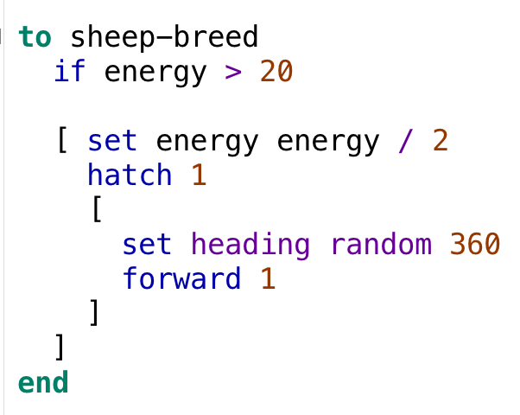
SHEEP -BREED PROCEDURE
Your procedure should look like this:

Slide 21
“sheep-die” procedure
We want each sheep to die if its energy drops to (or below) zero. We have to name this procedure “sheep-die” because the computer already knows the word “die” so we can’t use it as the name of a procedure. See if you can create this procedure yourself. Once you have done it, save your model, use the “check” button, and then (if you have put ;; in front of the “regrow-grass” procedure), see if your model is working so far on the interface.

Slide 22
“regrow-grass” procedure
Finally, we want our model to re-grow the grass as the program is running. After the “to regrow-grass” this procedure needs to ask the patches whether they are brown, and if so, create a very small random chance (random 1000 < 1) of turning green.
Why does this chance have to be so small?

Slide 23
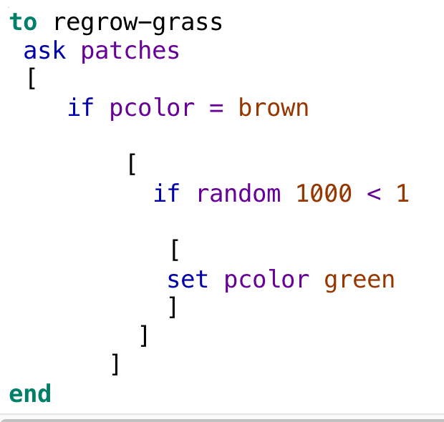
re-grow grass PROCEDURE
Your procedure should look like this:

Slide 24
SAVE AND TEST
We have written all procedures, so save your model, be sure to remove any ;; you put in to test the model before we were finished, hit the “check” button, and go to the interface to see if the model runs.

Slide 25
CONGRATULATIONS!
You have a model that behaves as you want it to, but you can’t collect any data yet. Let’s create some data boxes and a graph to see how the model runs. On the interface tab, choose “monitor” from the drop down arrow on the upper left, then hit the green plus sign ADD button, then use your mouse the put the button where you want it. You should see a “reporter” screen, and to count the sheep, type in count sheep and put the word “sheep” in the display area. No need to change the other values.

Slide 26
more data boxes
Push setup, and see that the sheep monitor shows the number of sheep created. Push go, and the monitor should show the changing number of sheep. Once this monitor is working, make a monitor to count the grass (count patches with [pcolor = green]).
Next, try creating a graph (a “plot”) and name it Populations. Tell it to “plot count sheep” and use a similar code to the monitor for the grass to tell it to count the grass.

Slide 27
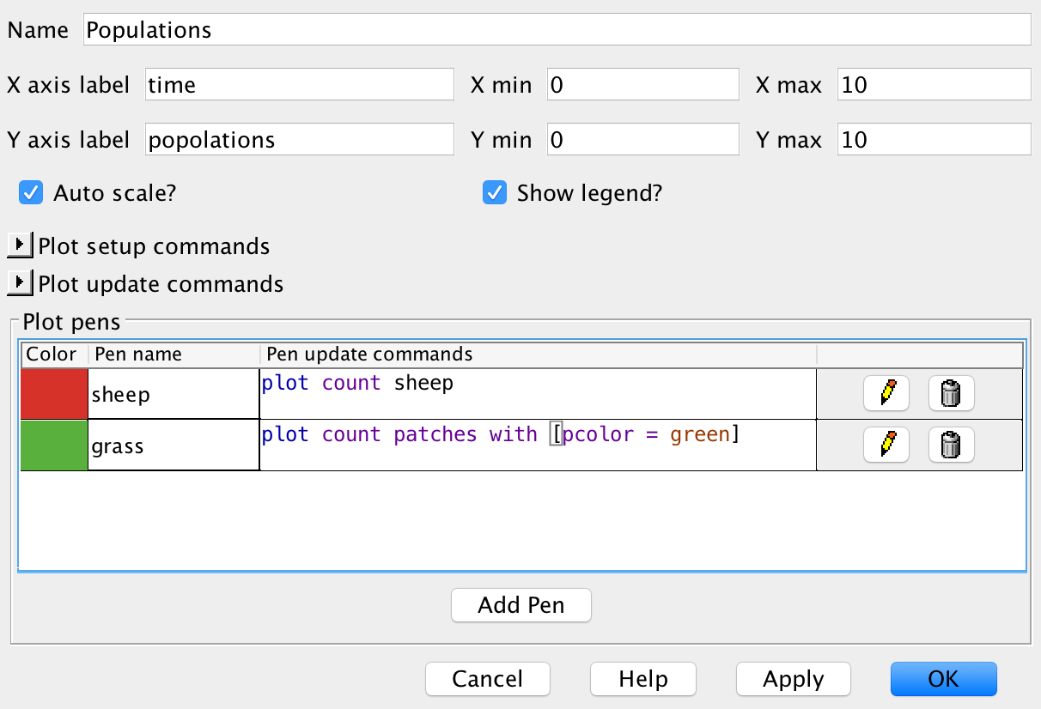
create a graph

Slide 28
we have a model!
Now that you have a working model with monitors and a graph, look for patterns of behavior. How do the populations of sheep and grass change over time?
Can we run any experiments with this model? What could we ask about, that running the model might help us figure out?

Slide 29
MAKE THIS AN EXPERIMENTAL MODEL
To make it easy to experiment with the model, let’s create a slider. On the interface screen, select “slider” from the drop-down menu, and use your mouse to create a slider button. In the first blank (global variable) put the name of your slider: “initial-sheep.” Set the minimum to 1, the maximum to 100, and the “value” (where the slider will be when you open the model) to 50. Click OK.

Slide 30
slider continued
We have a slider on the interface but like any button there, it doesn’t work until you put something in the code to tell the computer where to use the slider value. What number (hard-coded into our code) does we want the slider to replace?

Slide 31
slider continued
We want the slider to control the number of sheep created when we hit the setup button. Find that number in the code, and instead of the number (50), type in the exact name of the slider.
Save your model, and test your slider by moving it all the way to the bottom and then hitting setup, and then by moving it all the way to the top.
Now, we can easily see how changing one variable (the number of sheep we have to start with) affects the model.

Slide 32
add a predator
Use what you have learned about creating a breed, setting it up in the set-up, and writing procedures to create wolves which will walk around (lope) and lose a little bit of energy, eat the sheep and gain energy, reproduce, and die. You can copy the procedures you used for the sheep but you must change the name of the procedure. When you have your wolves doing everything you want, add a monitor to count the wolves, and add a “pen” to the graph to count the wolves. Be sure to save often and check your code after writing each procedure.

Slide 33
add a slider for your wolf population
How did adding 10 wolves change the dynamics of your model? Would you also like to experiment with the number of wolves created? If so, try adding a slider for the initial-wolves, and experiment with your code.
Extension: add a slider for the grass-regrowth rate, so you can experiment with any of three variables in your code.
What other ideas do you have about how to improve this model, to run interesting experiments?

