Slide 1
Computer Science
2021-2022
Ms. Lunsford

Slide 2
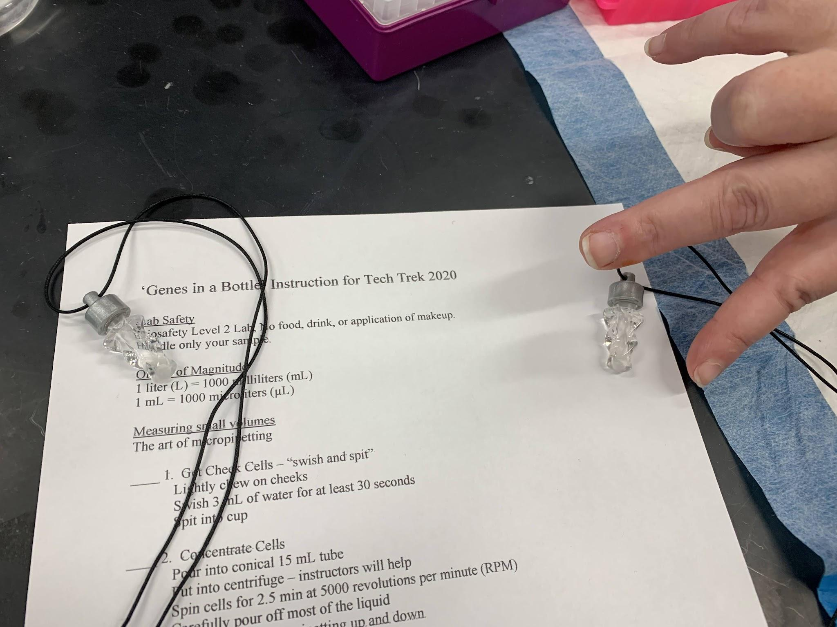
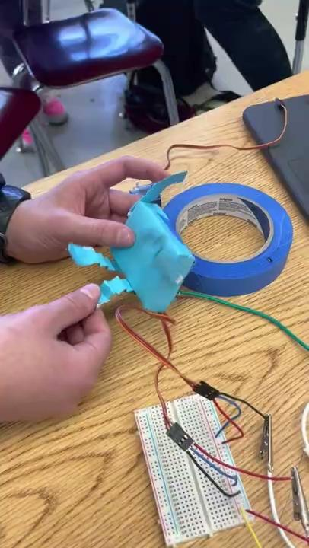
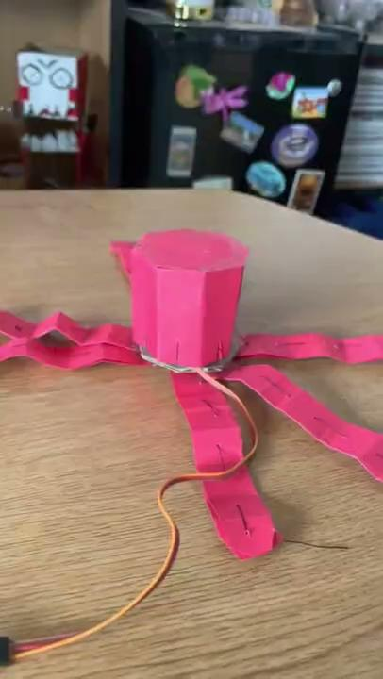
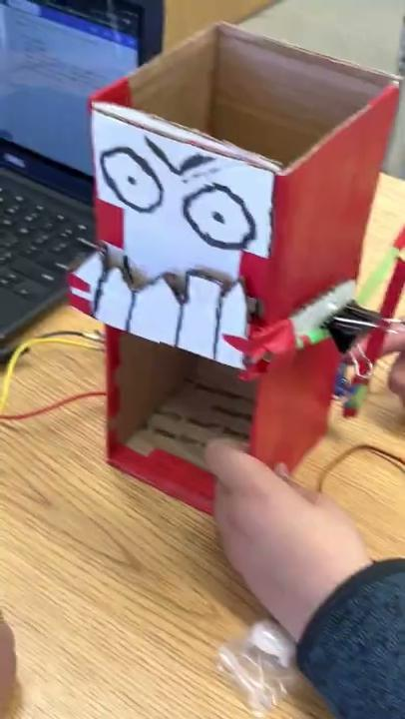
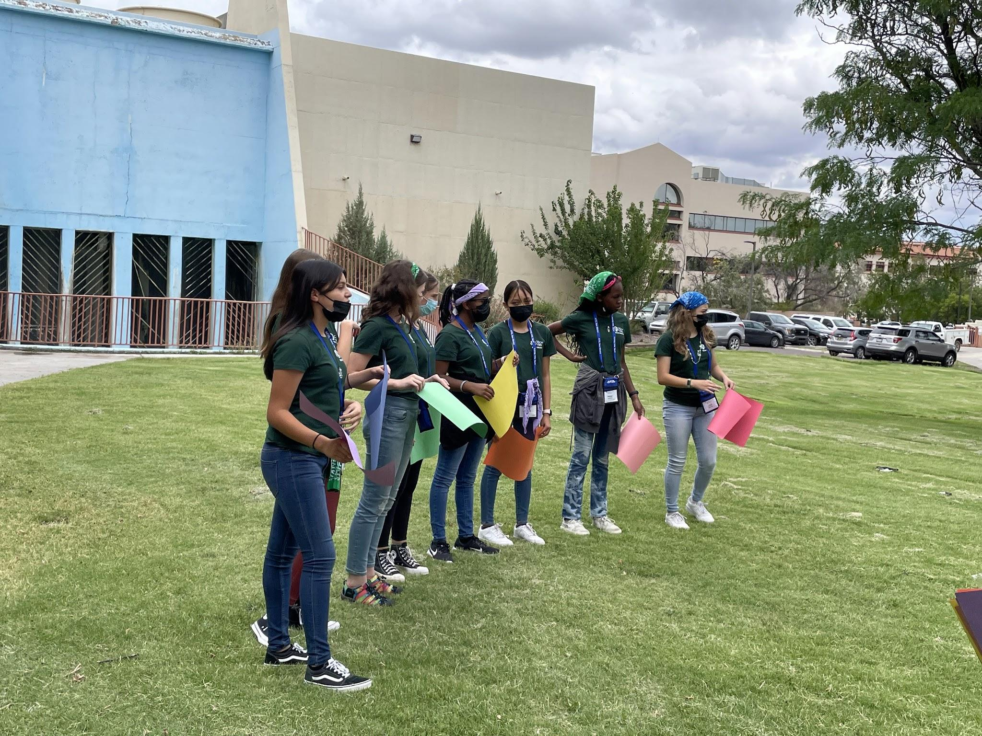
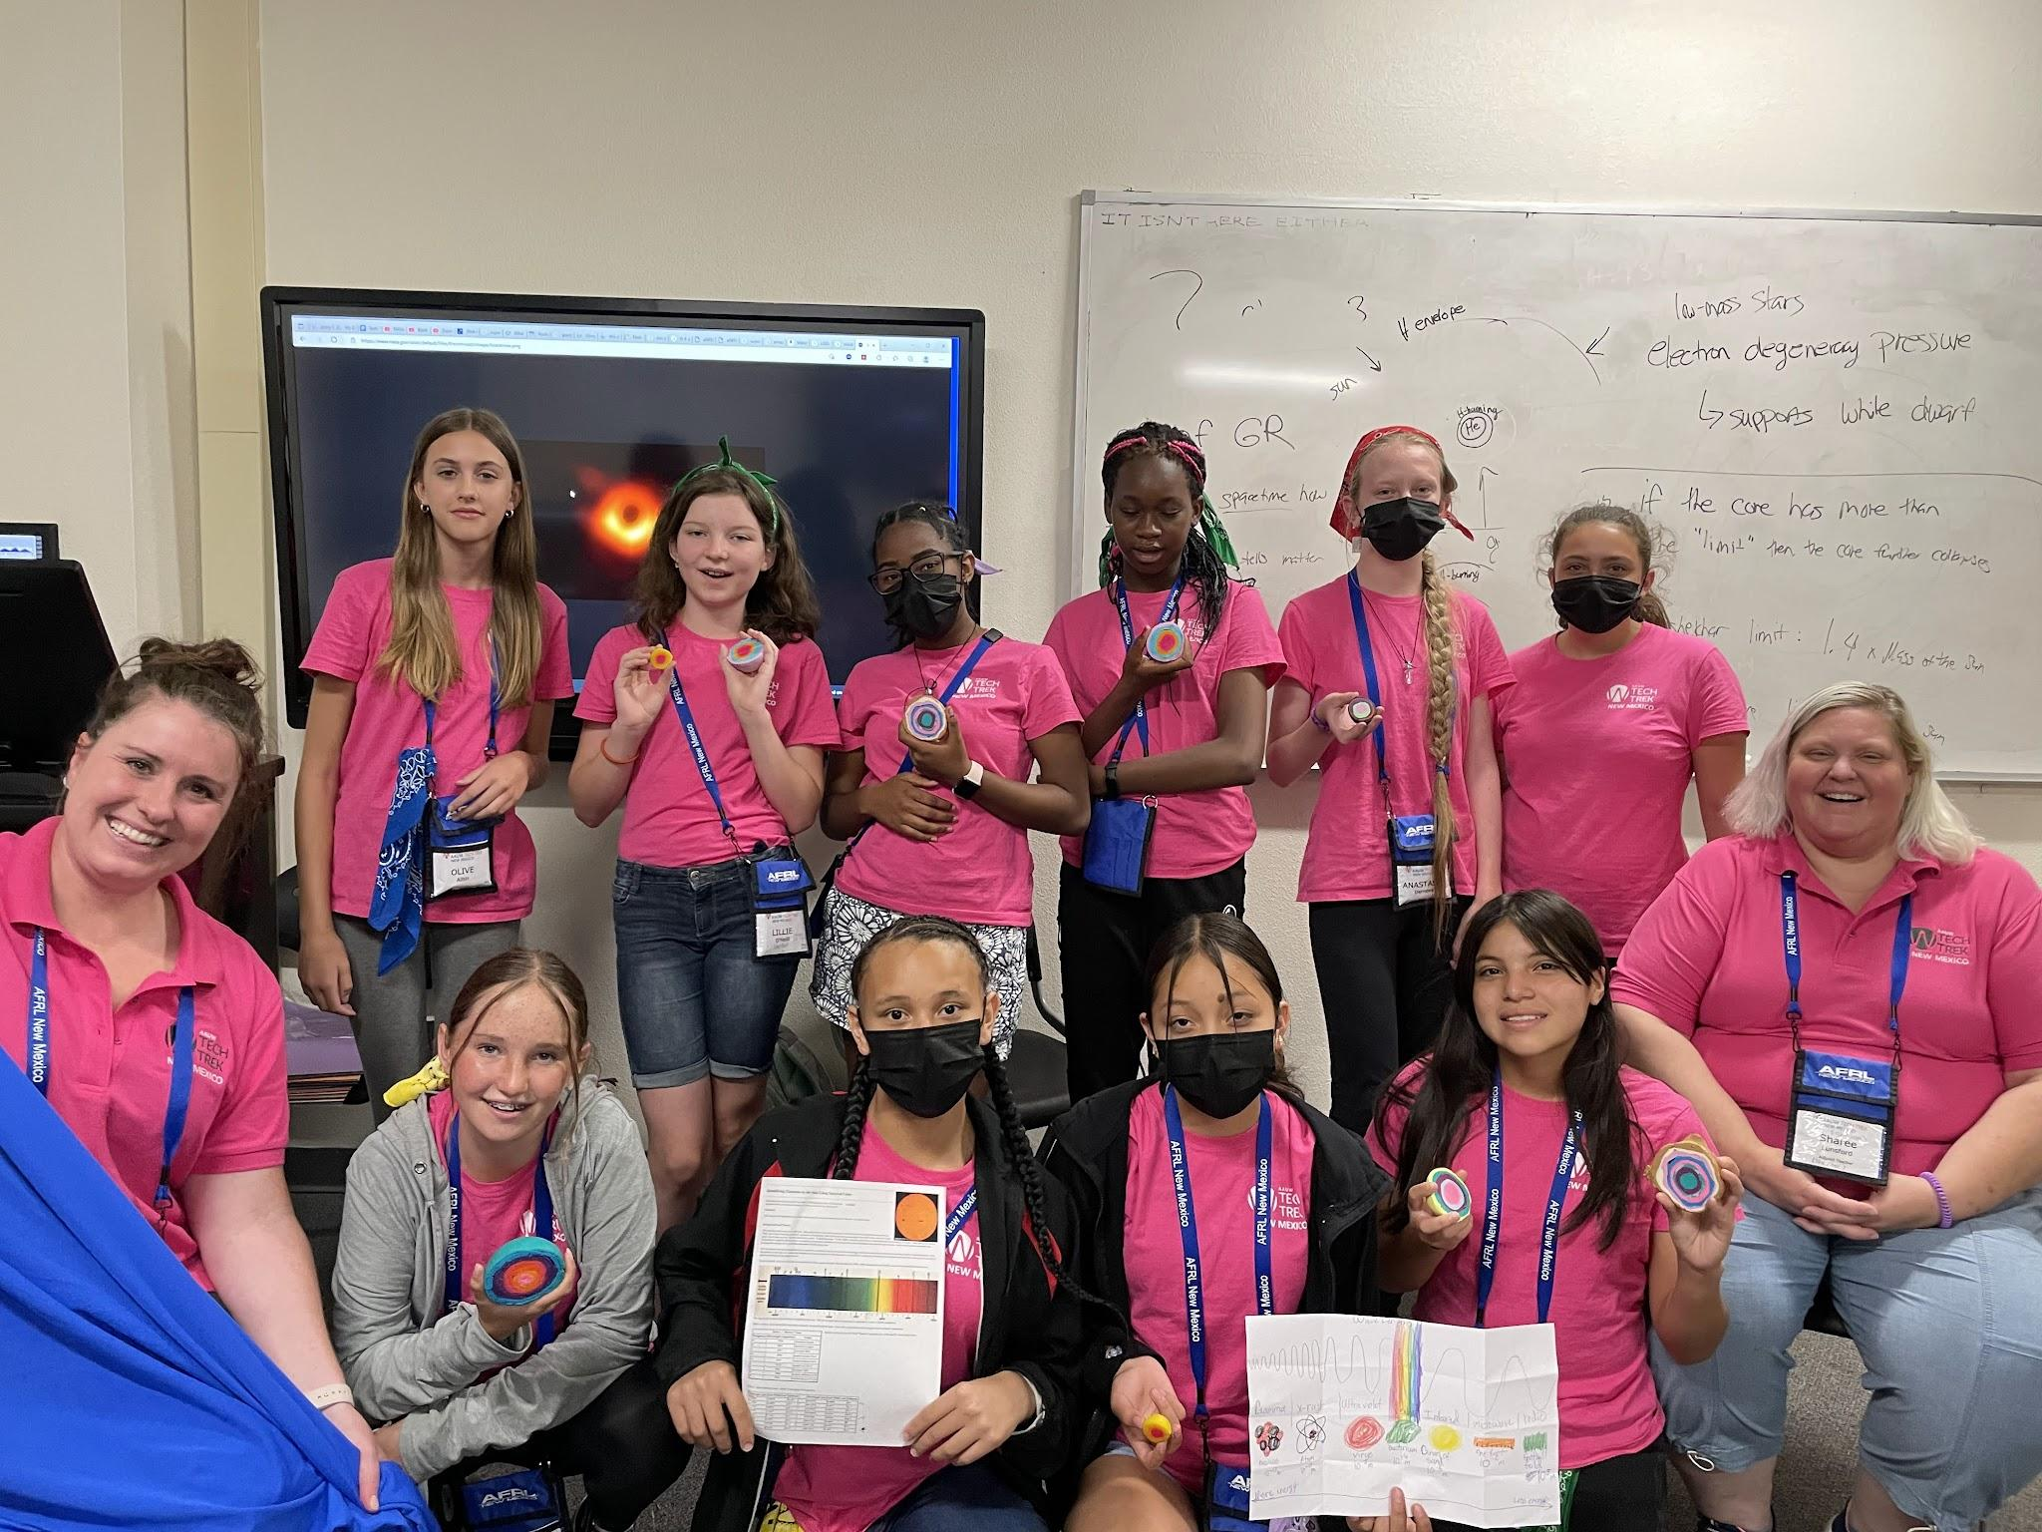
School Activities

Slide 3
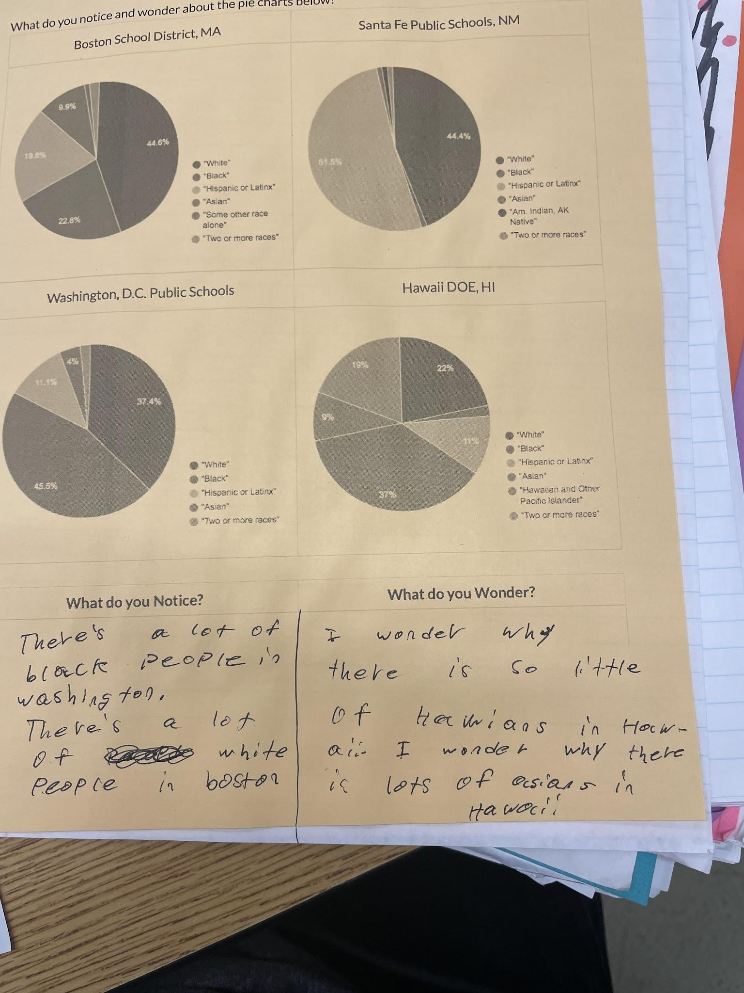
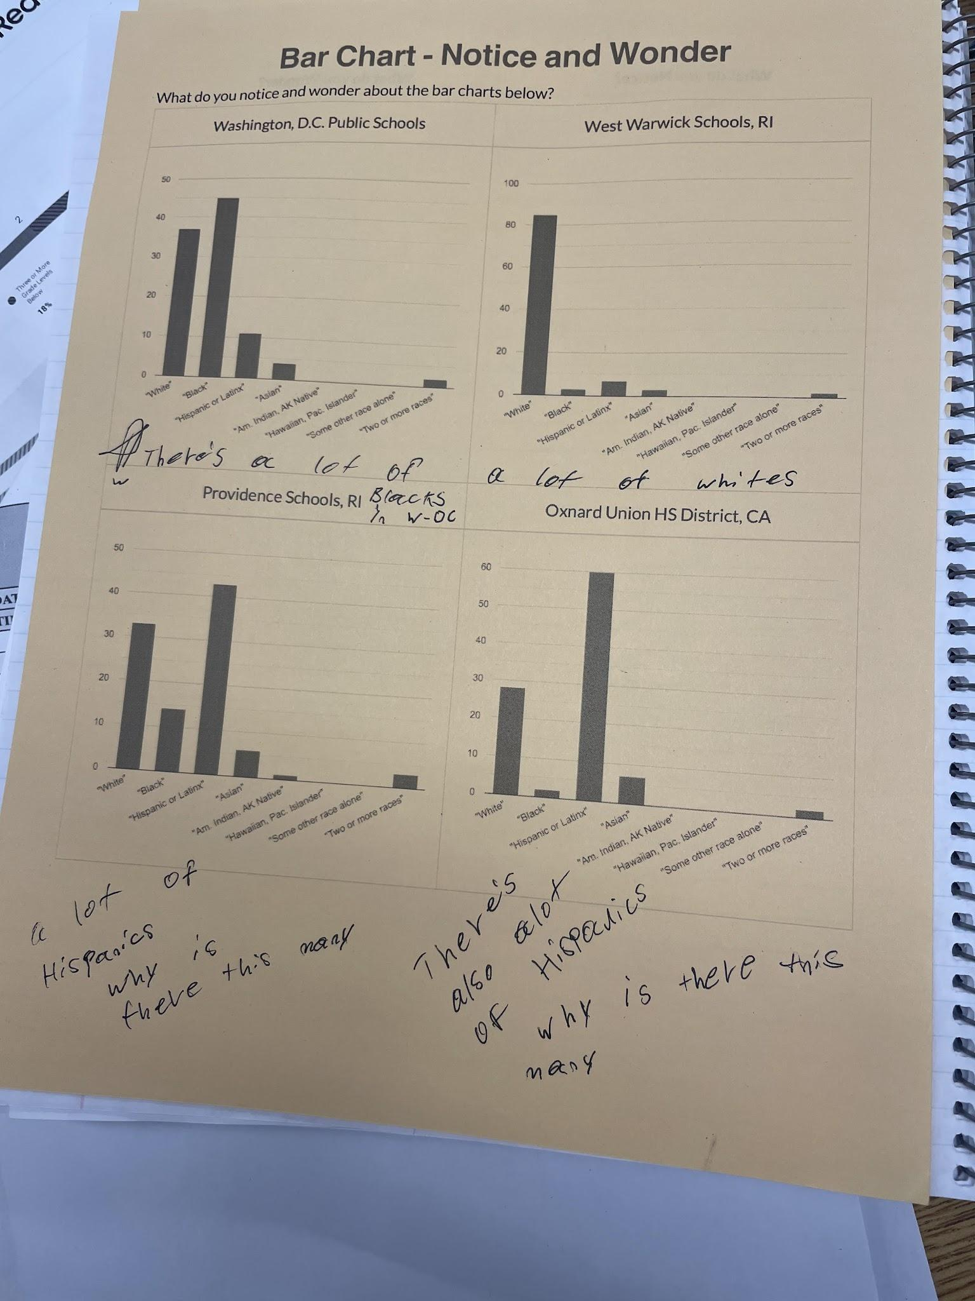
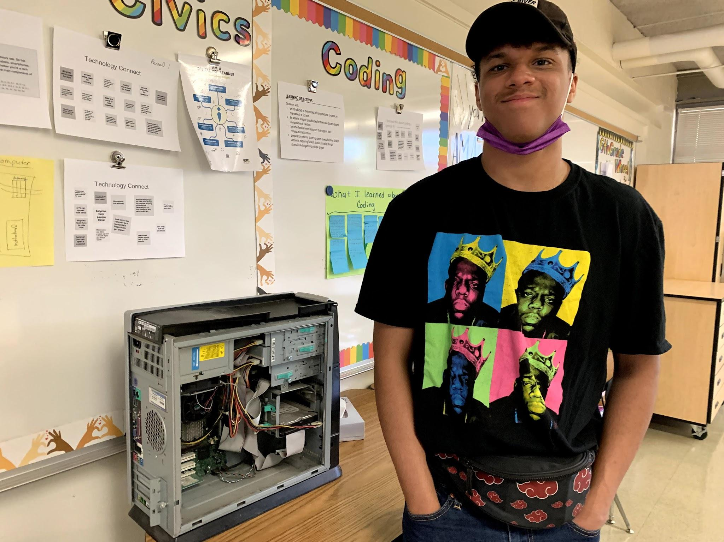
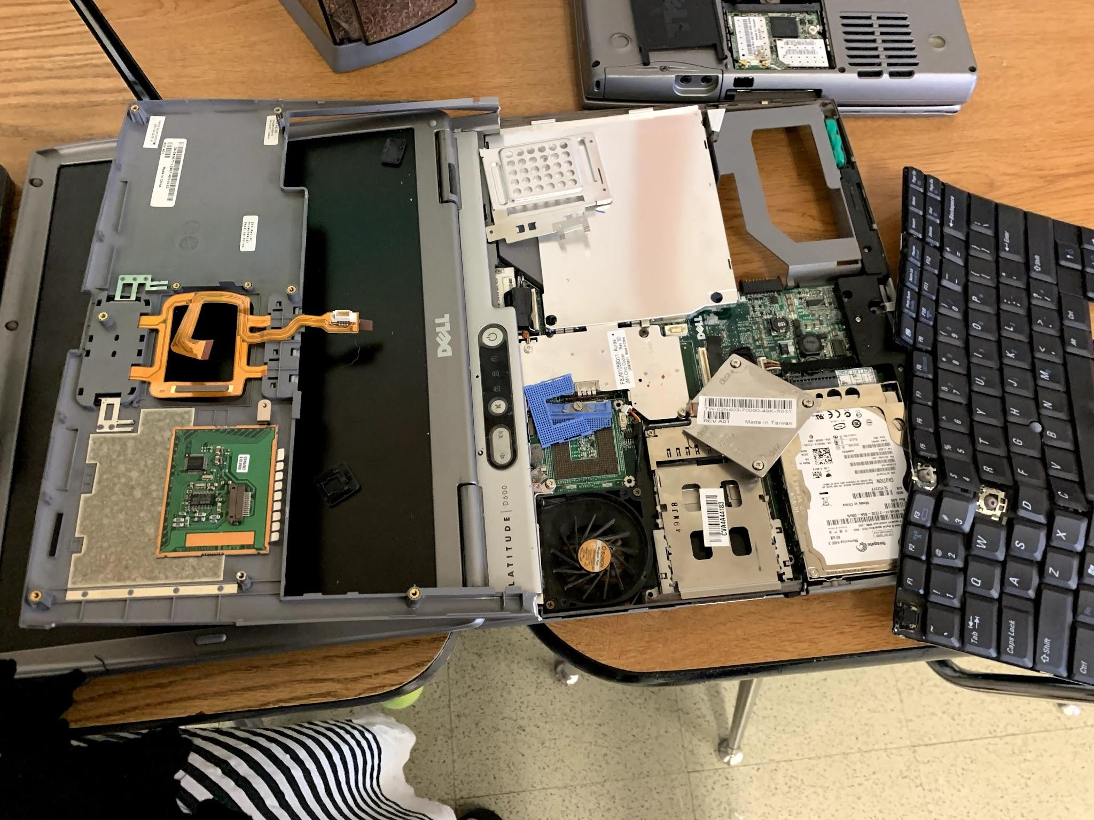
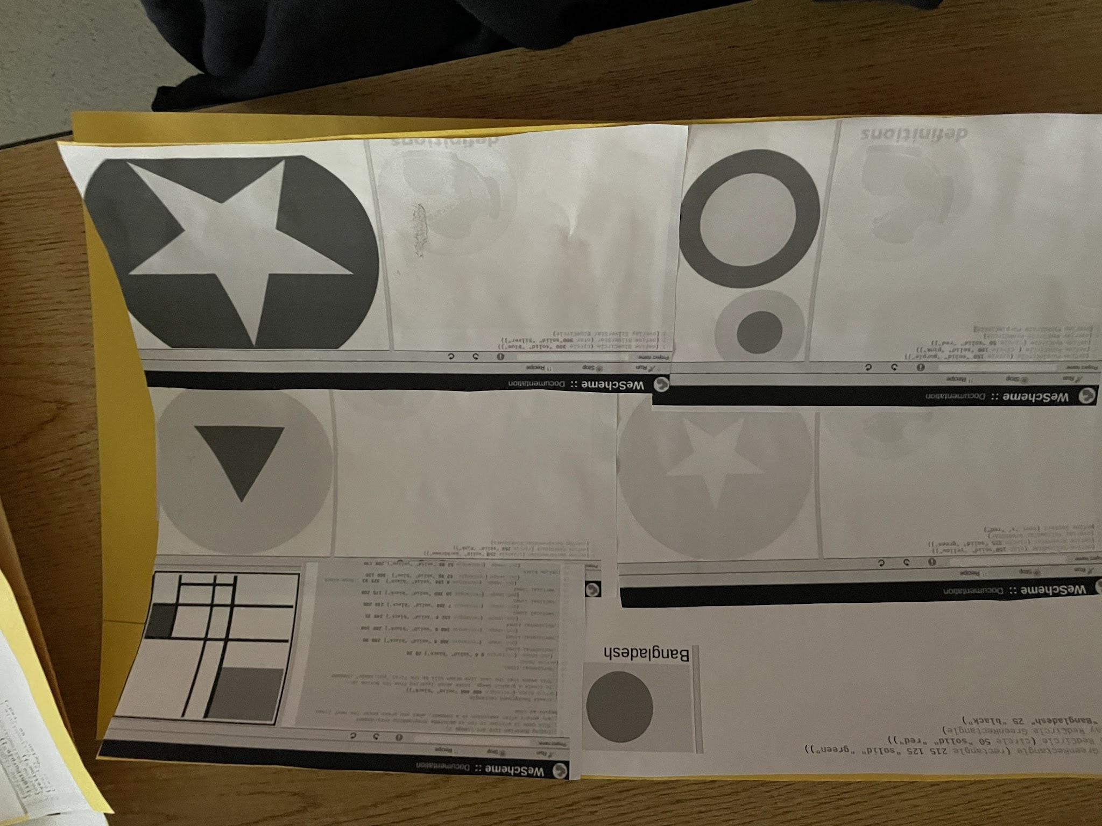
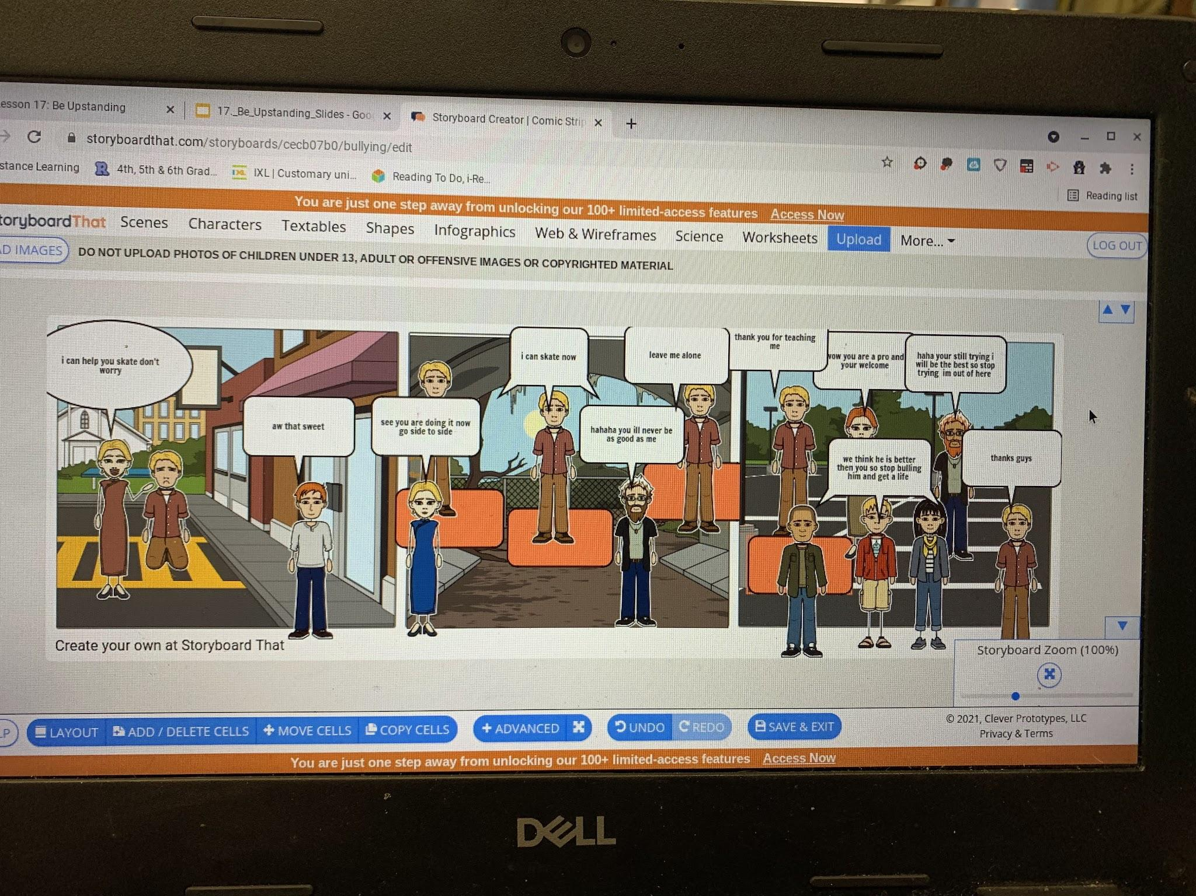
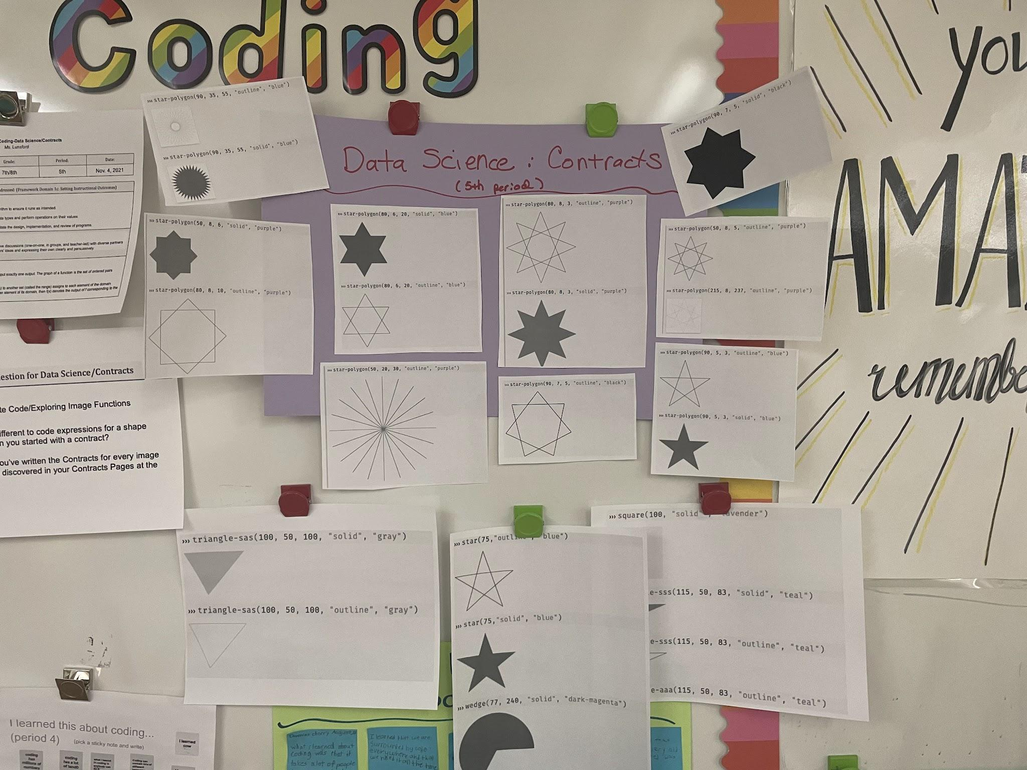

Slide 4
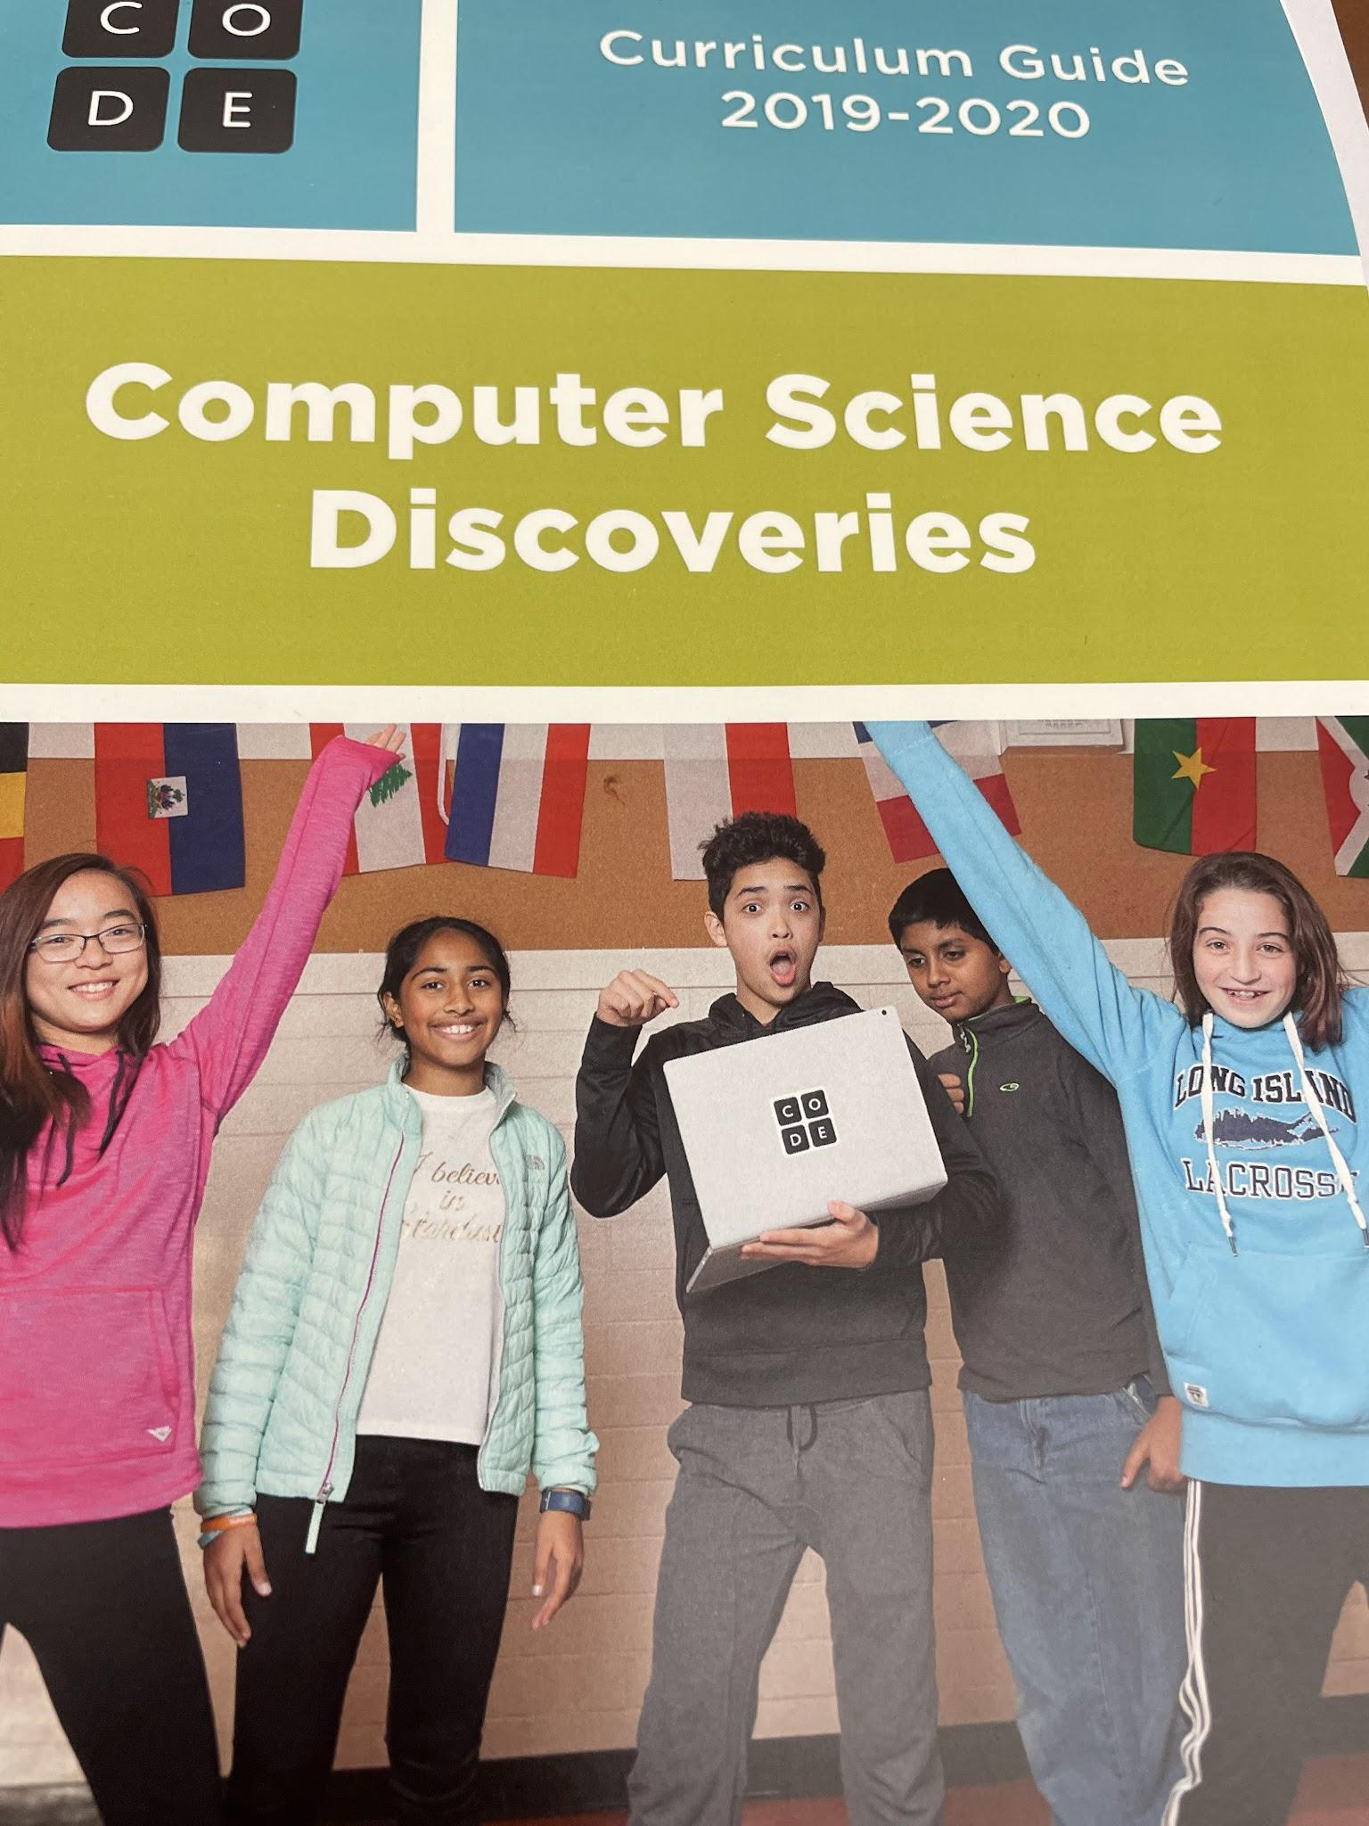
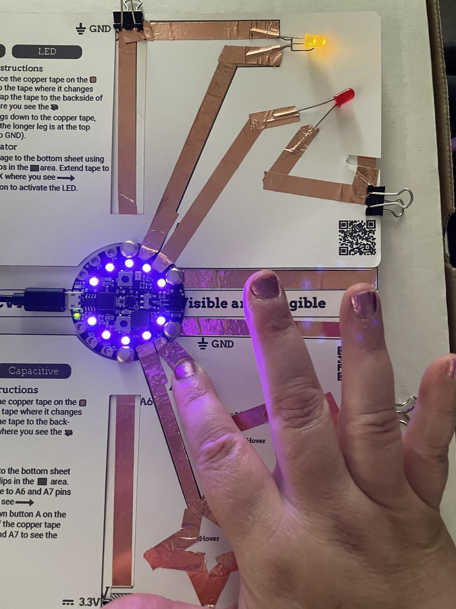
Summer Learning Activities

Slide 5
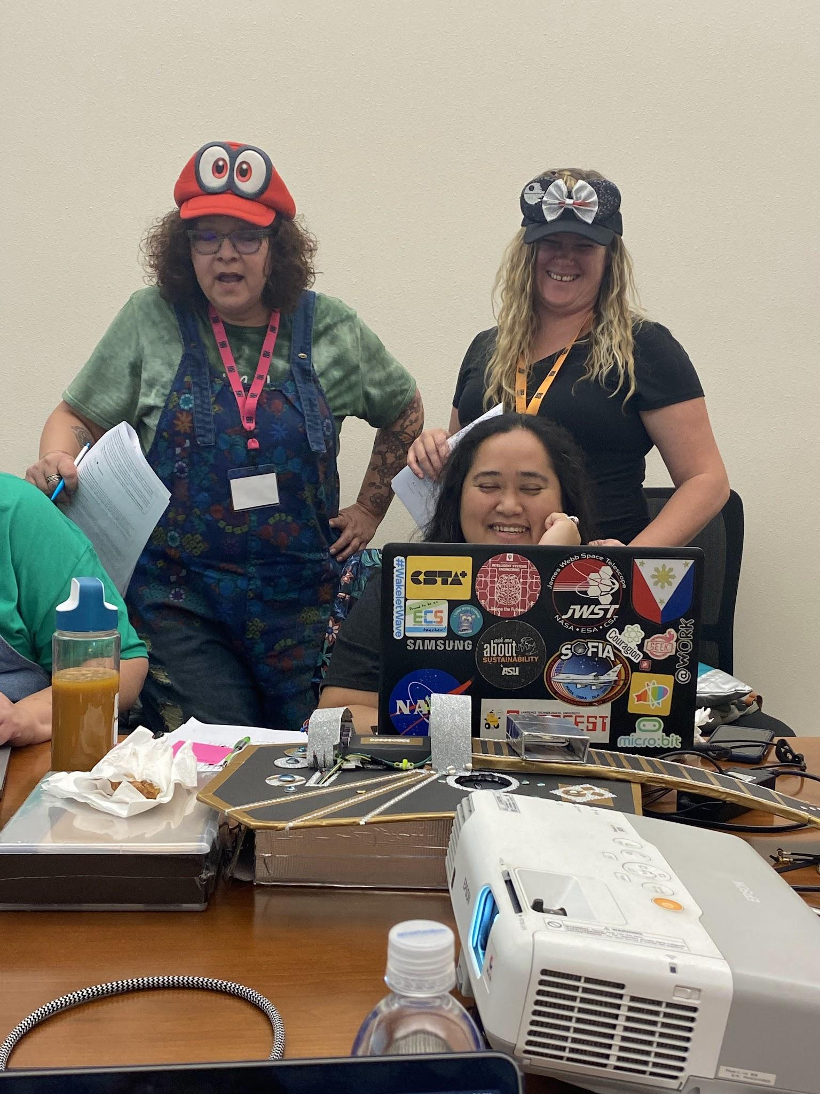
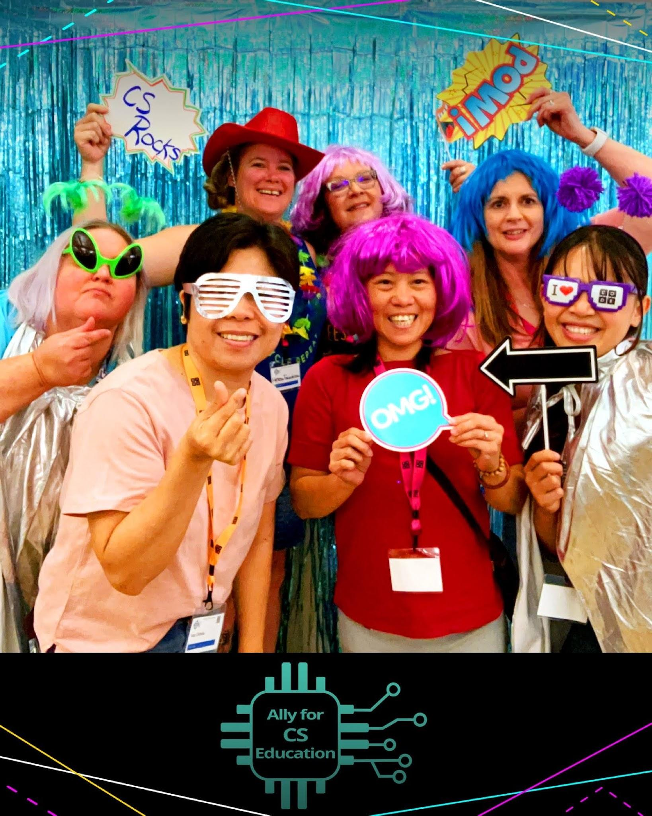

Slide 6
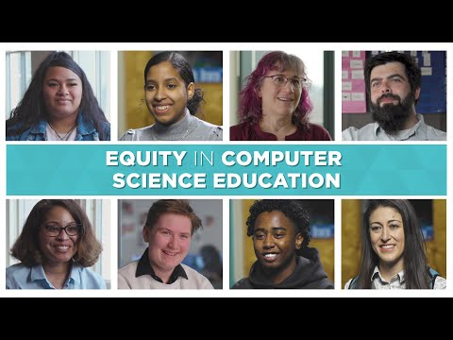

Slide 7
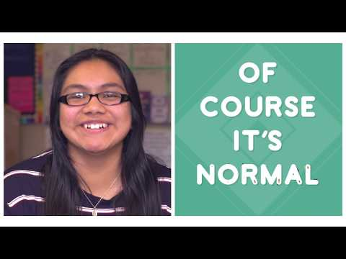
Web Design Lesson 3 - Activity
Why do you think professional programmers use pair programming?
How do you think pair programming will help you to program better?

Slide 8
Source: Guide to Inclusive Computer Science Education

Slide 9
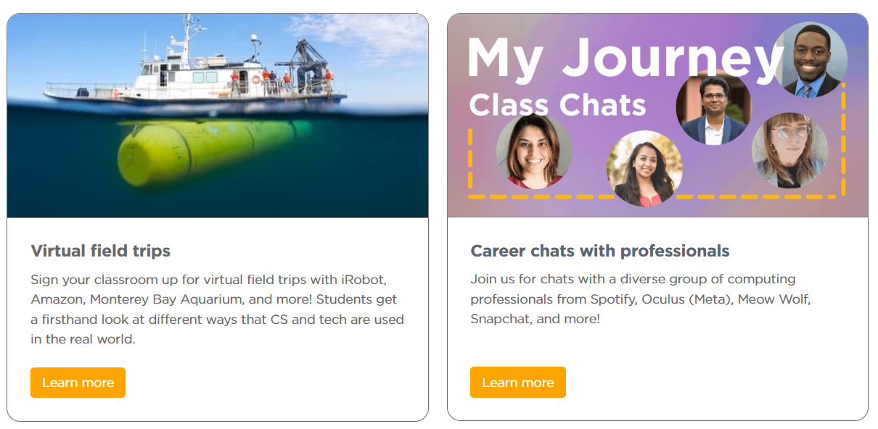
Leveraging Community Resources
CS Journeys is a program that offers virtual field trips or virtual chats with industry professionals to make real-world connections to student learning
https://code.org/csjourneys

Slide 10
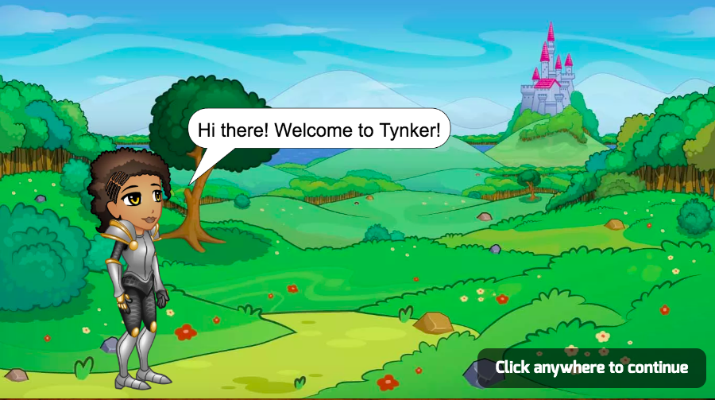
Monday
Intro Tynker
Students will use coding to make their own versions of their favorite games, animate captivating stories, and program mathematical art! Each project includes step-by-step instructions that help students figure out the steps to create the game or app. At each step along the way, there are opportunities for your students to personalize the project, create custom assets, and express themselves creatively.

Slide 11
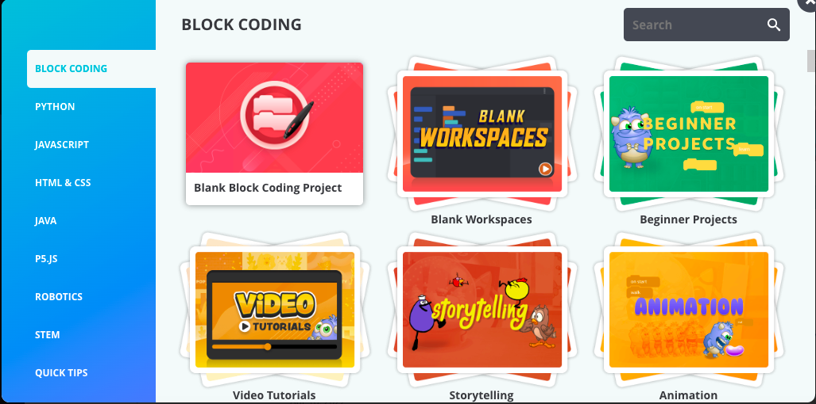
Tuesday
Tynker has Hour of Code Activities
If you were absent yesterday please talk to one of us to get logged in.

Slide 12
Check this Out!
Make PDFs editable using
APS teachers have access to Adobe Express
Google extension- Kami (free trial- possibly longer using this link: https://kami.app/NHNx0rtdKt3d
https://tinywow.com/

Slide 13
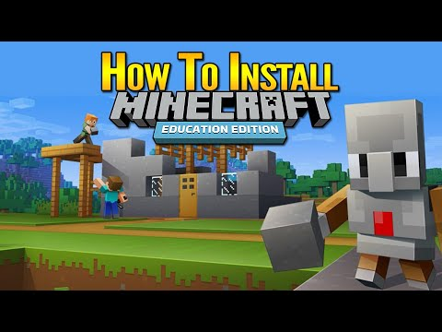
Prepping for Wednesday
Try Minecraft: Education Edition for free link
Get it through the free trial or through the demo lesson. The free trial requires you to have an account, either an Office 365 Education account or a Microsoft 365 account. The demo lesson does not require any account or log-in.Download: https://education.minecraft.net/en-us/get-started/download

Slide 14
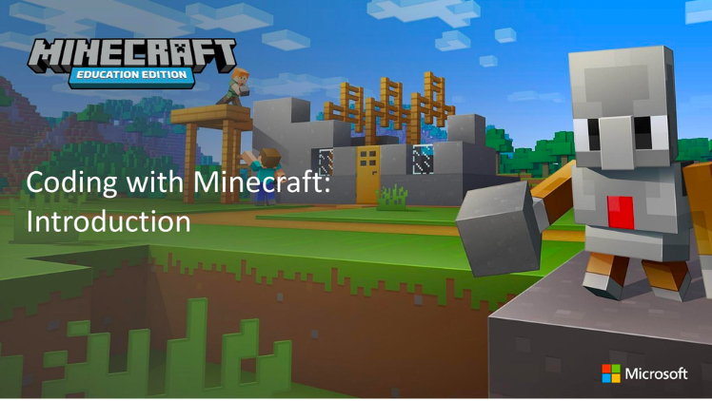
Wednesday
Learn to teach with Minecraft, find activities to engage your students across subjects and join our global community. Whether you are new to Minecraft or looking to improve your skills, these training materials will help.

Slide 15
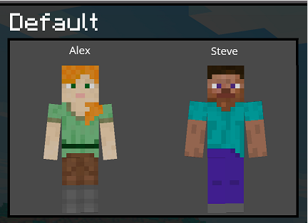
Wednesday
Change skins to personalize game play link
Minecraft Education Edition allows for the changing of skins. Changing skins allows you to customize the player and choose an avatar. Your avatar can closely match your identity or your skin can fit into the world you create.

Slide 16
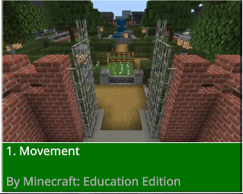
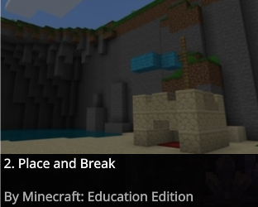
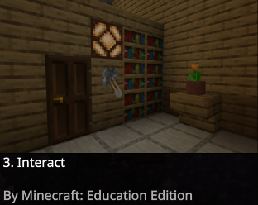
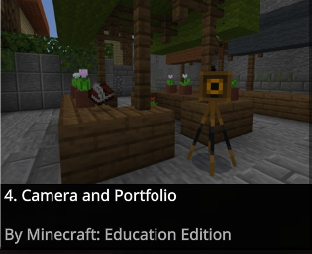
Wednesday
HOW TO PLAY 1
These worlds and activities have created as an introductory experience for learning how to use Minecraft Education

Slide 17
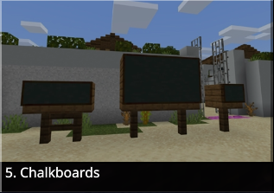
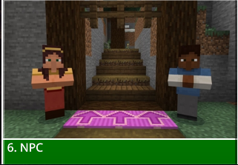
Wednesday
HOW TO PLAY 2
These worlds and activities have created as an introductory experience for learning how to use Minecraft Education

Slide 18
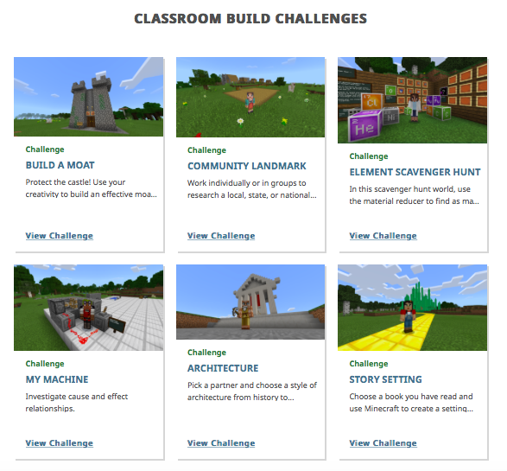
Wednesday
Project 5- Minecraft Build Challenge

Slide 19
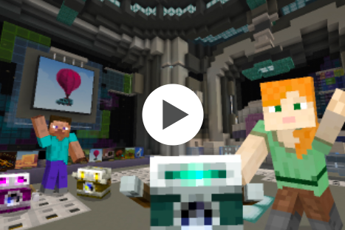
Minecraft Hour of Code Video
Thursday
Understand the importance and benefits of computer science in all aspects of life.
Analyze and solve problems using algorithmic thinking and problem decomposition.
Practice computer science concepts such as sequences, events, loops and debugging.
Create coding solutions to successfully complete a task or solve a problem.
Recognize the expanded career connections offered through computer science.
Minecraft Hour of Code
Notes:
Making animals come to life- coding-Ms. Barreto
Making vehicles move-coding-Ms. Barreto
Coding in Minecraft-Hour of code

Slide 20
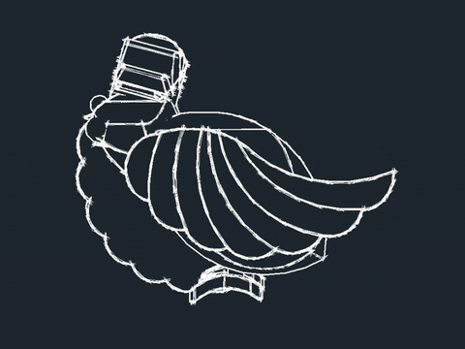
Thursday
Prepping for Friday
Task:
Create Free TinkerCad Educators Account.
Go here:
https://www.tinkercad.com/login

Slide 21
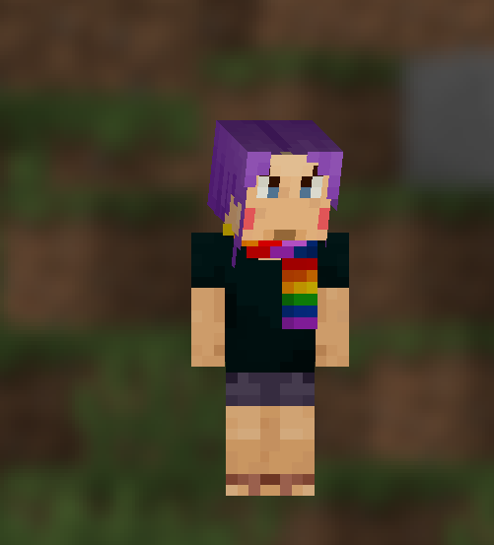
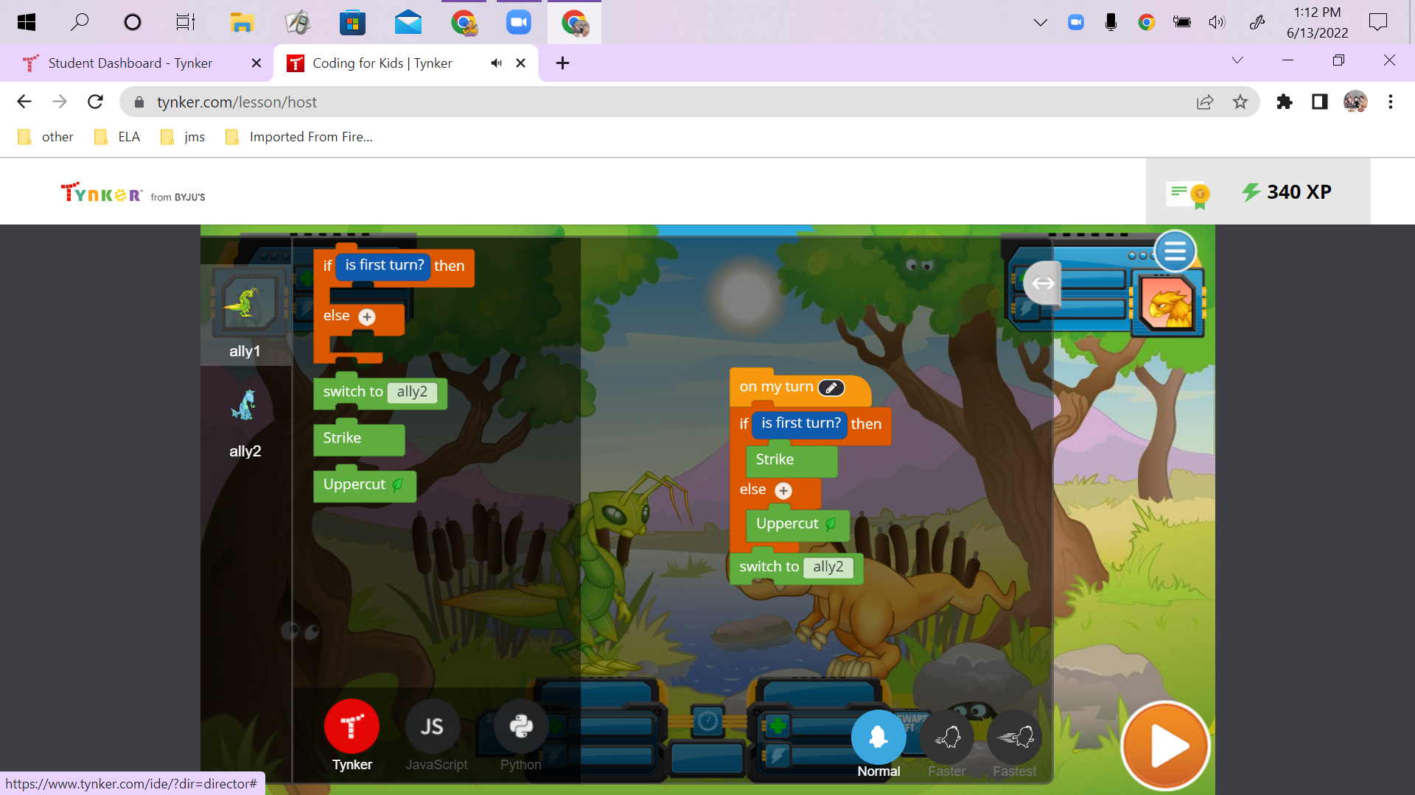
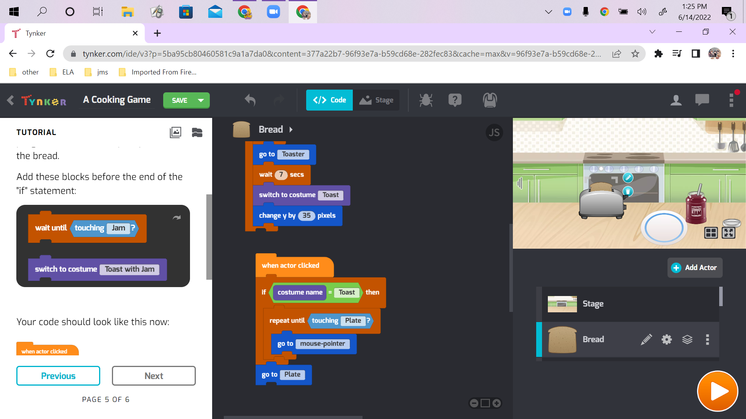
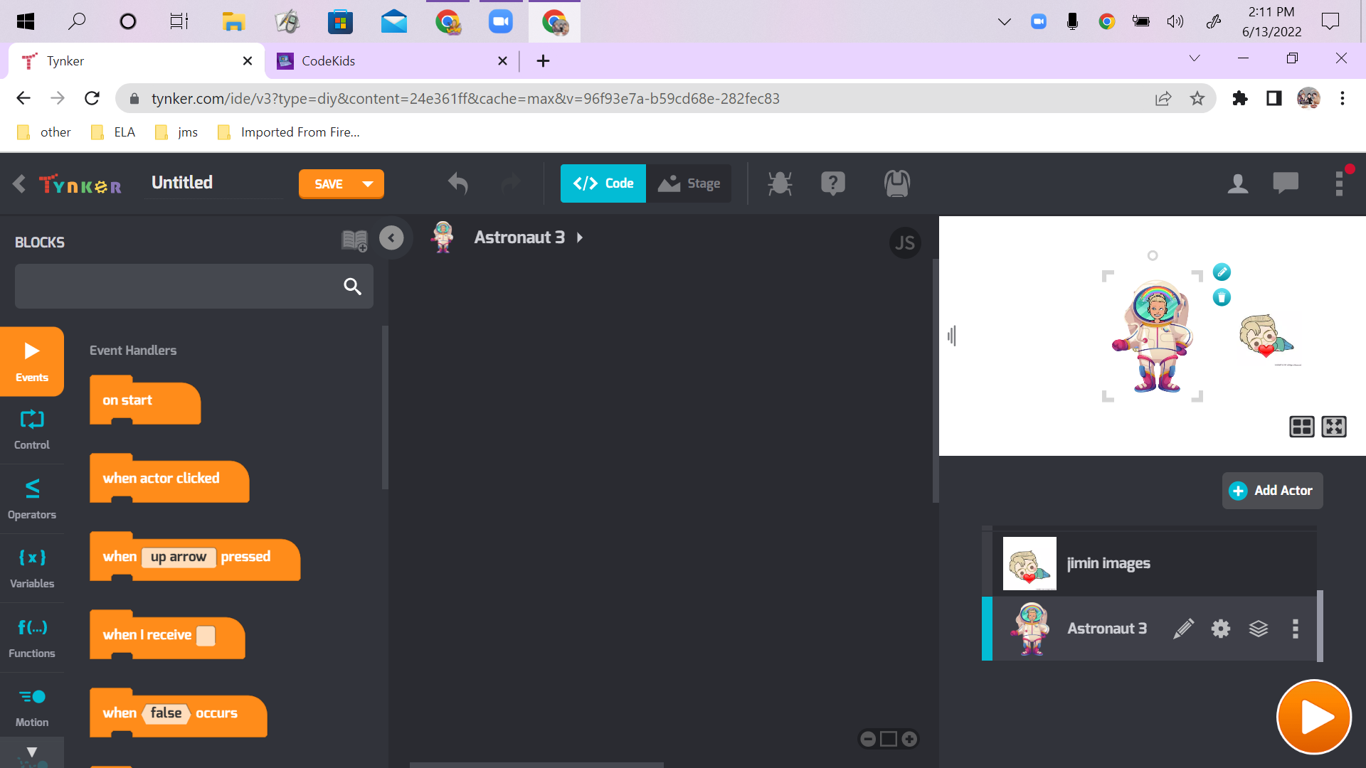
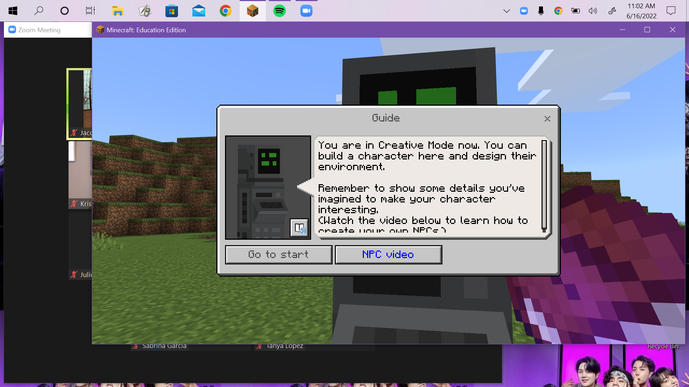
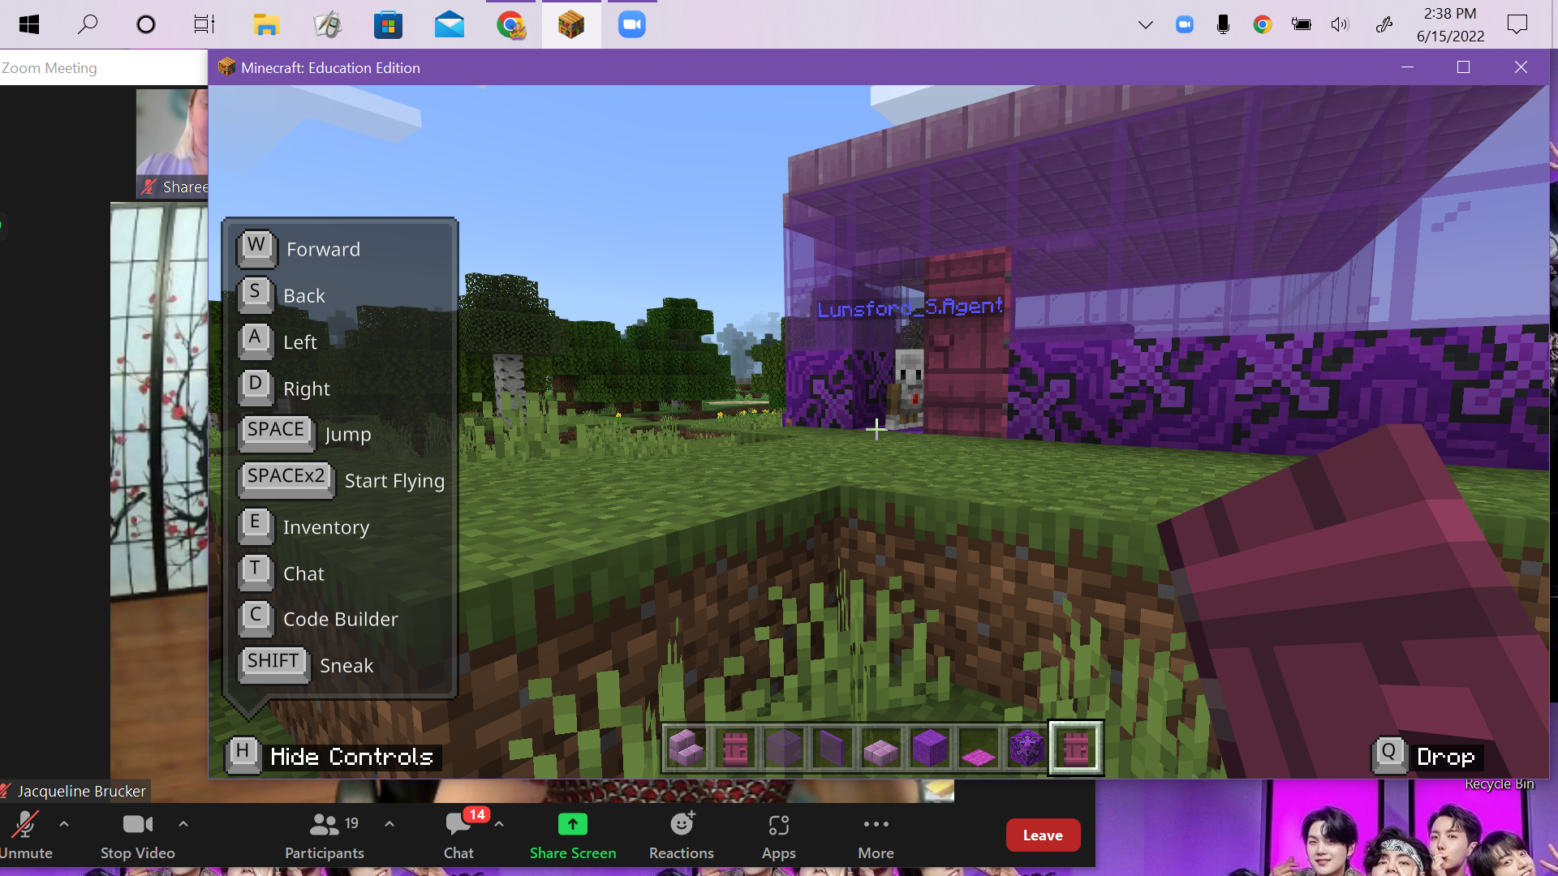
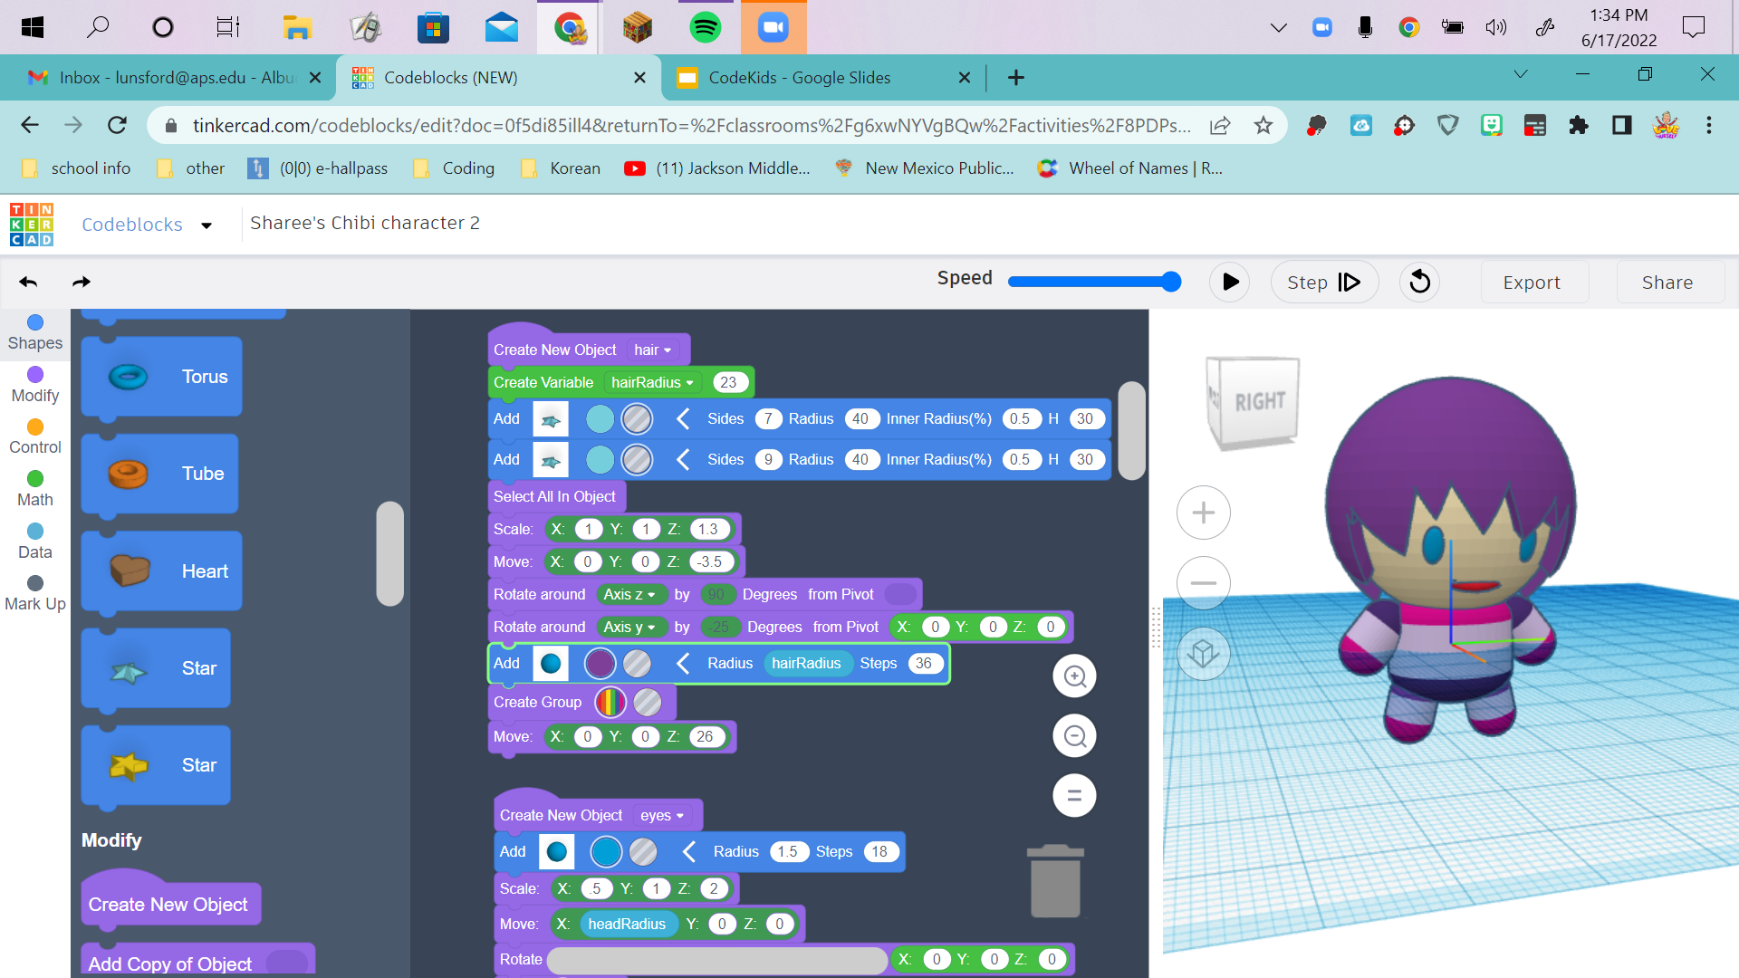
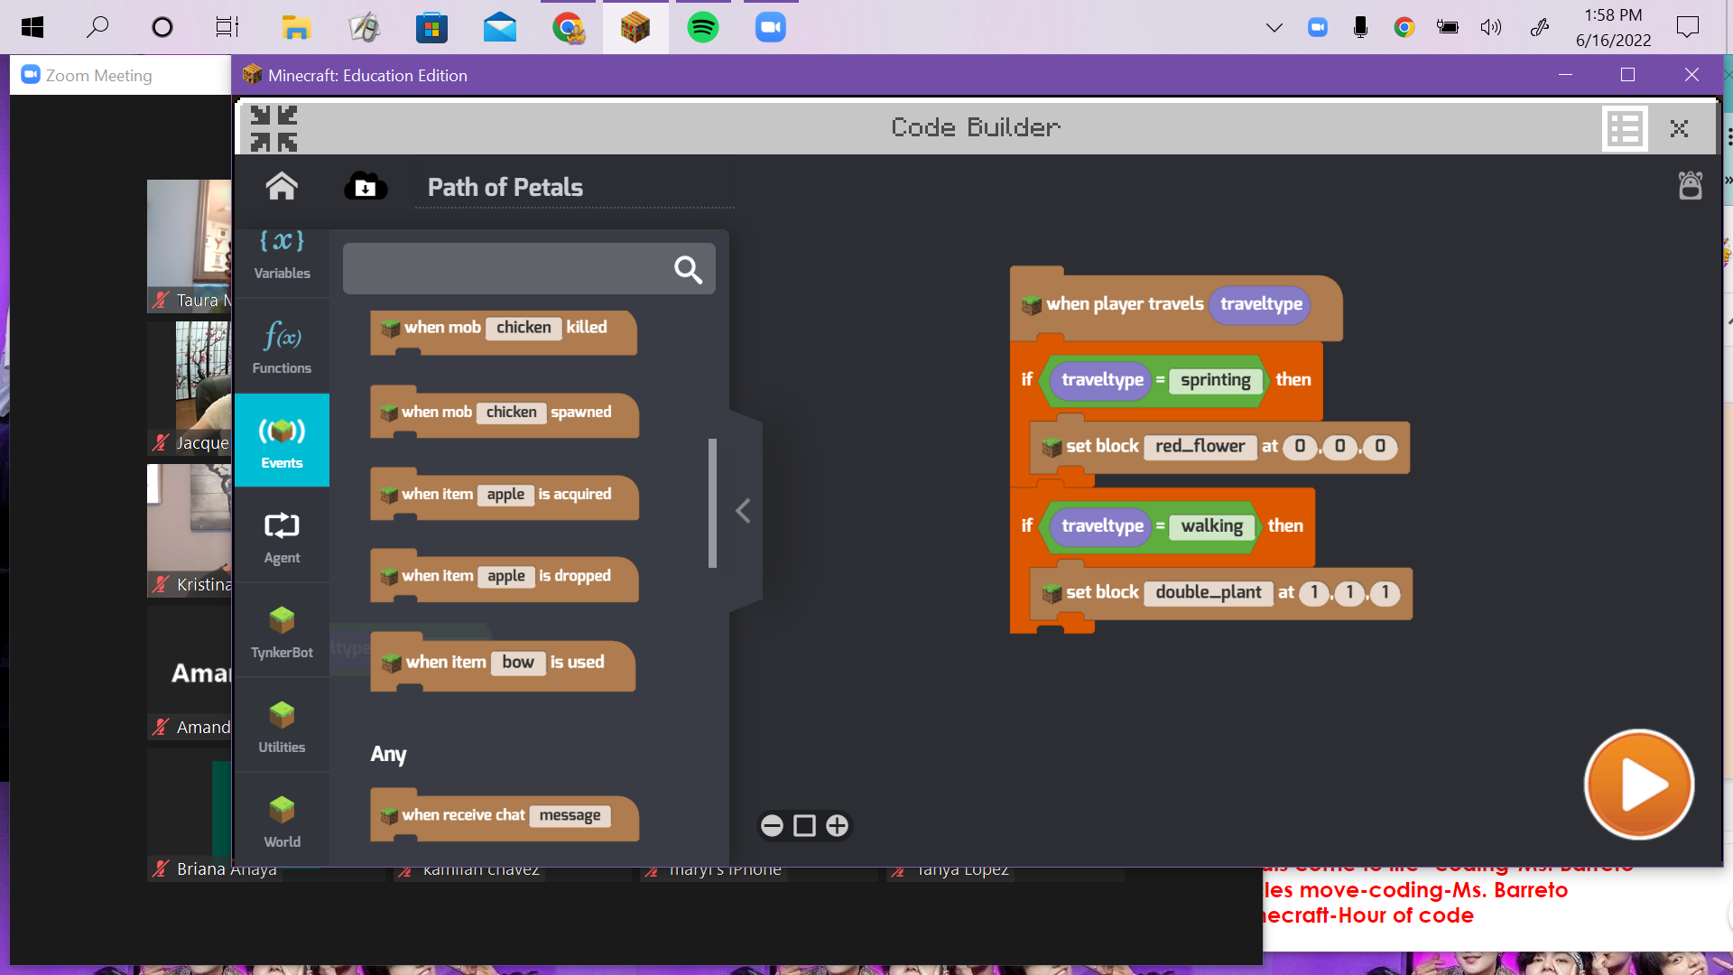

Slide 22
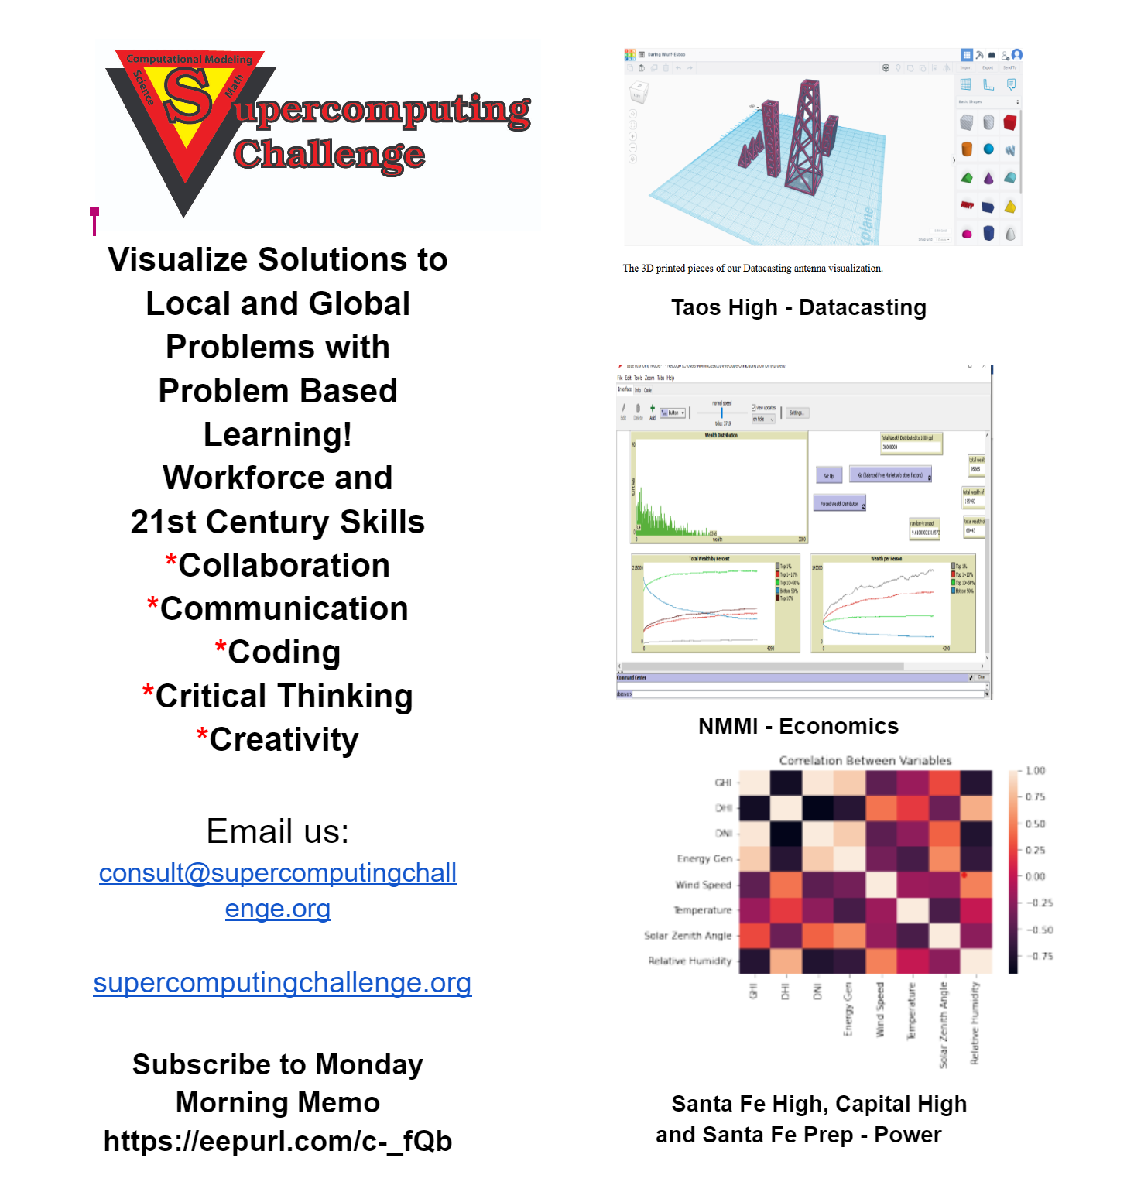
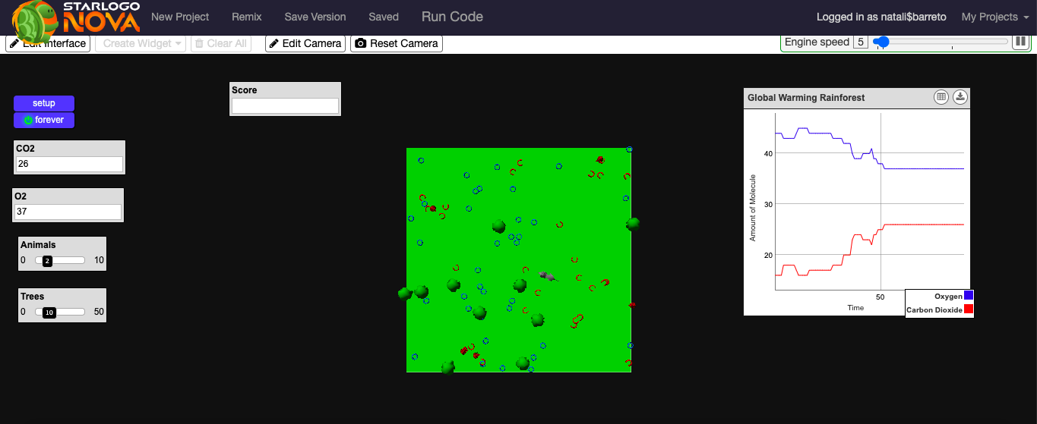
Supercomputing Challenge Website
https://docs.google.com/document/d/1MlP67i7wZvlVfJJc3vTaxRYPae3yYxwMLB9i04pmk3A/edit
https://www.slnova.org/natali$barreto/projects/829314/ Code blocks

Slide 23
CodeCraft-ing
Coding
Science & Engineering
Making, Crafting & Storytelling

Slide 24
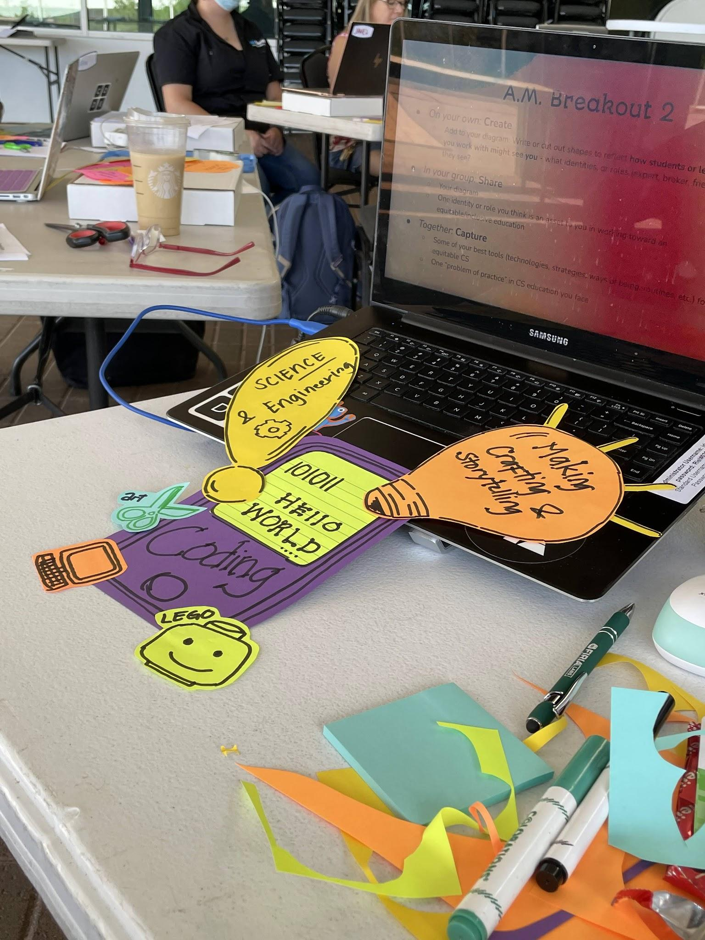
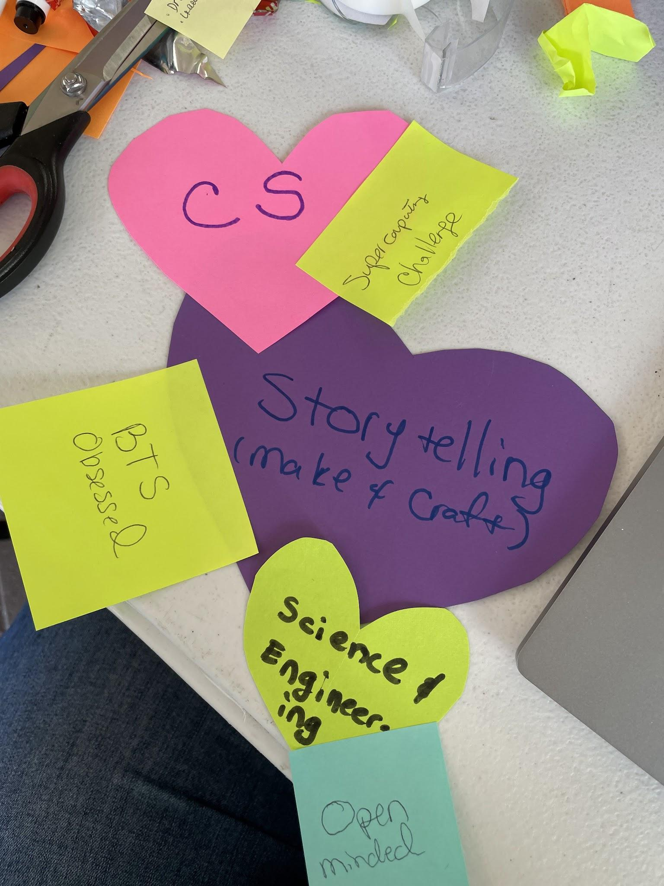

Slide 25
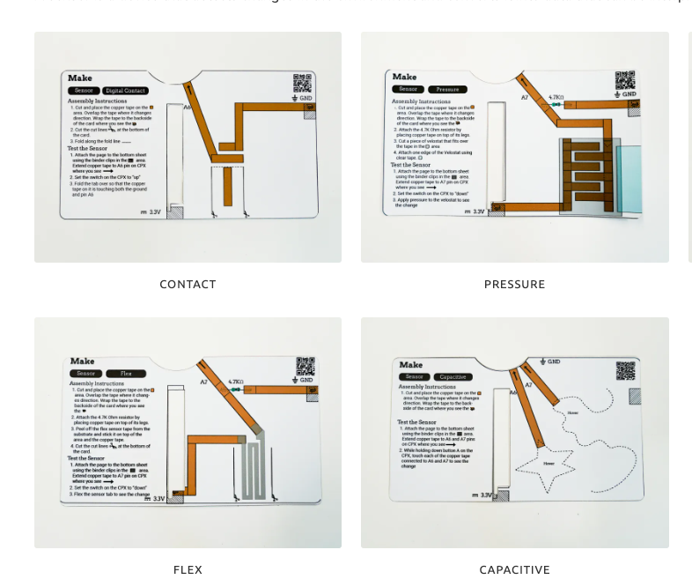
02
The
MCVT KIT
https://mcvtlab.com/
Creative, Responsive, Physical Computing

Slide 26
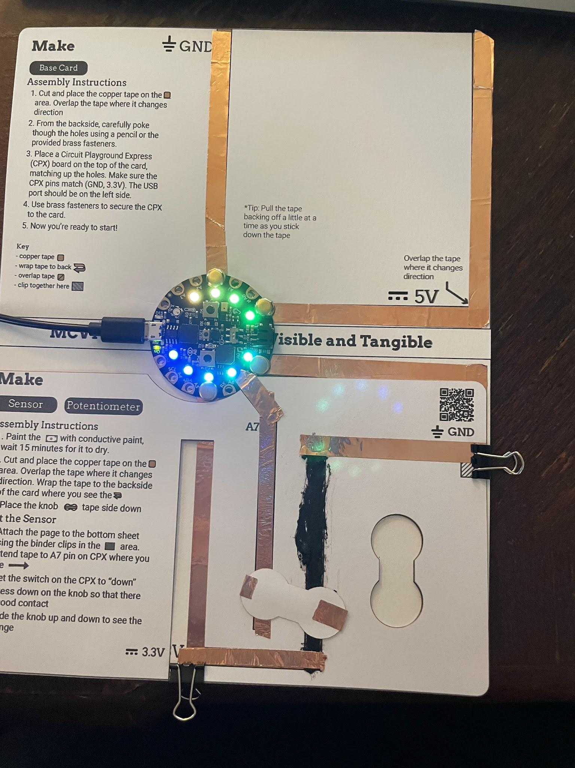
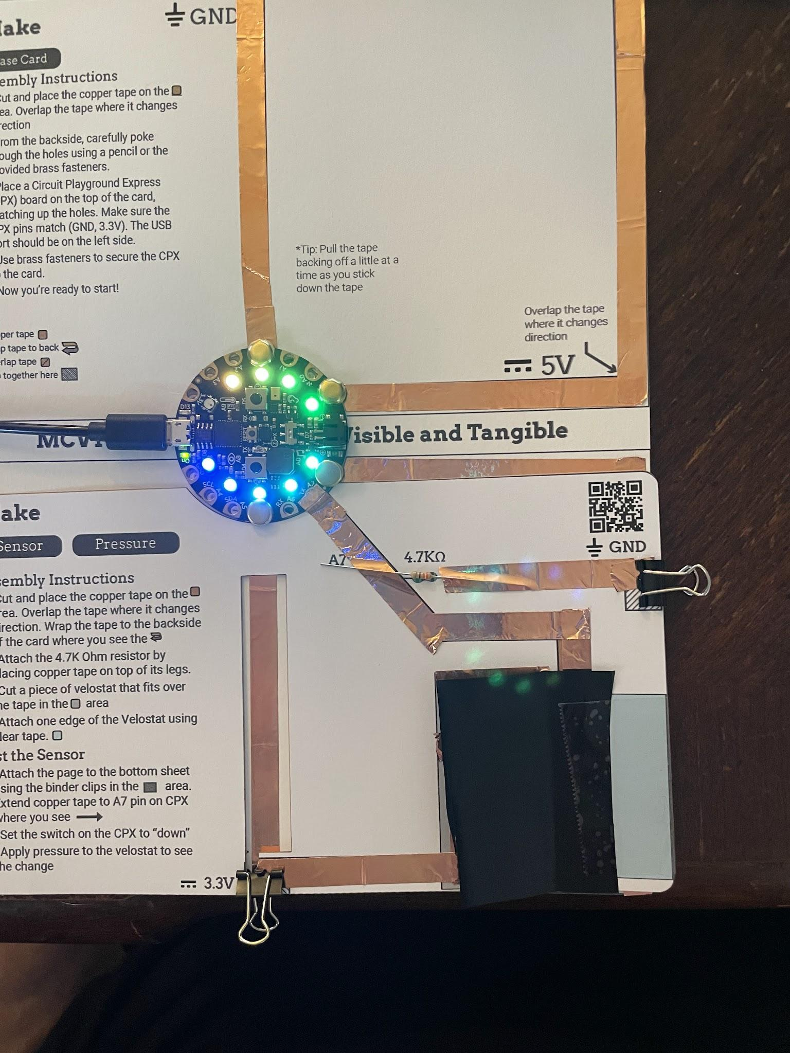
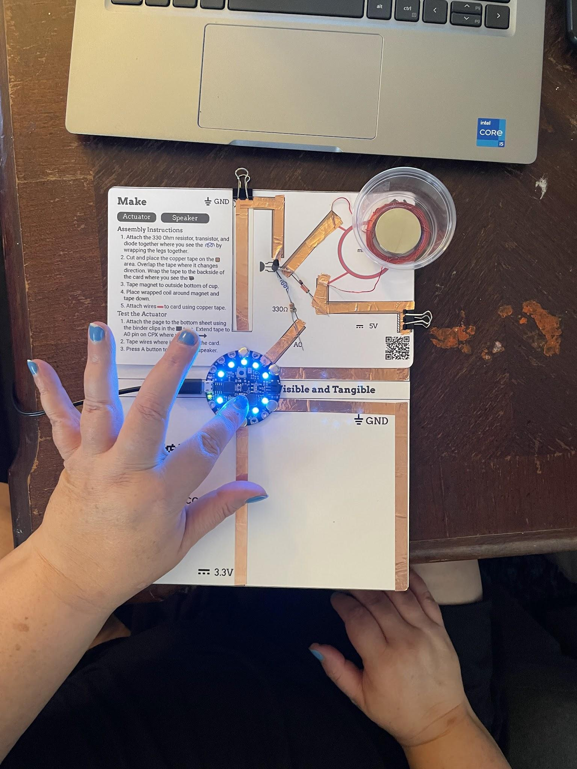

Slide 27
Parking Lot
Links to resources:
https://orise.orau.gov/step/activities.html (Try to contact them but as soon as you join one of their PD’s they can loan stuff out.)
https://pathfinders.onwingspan.com/en/page/home (sign-up, join the online PD’s some of them have free kits (ie. Project Trix, Finch Robot, ChibiTronix, Firia Labs)
https://arcade.makecode.com/ (Alternative to Game Design)
https://makecode.microbit.org/ (Microbit Simulator)
https://sim.firialabs.com/ (Python Simulators)
https://vr.vex.com/ (Block Coding and Python Simulator) https://certifications.vex.com/educator/vexcode-vr-certifications (Certification Link)
Supercomputing Challenge https://supercomputingchallenge.org/21-22/

