Slide 1
MIT APP Inventor
3 hours Saturday, 1 hour on Sunday

Slide 2
Code of Conduct
Today, phones and computers are not for games, but MIT App Inventor needs your full focus
Have a “I’ll try again and this will not beat me attitude!”
Think of how you’ll use it in your project

Slide 3
Setting Up App Inventor
Google “MIT App Inventor”
Open “MIT App Inventor”
Create an account with a Google Gmail account
https://appinventor.mit.edu/explore/ai2/setup
You tube Video https://www.youtube.com/watch?v=eSvtXWpZ6os

Slide 4
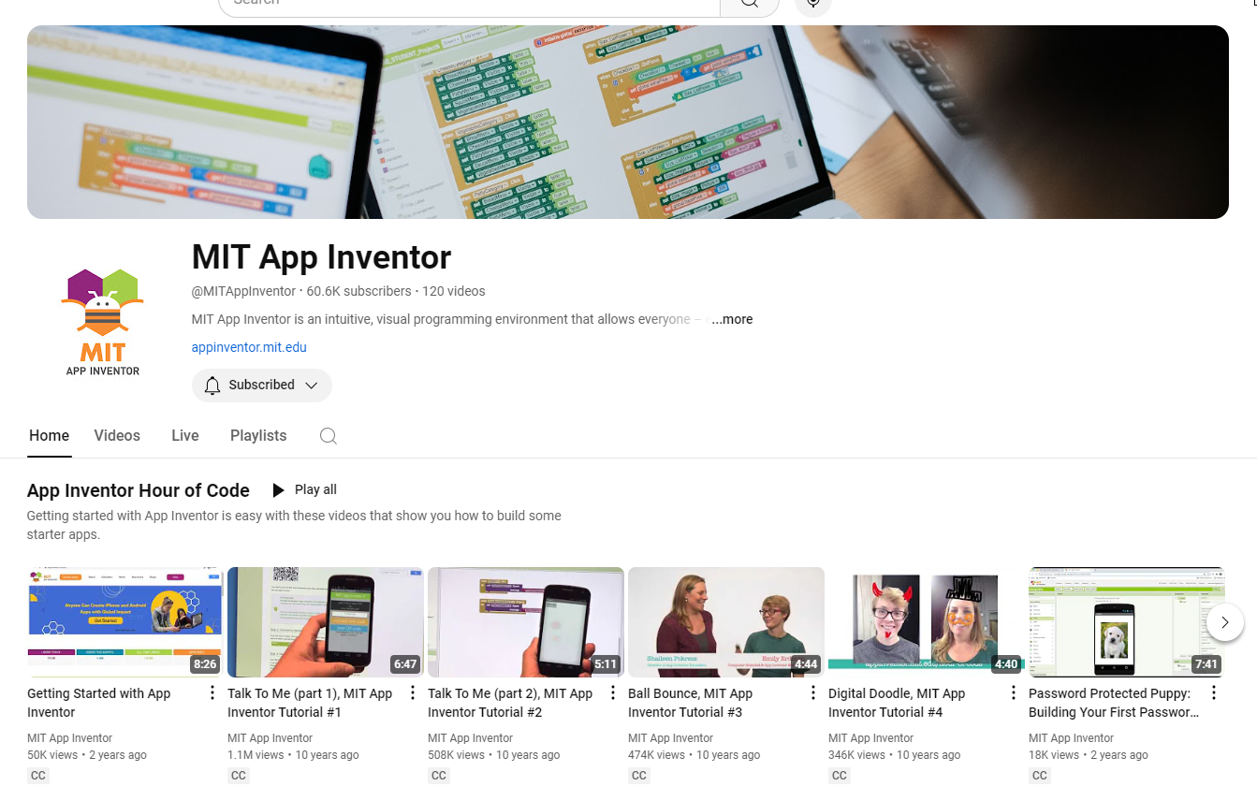
MIT App Inventor Youtube Page

Slide 5
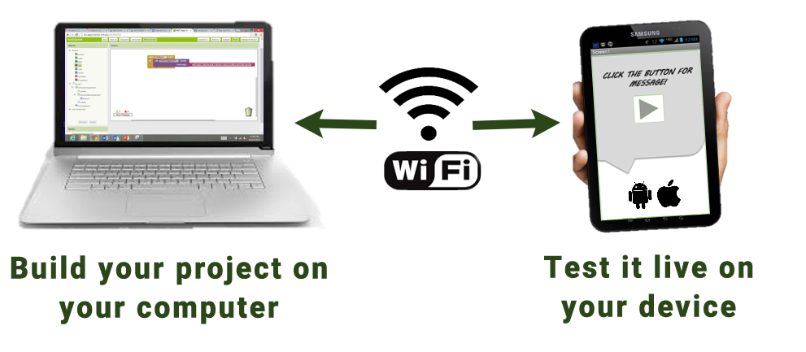
Setting Up App Inventor on your Computer
To test your app as you create it, follow these steps to install the MIT App Inventor Companion app on a phone or tablet:

Slide 6
Step 1: Download and install the MIT App Inventor Companion app on your Android or iOS device.
Open the Google Play store or Apple App store on your phone or tablet.
Download the MIT App Inventor Companion app
After downloading, step through the instructions to install the Companion app on your device. You need to install the MIT App Inventor Companion app only once, and then you can leave it on your phone or tablet for whenever you use App Inventor.

Slide 7
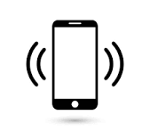
Step 2: Connect both your computer and your device to the SAME Wi-Fi network
App Inventor will automatically show you the app you are building, but only if your computer (running App Inventor) and your device (running the Companion) are connected to the same Wi-Fi network
SAME

Slide 8
Step 3: Open an App Inventor project and connect it to your device …
Go to App Inventor and open a project (or create a new one — use Project > Start New Project and give your project a name).
Then Choose “Connect” and “AI Companion” from the top menu in your browser:

Slide 9
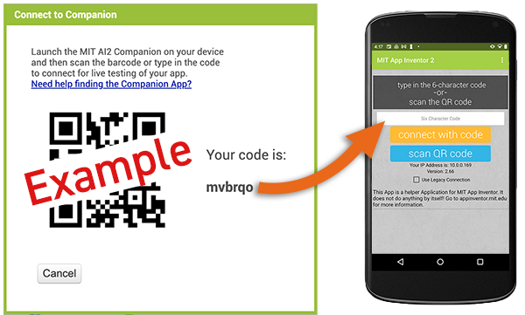
Step 3: …Continued….
A dialog with a QR code will appear on your PC screen. On your device, launch the MIT App Companion app just as you would do any app. Then click the “Scan QR code” button on the Companion, and scan the code in the App Inventor window or enter the code

Slide 10
Step 3: …. Continued
Within a few seconds, you should see the app you are building on your device. It will update as you make changes to your design and blocks, a feature called “live testing.”

Slide 11
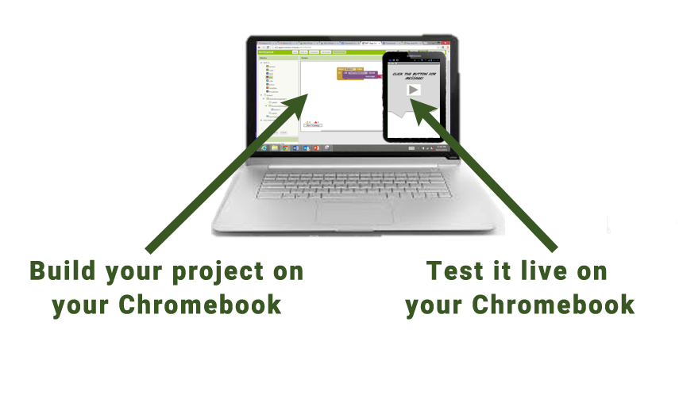
Setting Up App Inventor on your Chromebook
Many Chromebooks are capable of running Android apps. That lets you create, test, and run the finished app on the same device.

Slide 12
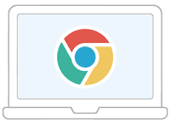
Step 1.
If you are unboxing a new Chromebook, you should use the “settings” app and go to the “About Chrome OS” item (usually the last item on the left-hand side of the window). There it will tell you the version of Chrome OS running on the Chromebook along with a “Check for Updates” button. Click the button. It will either tell you that your Chromebook is up to date or it will start the update process. It is possible that you may have to update multiple times. Once your Chromebook takes the update, again “Check for Updates” until your Chromebook says that it is up-to-date.

Slide 13
Step 2.
Turn on the Google Play Store setting to enable the use of Android apps. To do this, search under settings for Play Store and you should see the option to turn on the store. as shown below. If you do not see Google Play store under the settings list, make sure you are running the latest version of Chrome OS. If your Chromebook is managed by a school or business, you may need to discuss with your IT administrator about enabling this feature if it has been disabled. If you are still unable to install Android apps from the Play Store, your Chromebook is unable to run apps and is not usable with App Inventor.

Slide 14
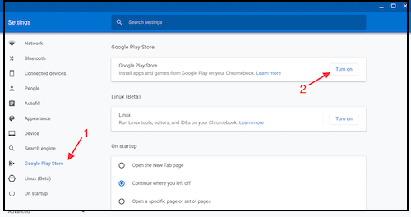
Step 2. …Continued

Slide 15
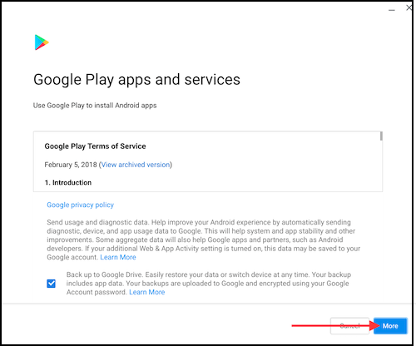
Step 3. Accept Google Play Store conditions and set up Google Play

Slide 16
Step 4. Next, launch the Play Store app to access the Google Play Store.

Slide 17
Step 5. Once you have opened the Play Store, use the search feature to find the MIT AI2 Companion, similar to how you would find an app on a phone or tablet.

Slide 18
Step 6. Click the Install button to install the Companion app.
To open the MIT AI2 Companion, click on its icon in the ChromeOS menu. You can also pin this icon to the task bar for fast access in the future.

Slide 19
Introduction to the Environment
There are two main components to the App Inventor environment: the Designer and the Blocks Editor.
The Designer allows you to add components to your app and lay out what it will look like.
The Blocks Editor allows you to code your app to give it functionality--that is, make it do stuff!

Slide 20
Choose an app to create (pdf’s)
Hello Codi (A)
https://appinventor.mit.edu/explore/ai2/hello-codi.html
Hello Purr (A)
https://appinventor.mit.edu/explore/ai2/hellopurr
Digital Doodle (A) https://appinventor.mit.edu/explore/sites/all/files/hourofcode/DigitalDoodle.pdf
My Piano (A)
https://drive.google.com/file/d/1TiAbErJoV7xjb-HM4y_Iq1NJ3vTRAqSe/view Video

Slide 21
Hello Codi Tutorial
We need a picture of the finished app here to link this to, this link also loads the starter project
https://ai2.appinventor.mit.edu/#6054451347521536

Slide 22
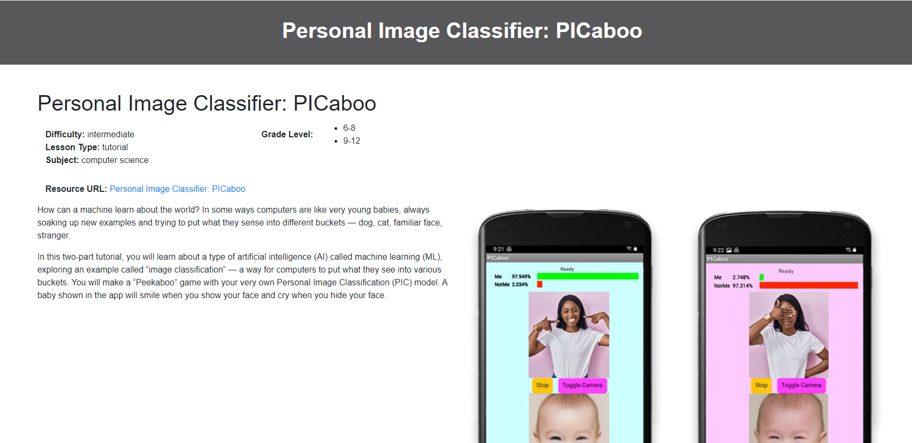
Click on the image to load the starter program and tutorial

Slide 23
How to set up a microbit for data collection
https://docs.google.com/document/d/1ZQTJkaSMPmRB8W4L7NCgQ6rTbe8Nx_iPDJxXCUgAi9o/edit?tab=t.0
https://makecode.microbit.org/

Slide 24
USING SENSORS TO COLLECT DATA

Slide 25
Lesson 1: Setting Up Sensors

Slide 26
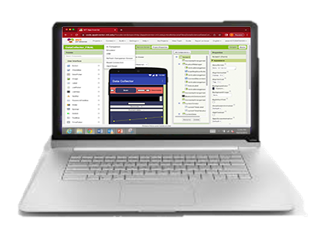
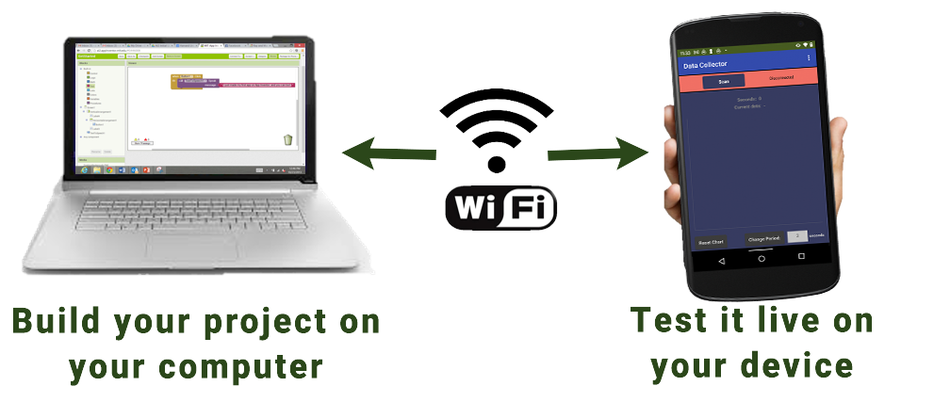
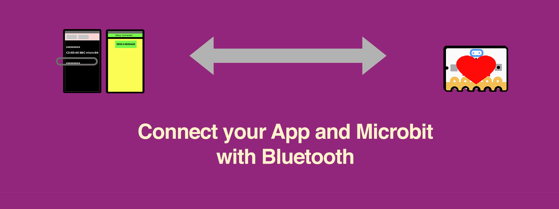
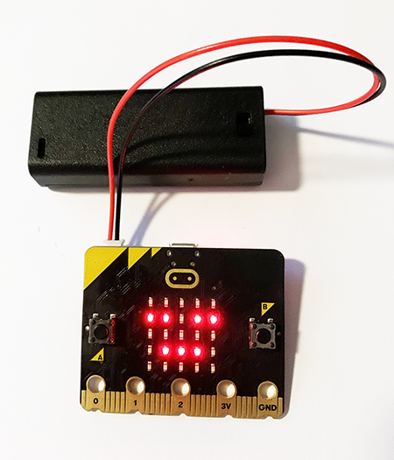
Connect Your App to the Microbit
Type in this link on your browser to access instructions —
bit.ly/ecobits_app_setup
STEPS:
On a Chrome browser: Access the app code in App Inventor
On the Microbit: Connect the Microbit to power
\
On the phone, tablet, or Chromebook: Connect the device to App Inventor
Connect your app to the microbit.

Slide 27
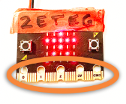
Guess the Sensor Type
What kind of sensor is your team’s Microbit using?
LIGHT?
TEMPERATURE?
ACCELERATION (motion)?
SOIL MOISTURE?
Perform experiments with your team to find out. Try to:
Cover the Microbit with your hand and guess based on data coming into your app
Bring it to different areas of the room
Shake it!
Touch the metal pads along the Microbit’s edge connector. Does the data change?

Slide 28
Lesson 2: Good Questions and Creative Ideas

Slide 29
What sensors are working nearby — at home, your phone, car, neighborhood, or school?

Slide 30
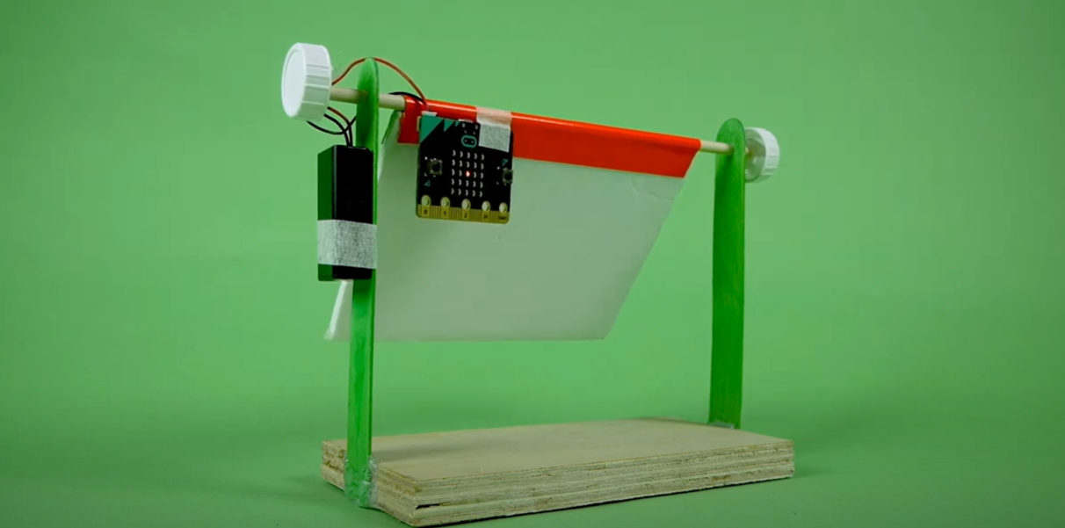
Make a Weather Station that works with Microbits and later with MIT App Inventor

Slide 31
Lesson 3: Sensor Locations and Data Collection
Student Resource Guide
Teacher Guide

Slide 32
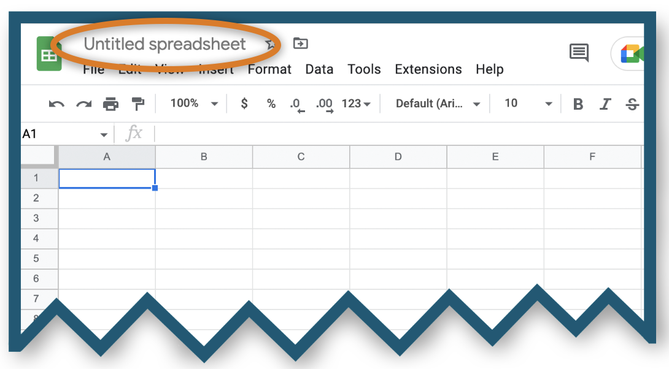
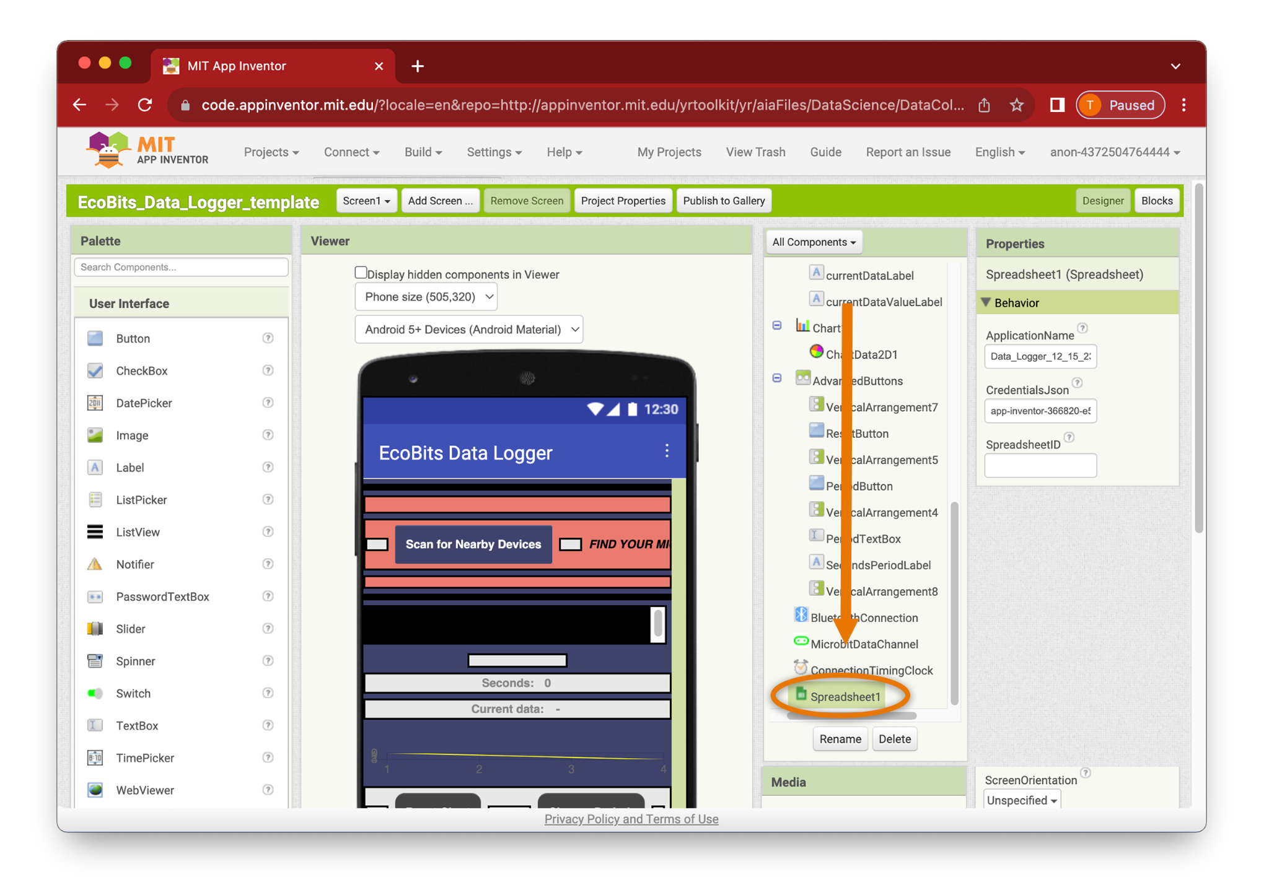
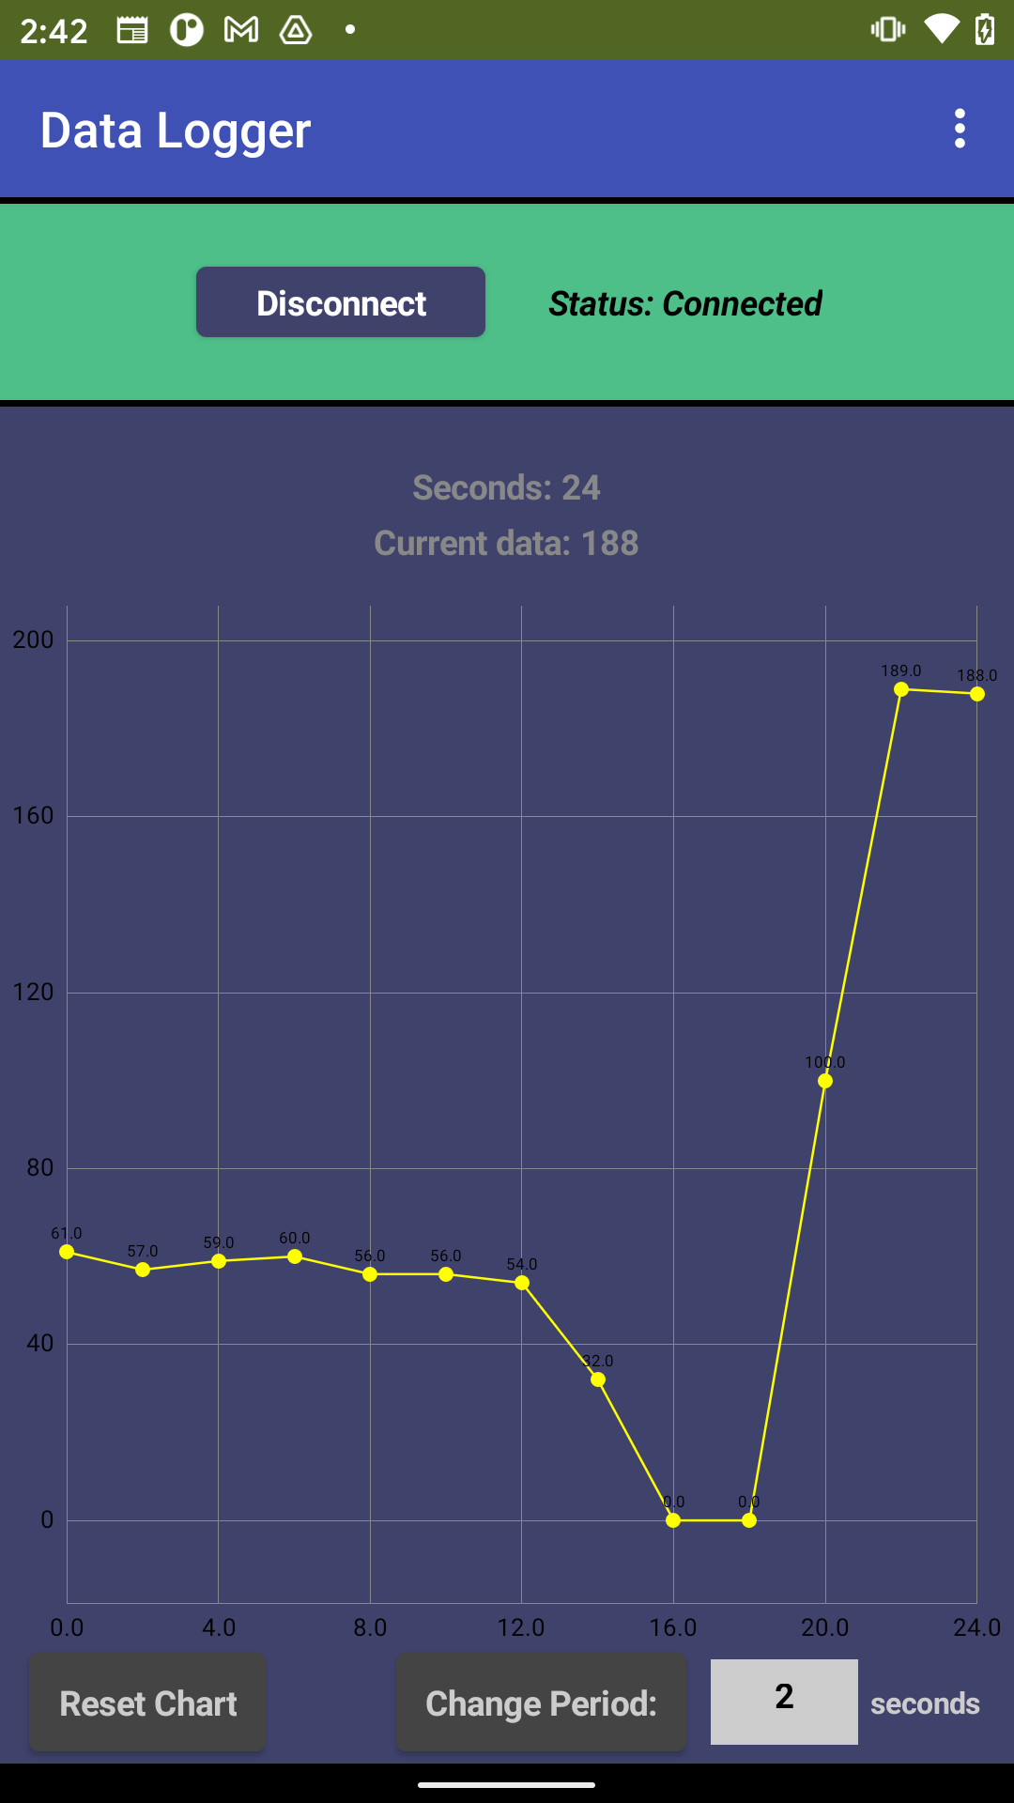
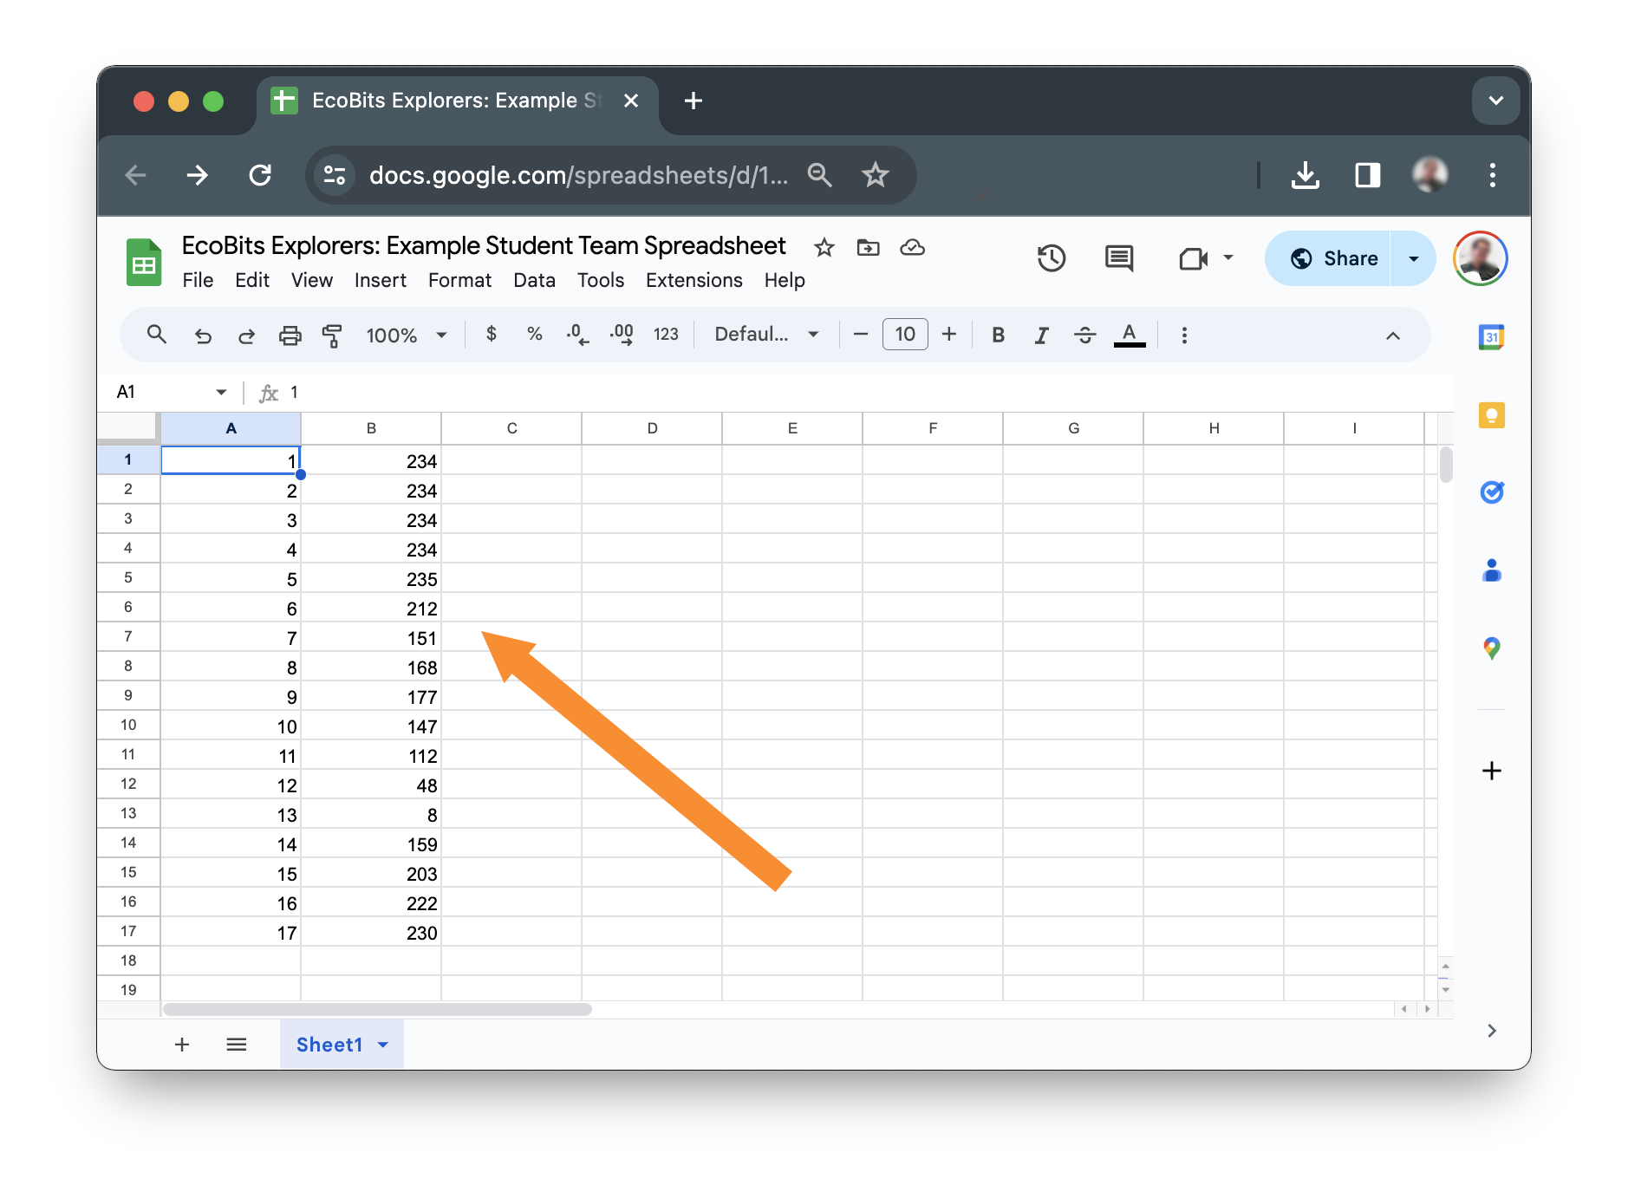
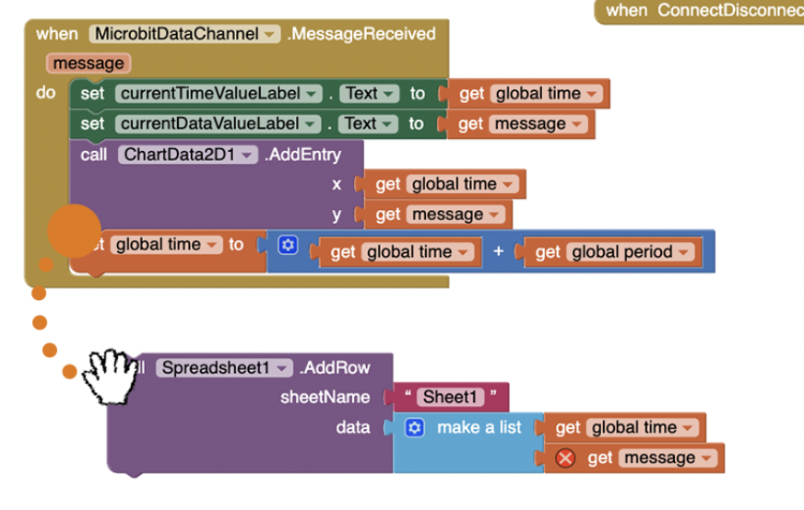
Connect Your App to Your Team’s Spreadsheet
Type in this link on your browser to access instructions —
bit.ly/ecobits_spreadsheet
STEPS:
On a Chrome browser: Create a spreadsheet on your (or your teacher’s) Google account.
Add the SpreadsheetID to your team’s Data Logger app
Code the spreadsheet block in App Inventor
On the phone, tablet, or Chromebook: Connect the device to App Inventor
Scan and connect to your Microbit over Bluetooth
Check that your app is logging data
Check that your app is data to your team’s spreadsheet

Slide 33
Lesson 4: Building Data Apps

Slide 34
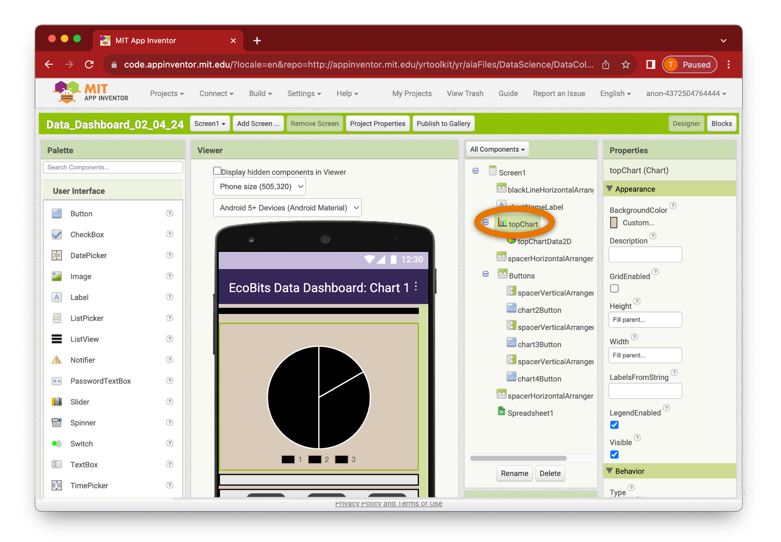
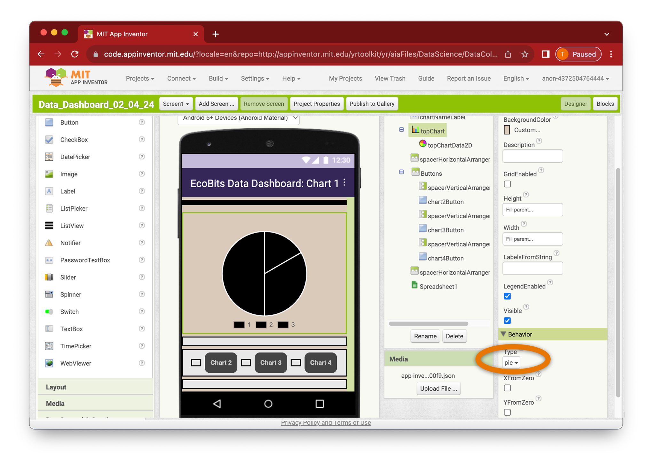
Change the Chart Type
Highlight the topChart component
Scroll down to find the Type property near the bottom of the Properties.

Slide 35
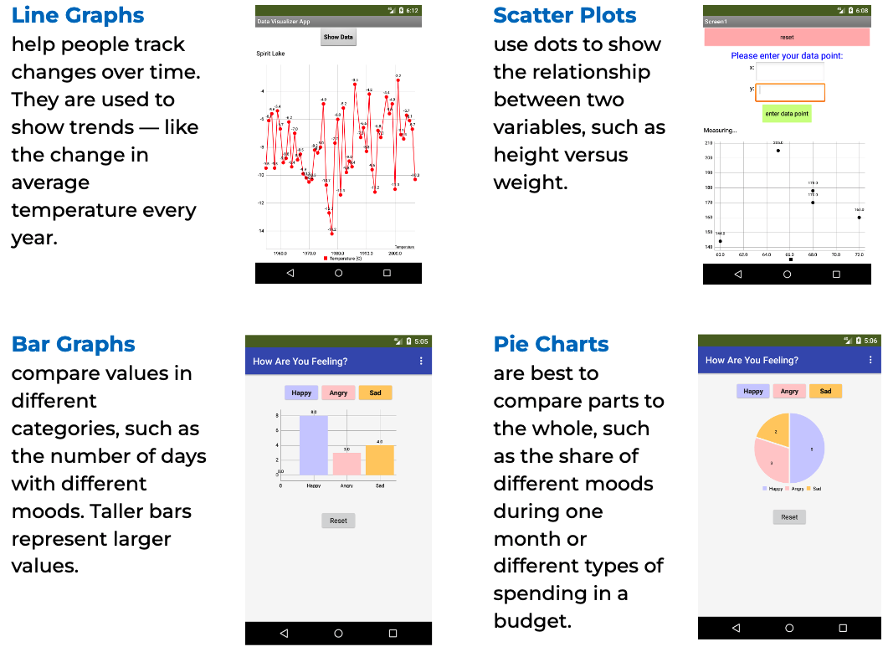
What Chart Is Best for Your Project?

Slide 36
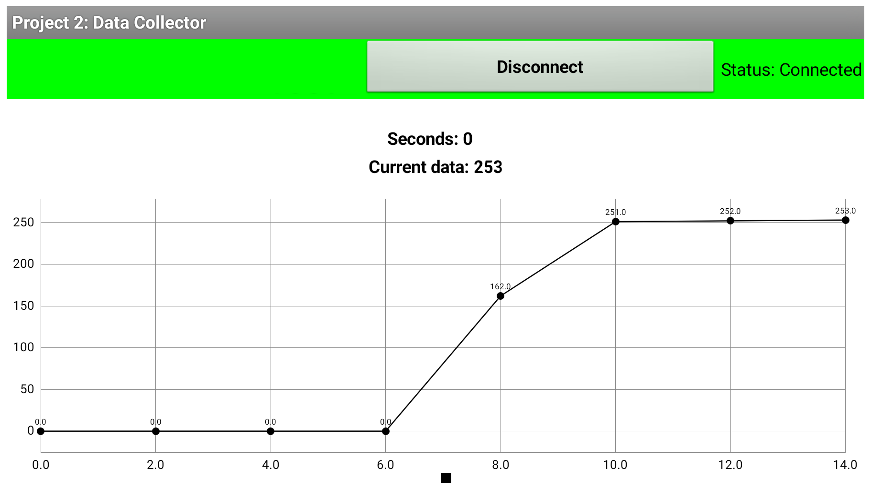
What kind of graph does the Microbit create?
Continued on next page . . .
Microbit sensor always creates the same kind of chart.
What kind of chart from the types that we studied?
Which is the x-axis on the graph to the right? The line going up and down, or side to side?
The x-axis of a chart showing the Microbit Data always measures the same quantity.
What does the x-axis measure?

Slide 37
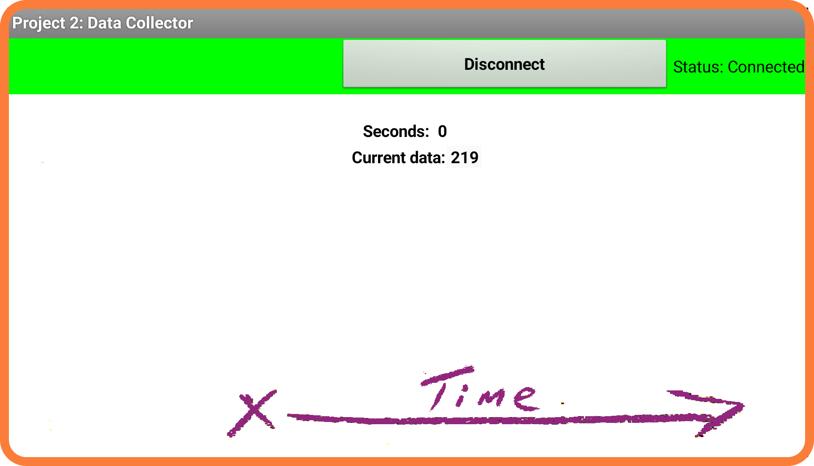
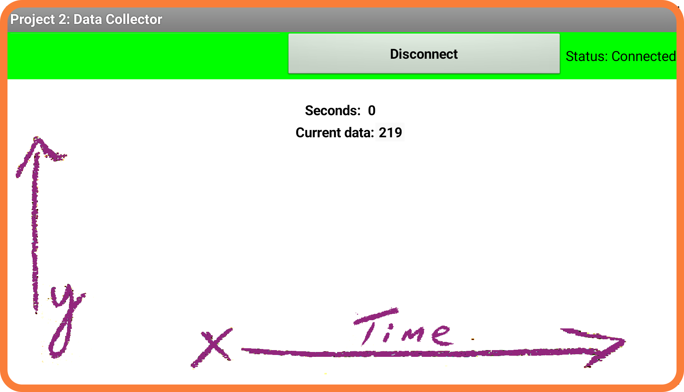
What is time series data? (Continued)
Continued on next page . . .
The x-axis, or horizontal axis of the graph, always measures time.
Microbit sensor creates time-series data.
A time series is a sequence of values collected over regular time intervals.
What values does the y-axis show?

Slide 38
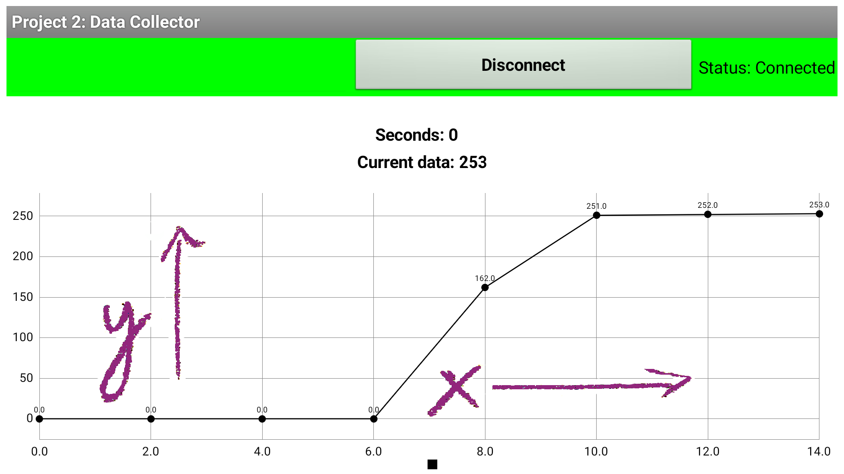
What is time series data? (Continued)
The y-axis will show various units measured by the sensor — temperature degrees, units of acceleration, or some other measure.
Microbit time series data will always make the most sense on line graphs.
The x-axis will show seconds, minutes, or hours
The y-axis will show sensor values.
Different sensors will show different types of units on the graph.
Using your experience with the Microbit, What data do you think is being measured to the right?

Slide 39
Lesson 5: Sharing Data Stories

Slide 40
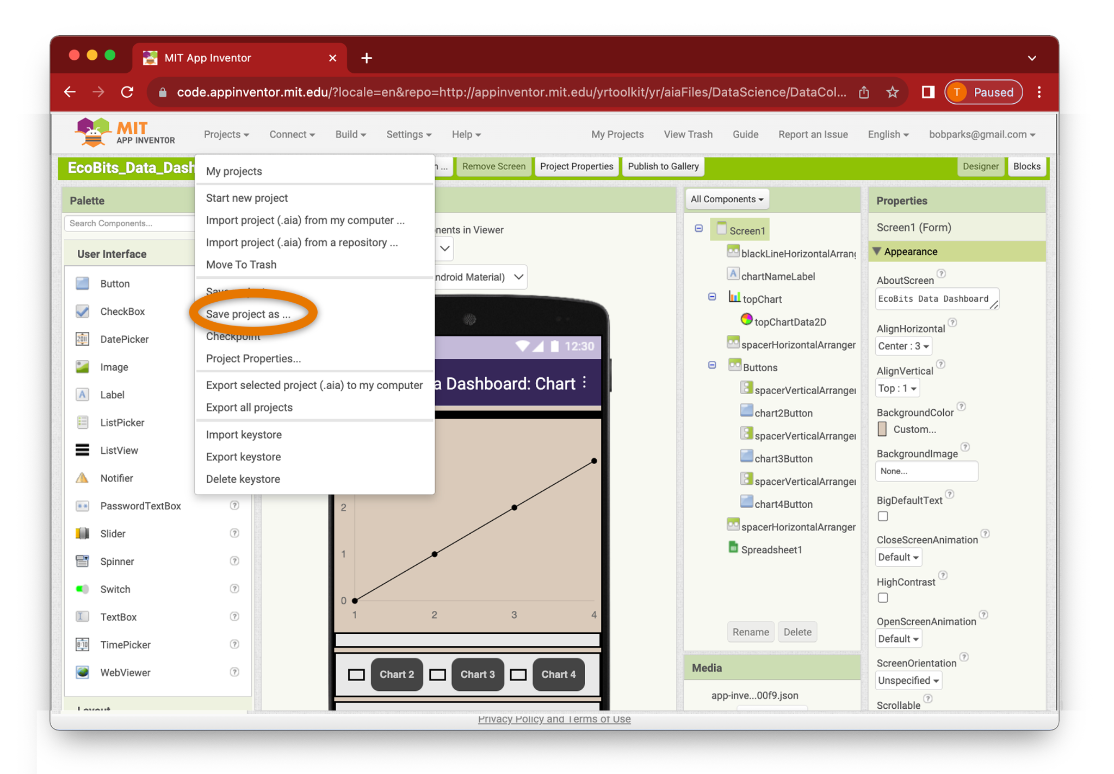
Change the Look of Your Graph
Continued on next page . . .
Save your app file under a new one (in case you want to back to the old file and undo changes!)
Explore the user interface properties of your app. What changes can you make?

Slide 41
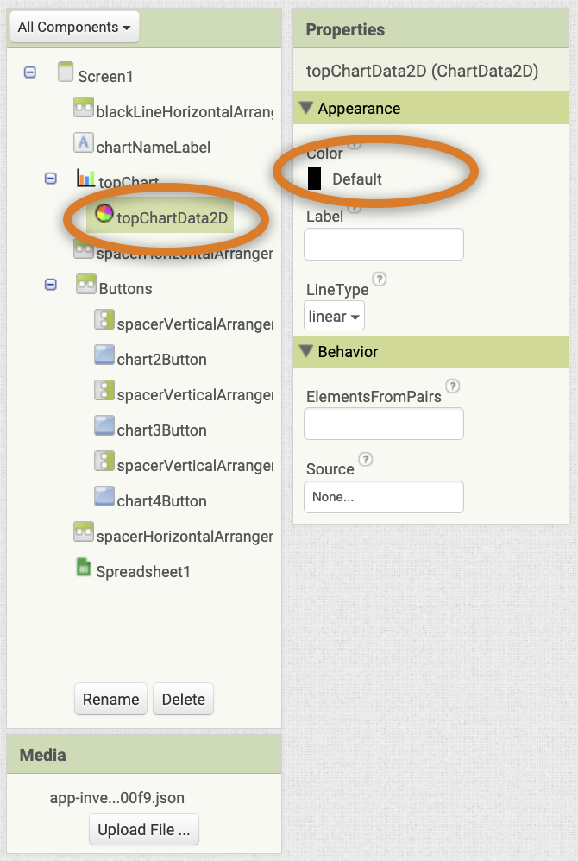
Change the Look of Your Graph
Continued on next page . . .
Things to try:
Change the color of the chart data:
Highlight the chart data component in the components view.
Change the Color property and test how it looks on your team’s phone/tablet.

Slide 42
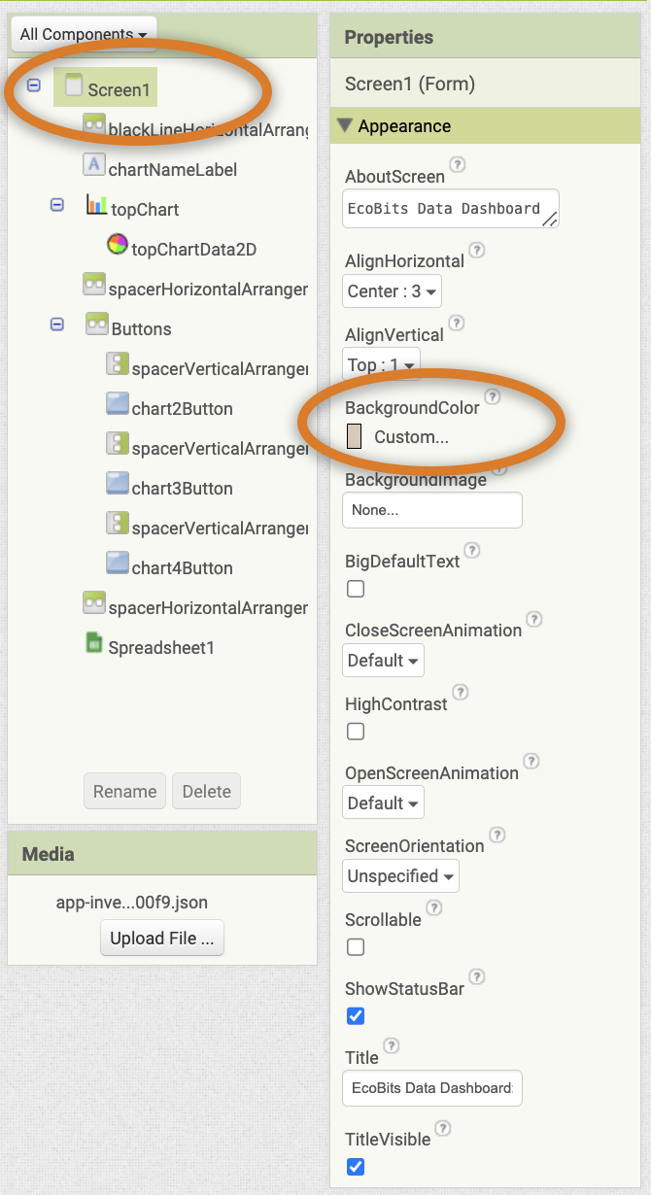
Change the Look of Your Graph
Things to try:
Change the screen background color:
Highlight the screen name.
Change the Background color property and test how it looks on your team’s phone/tablet.
What other user interface changes can you try?

Slide 43
Lesson 6: Connecting Nature Data to Climate Data

Slide 44
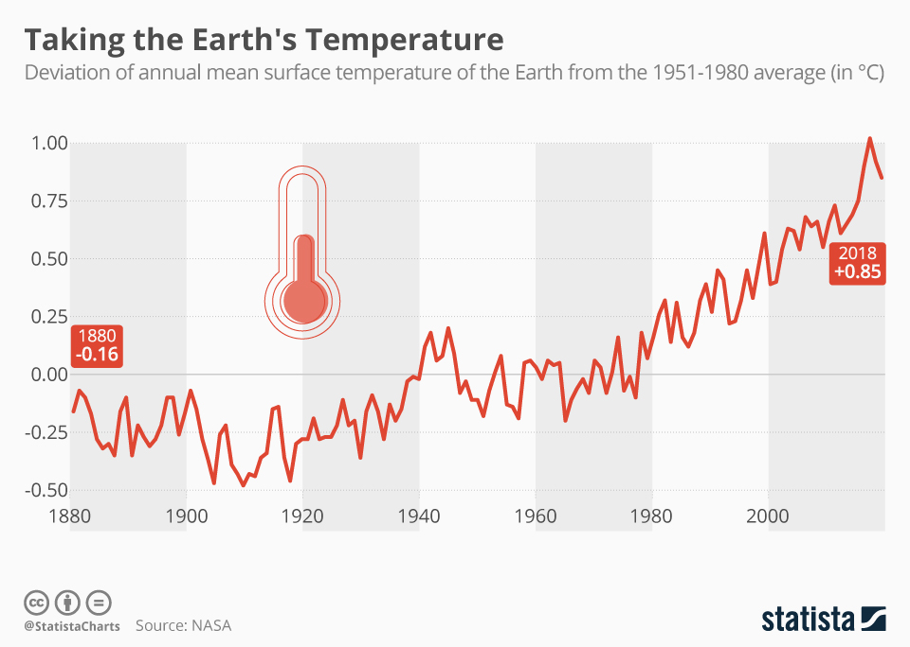
What is the graph measuring?
How is it measuring it?
Make a statement about the Earth’s whole climate based on this graph
Notes:
Answers to look for:
Measuring the average temperature of the whole earth over 140 years
Probably using thermometers in a bunch of different places everywhere
The earth is has been getting hotter over the last 140 years

Slide 45
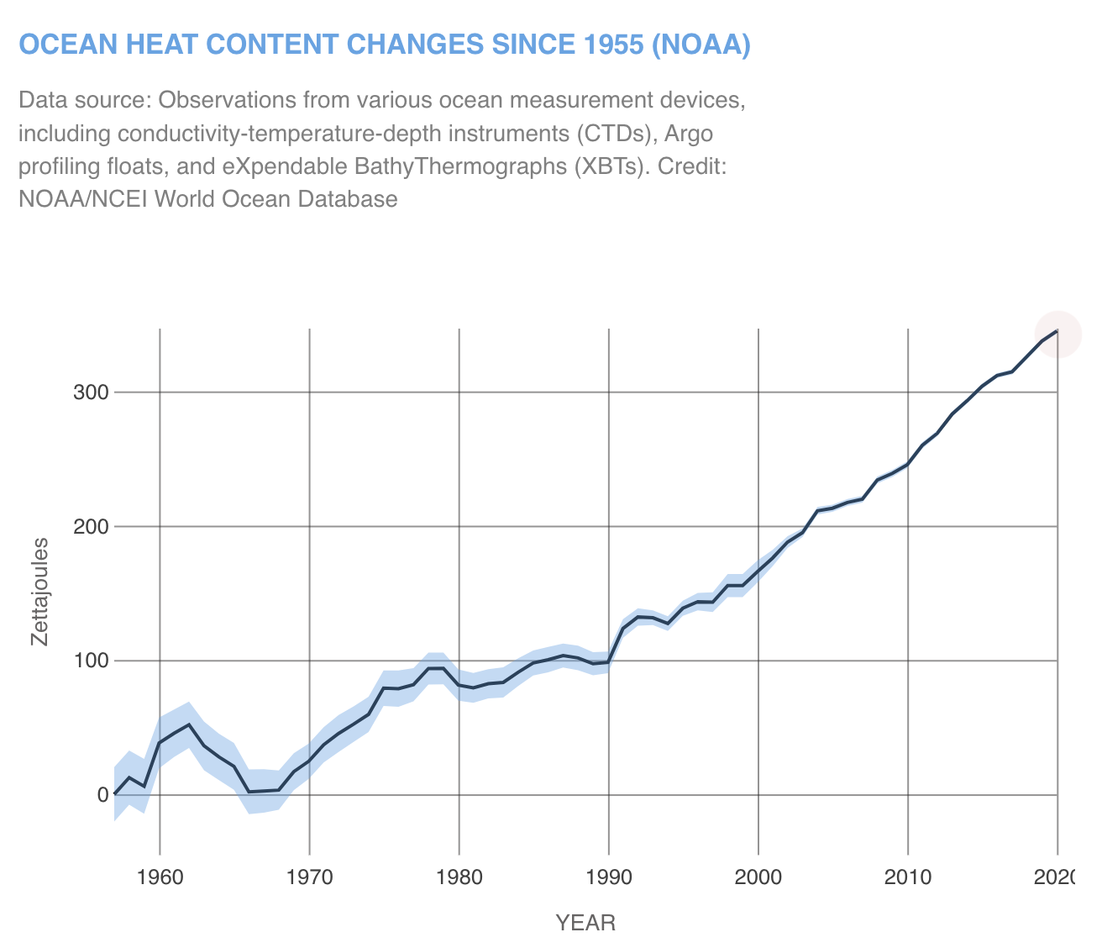
NOTE: More “Petajoules” = warmer
What is the graph measuring?
How is it measuring it?
Make a statement about the Earth’s whole climate based on this graph
From: nasa.gov
Notes:
Answers to look for:
Measuring the average temperature of the oceans over the last 60 years
Like some kind of ocean thermometer
The earth’s oceans have been getting hotter over the last 50 years

Slide 46
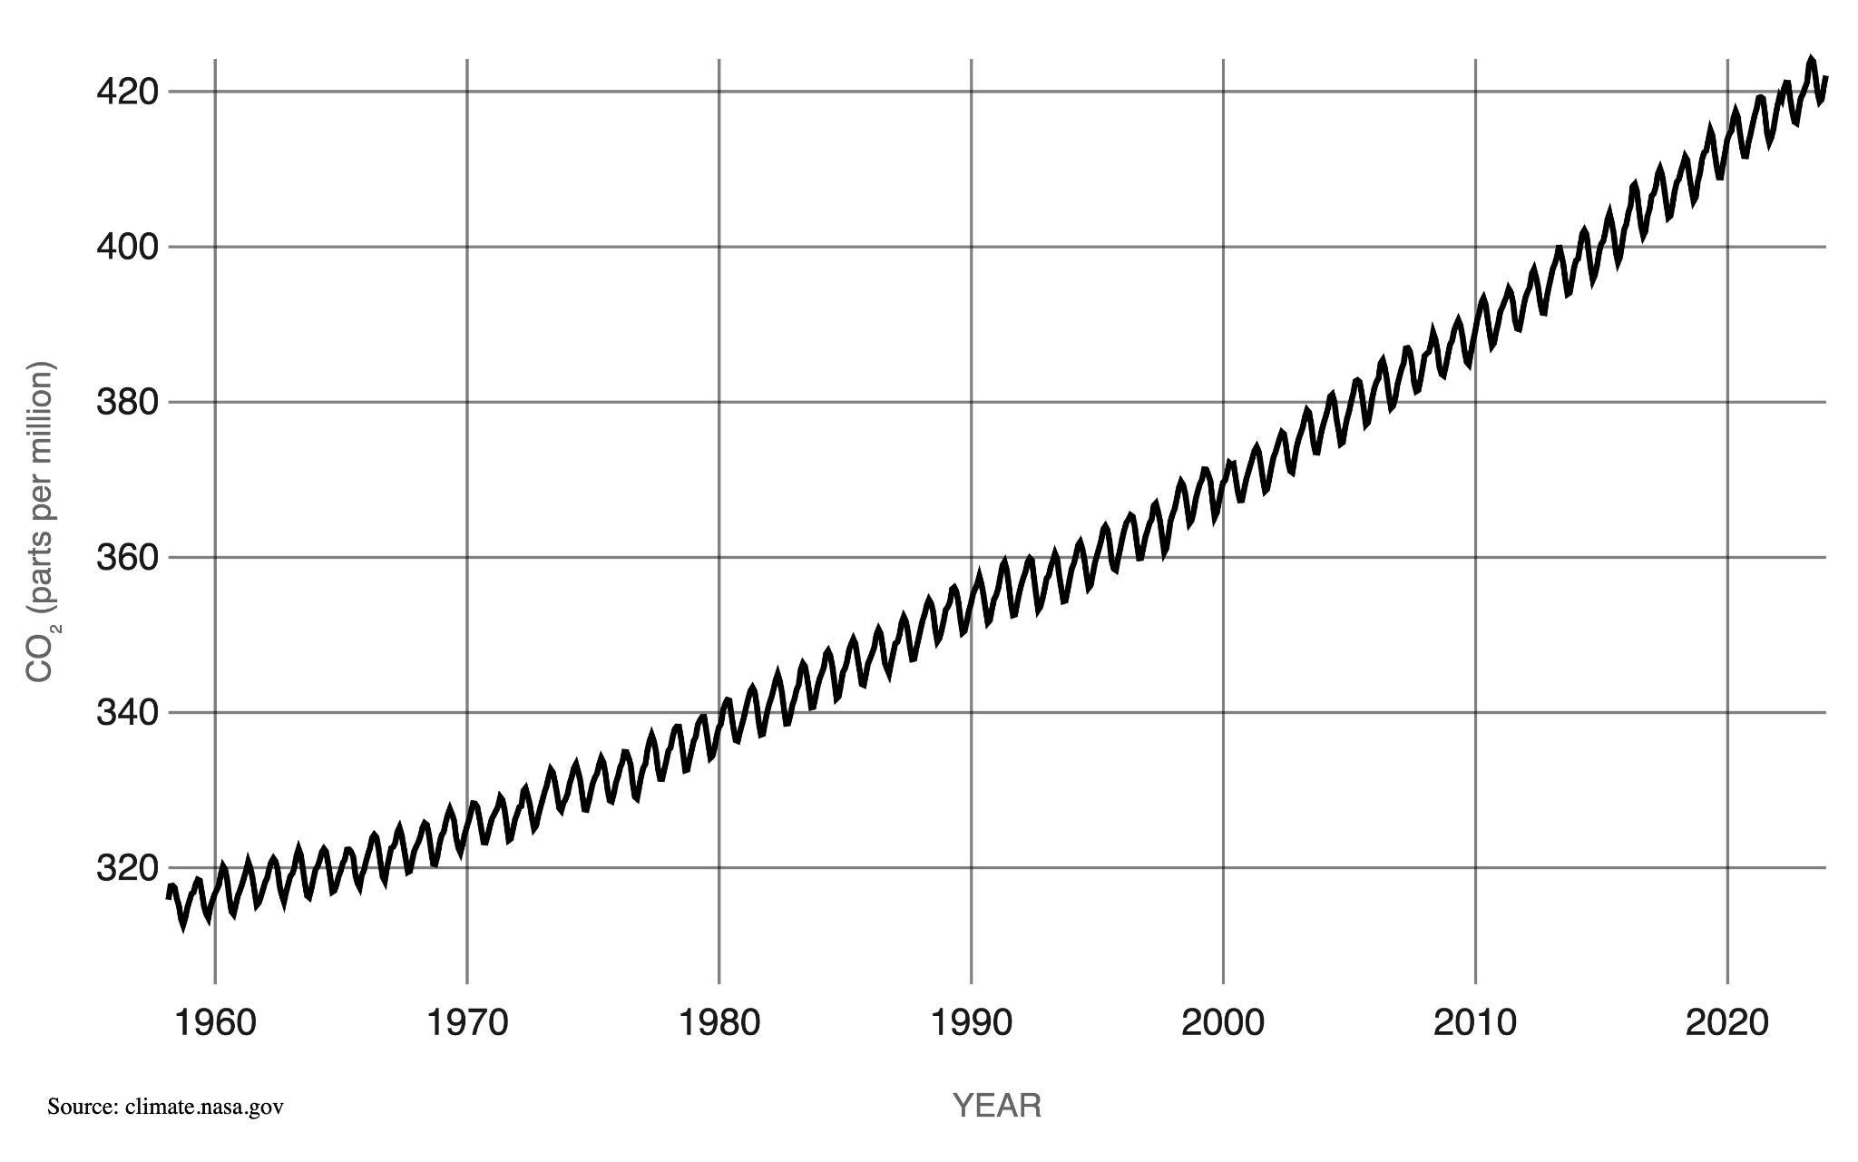
NOTE: CO2 = Carbon Dioxide. It’s what we breathe out, and what burning gas and coal creates.
What is the graph measuring?
How is it measuring it?
Make a statement about the Earth’s whole climate based on this graph
From: nasa.gov
Notes:
Answers to look for:
Measuring the amount of CO2 in the atmosphere over the last 60 years
Some kind of air filter or air molecule reader
The earth’s atmosphere has more CO2 in it now than it did in 1960

Slide 52
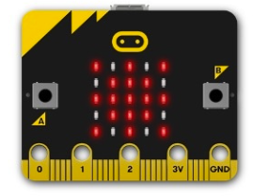
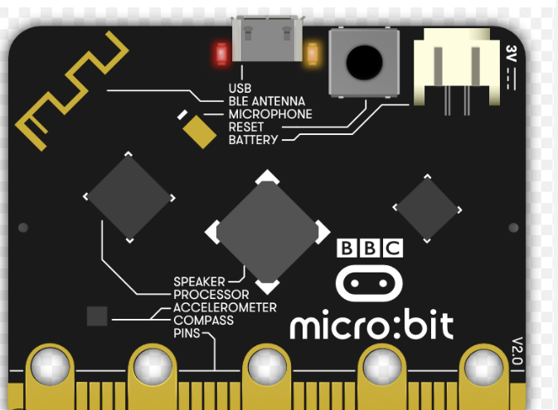
Understanding the Microbit

Slide 53
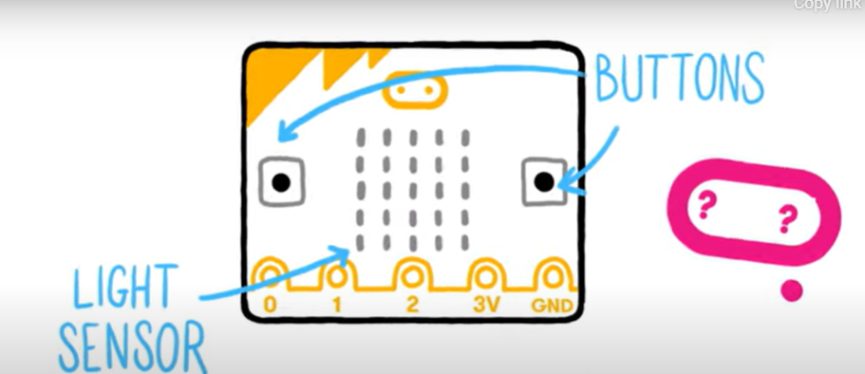
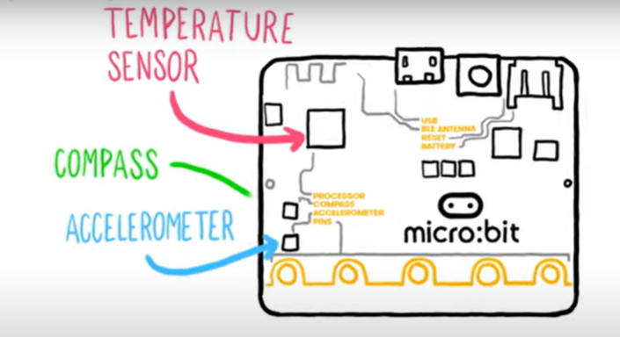
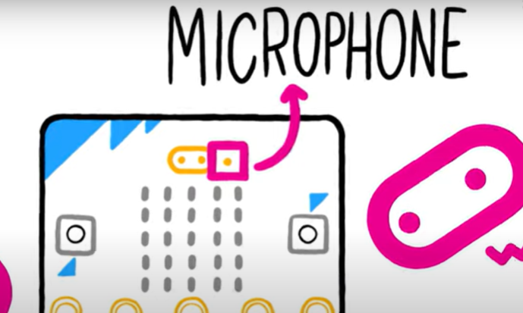
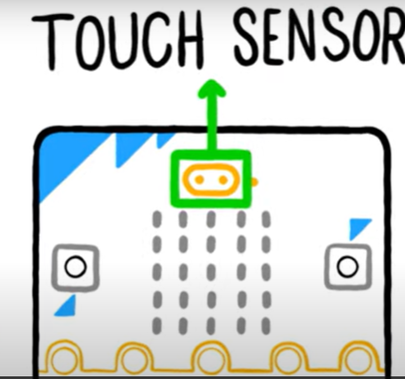
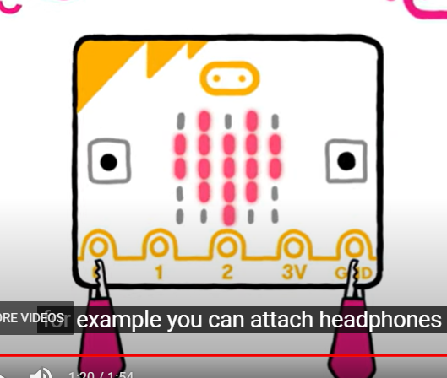
hLEDs and buttons
sound output
radio and pins
inputs and outputs
sensors
Data logging
sound input
Schematics

Slide 54
Beginner Tutorials (video, pdf and slideshow)
https://mit-cml.github.io/explore/ai2/beginner-videos.html
Using Alexa with MIT App Inventor
https://www.youtube.com/watch?v=l7Jw-Eps_Hs
Share your app with friends
https://mit-cml.github.io/explore/ai2/share.html
Other Tutorials
https://mit-cml.github.io/explore/ai2/tutorials.html
Importing Data
YouTube Channel for MIT App Inventor

Slide 55
More Resources
PDF’s, tutorials, videos
App Inventor Library

Slide 56
TEAM TALK
Talk about Ideas for projects before MTS (Meet the Scientist)
How will you use the MIT App Inventor
What elements will it have?

