Slide 1
Intro To artificial Intelligence!
Notes:
Okay, so this class is all about artificial intelligence.

Slide 2
Key points
Throughout the lesson, these are the key points to emphasize…
Most AI is made up of 3 components: a dataset, an algorithm, a prediction
These 3 components can be used as criteria to evaluate if a technology is AI or not.
A dataset is a collection of curated data
Data can be images, videos, music, text, gestures, etc., really any collection of information
Notes:
For Teacher Reference (not student facing)

Slide 3
What does
“Artificial Intelligence”
make you think of?
Notes:
Have you heard this word before? What do you think it means? What does it make you think of?

Slide 4
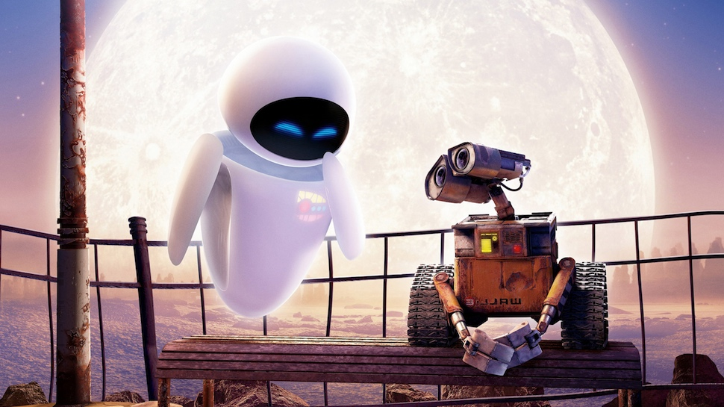
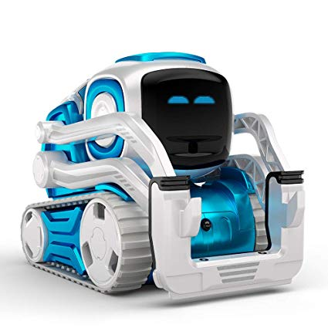
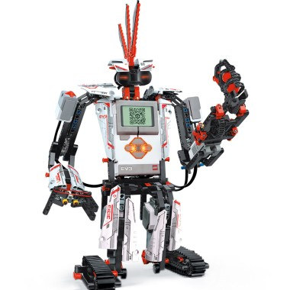

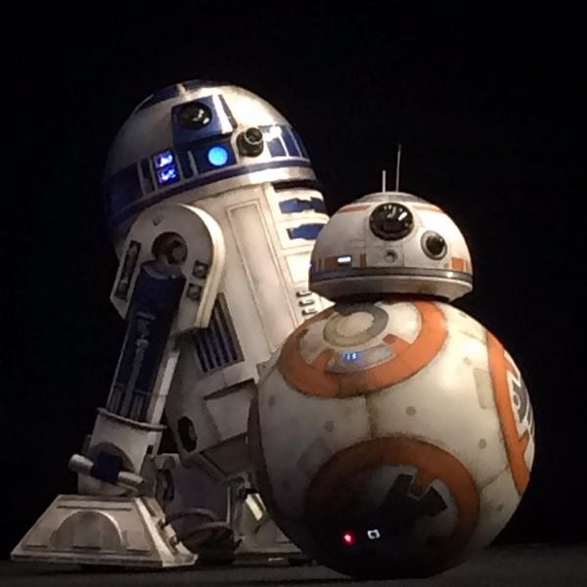

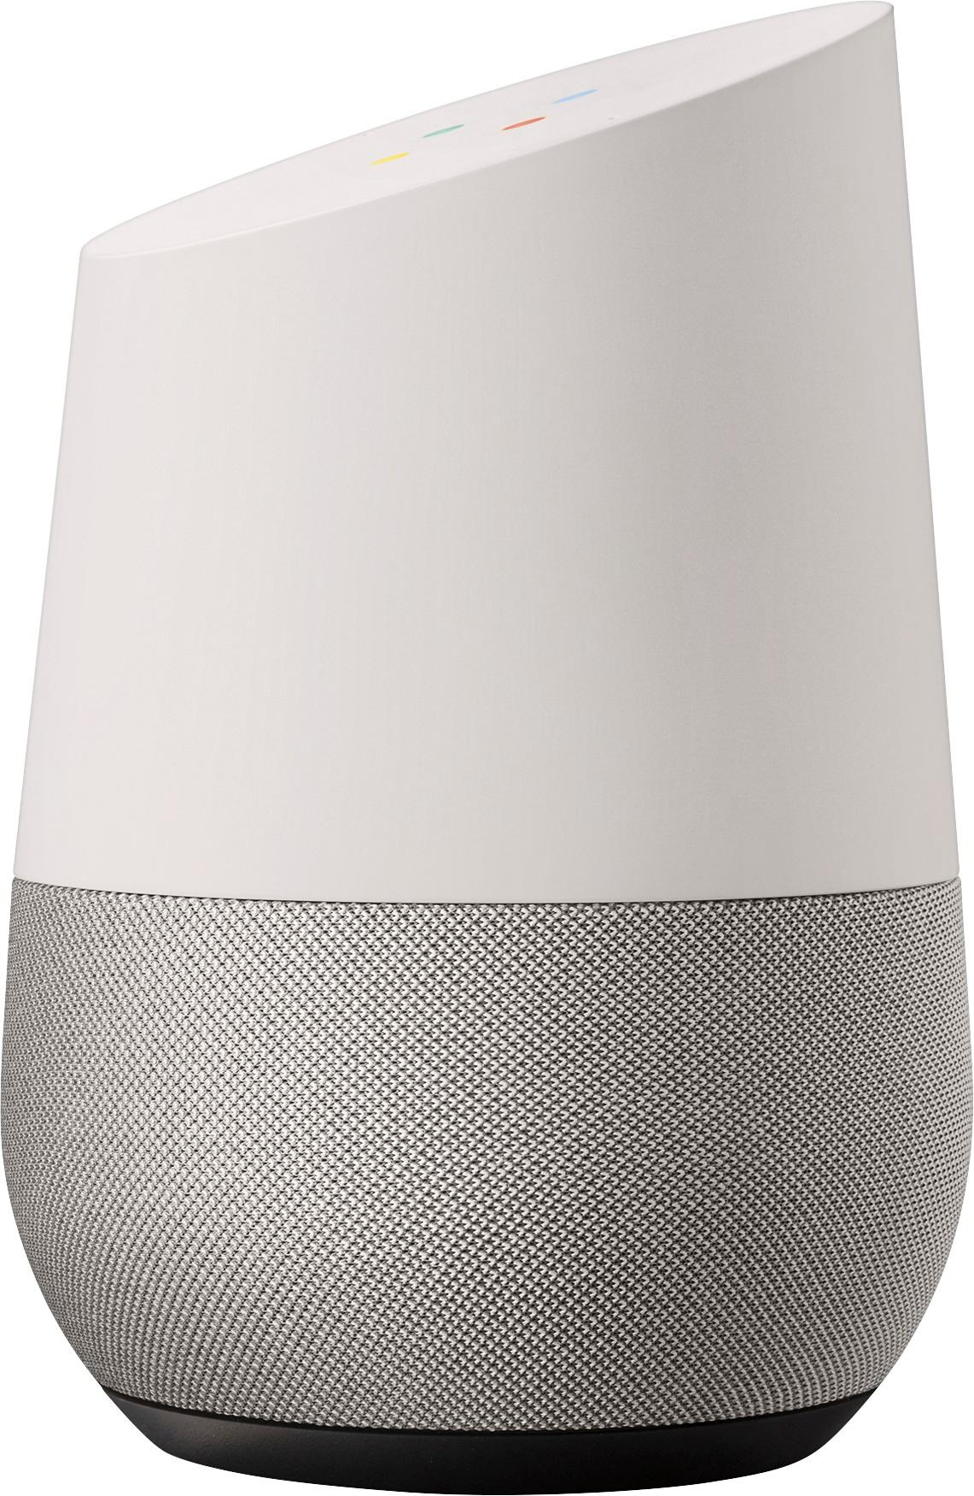
Notes:
So most people think of artificial intelligence as robots. Does anyone recognize these robots here? Which one is your favorite? Write them in chat, or say it out loud.

Slide 5

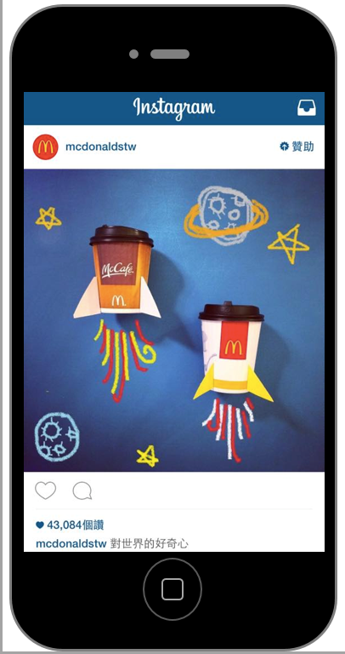
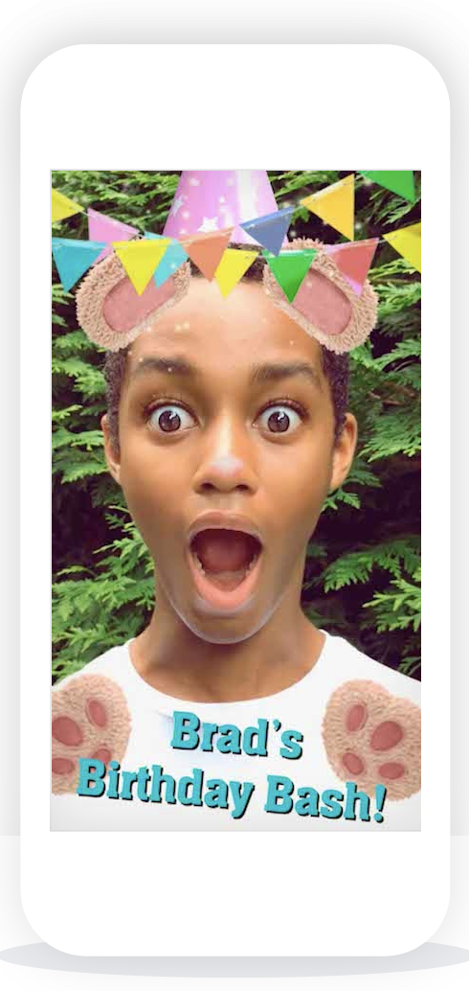
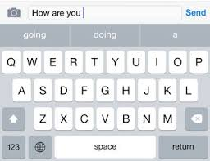
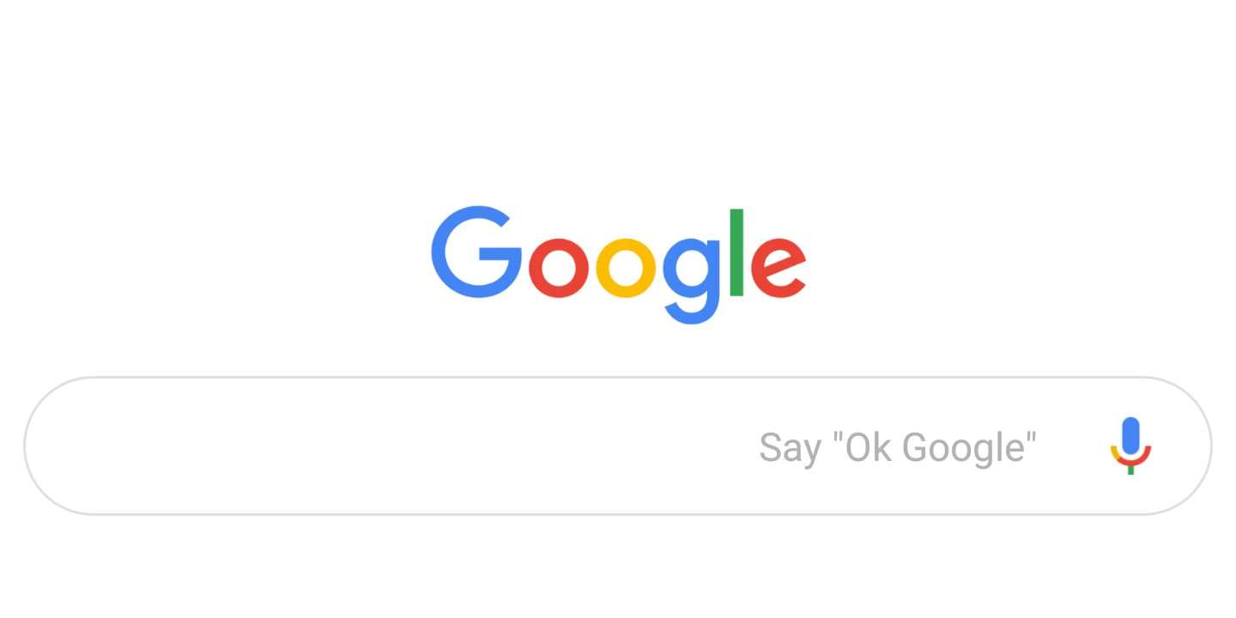
Notes:
Robots are my favorite type of AI, but they aren’t the only type. AI is actually present in many technologies that we use every day. For example, it is found in YouTube, in text messaging, our instagram and tiktok feeds, and in camera filters. AI can be categorized as something that uses data to make a prediction about something. Let’s explore that more.

Slide 6
"Making computers perform “intelligent” tasks such as recognizing things, understanding them, and making decisions about them."
Notes:
AI is defined as "Making computers perform “intelligent” tasks such as recognizing things, understanding them, and making decisions about them."
AI can be categorized as something that uses data to make a prediction about something. Let’s explore that more.

Slide 7
Parts of machine learning
learning algorithm
prediction!
dataset
Notes:
Most types of AI can be broken down into 3 parts. A Dataset, a learning algorithm, and a prediction. We’ll go more into detail to each one of these. The goal of an algorithm is to make a prediction about something.

Slide 8
Parts of machine learning
dataset
Notes:
Has anyone heard of a dataset before? What does it make you think of?

Slide 9
What is a
“dataset”?

Slide 10
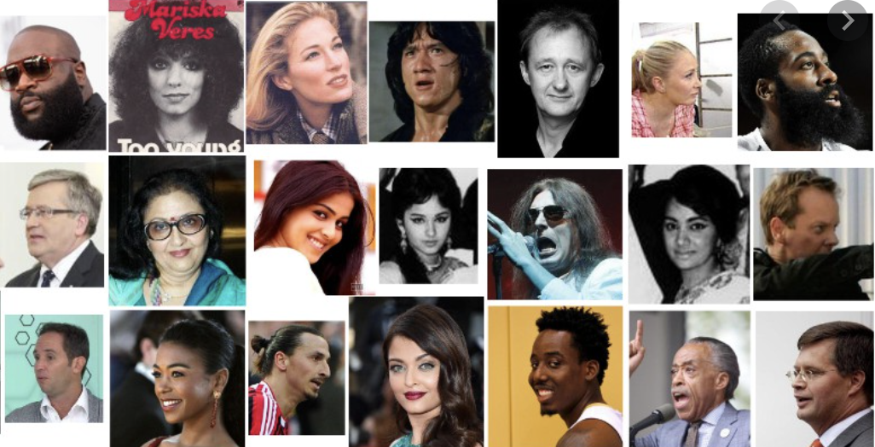
Datasets
A dataset is a collection of curated data
Images
Measurements (time, views, inches, etc)
Text
Video recordings!
VGG Face2 Data Set– paperswithcode.com
Notes:
A dataset is a collection of data that you put together. Data can include anything! We typically think of data as numbers, but it could also be a collection of text, video, or images.

Slide 11
Parts of machine learning
dataset
Notes:
So, a dataset gets fed into a learning algorithm in order to make a prediction.

Slide 12
Parts of machine learning
dataset
learning algorithm
Notes:
Does anyone know what an algorithm is?
An algorithm also includes three parts: input, steps to change the input, and then output. For example, adding a contact to your phone is kind of like an algorithm. You take a contacts name and phone number, you put it into your address book, and you get out a new contact.

Slide 13
Algorithm
learning algorithm
prediction!
dataset
Notes:
The last part of AI is a prediction. This can be anything such as what YouTube video you might like or what a face is for a filtering app.

Slide 14
Let’s try some examples
Notes:
Let’s put it all together with some examples!

Slide 15
Instagram advertisement
prediction?
Notes:
What is instagrams algorithm trying to predict? Think about what kinds of ads you get?

Slide 16
Instagram advertisement
What you will click on

Slide 17
Instagram advertisement
learning algorithm
What you will click on

Slide 18
Instagram advertisement
learning algorithm
What you will click on
dataset?
Notes:
What kind of dataset do you think this learning algorithm is learning from… do you notice patterns?

Slide 19
Instagram advertisement
learning algorithm
What you will click on
Past clicks
Brands you follow and people like you
Text in captions

Slide 20
EMAIL SpAM filter
learning algorithm
prediction!
dataset

Slide 21
EMAIL SpAM filter
prediction?

Slide 22
EMAIL SpAM filter
If email is spam or not

Slide 23
EMAIL SpAM filter
learning algorithm
If email is spam or not

Slide 24
Email Spam Filter
learning algorithm
If email is spam or not
dataset?

Slide 25
Email spam Filter
learning algorithm
If email is spam or not
Past emails you have labeled as spam
Text of emails

Slide 26
AI or not??

Slide 27


Slide 28
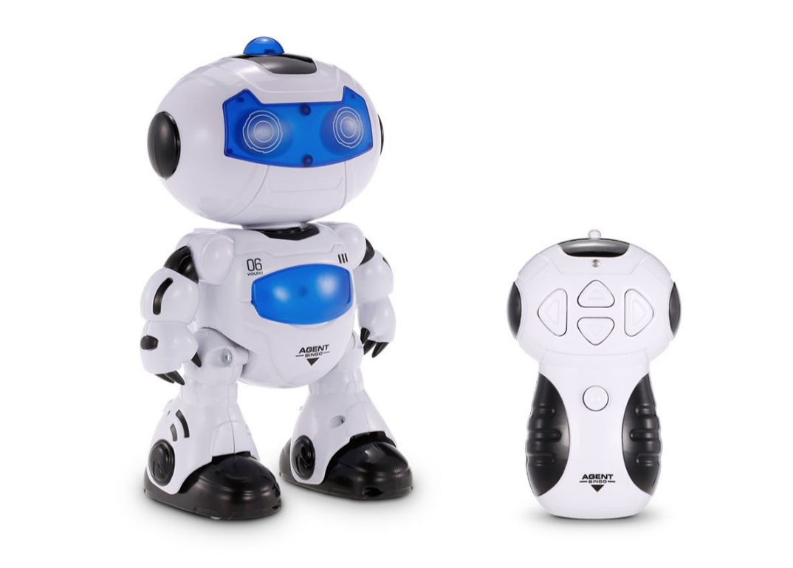

Slide 29
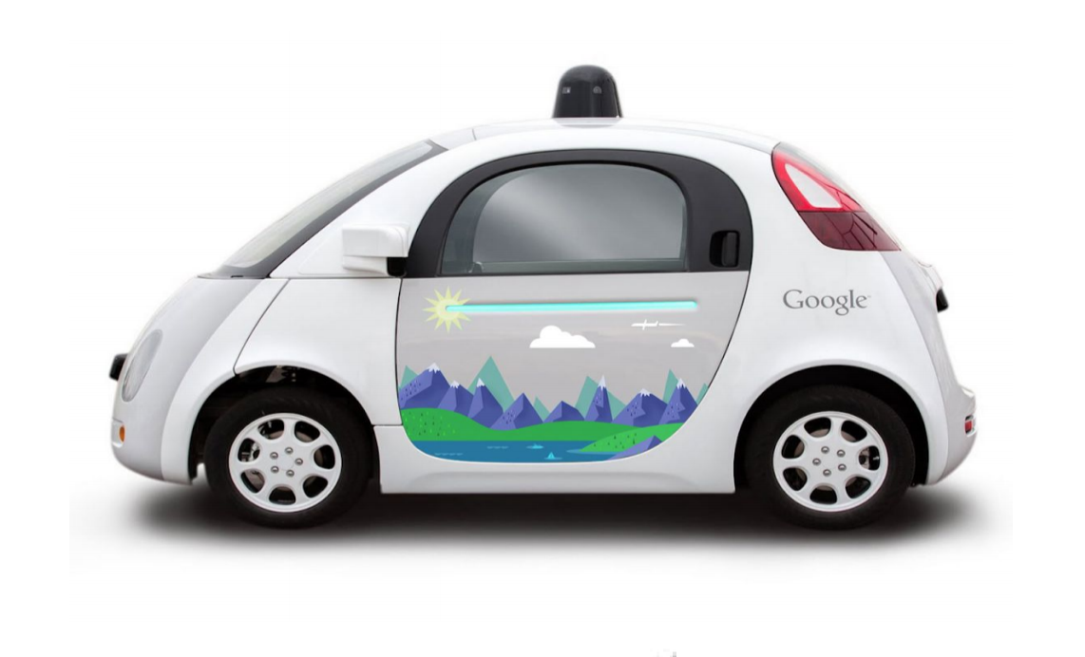

Slide 30
Dataset:
Prediction:

Slide 31
Dataset: routes that people have taken in the past
Prediction: how to get somewhere

Slide 32
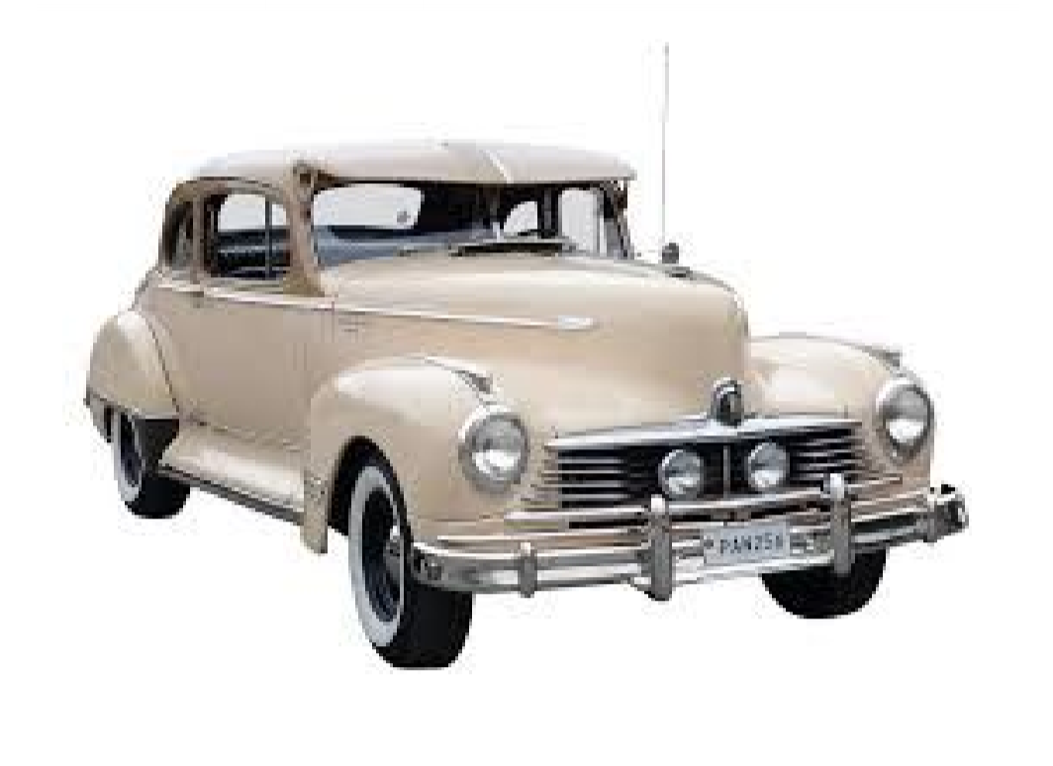

Slide 33
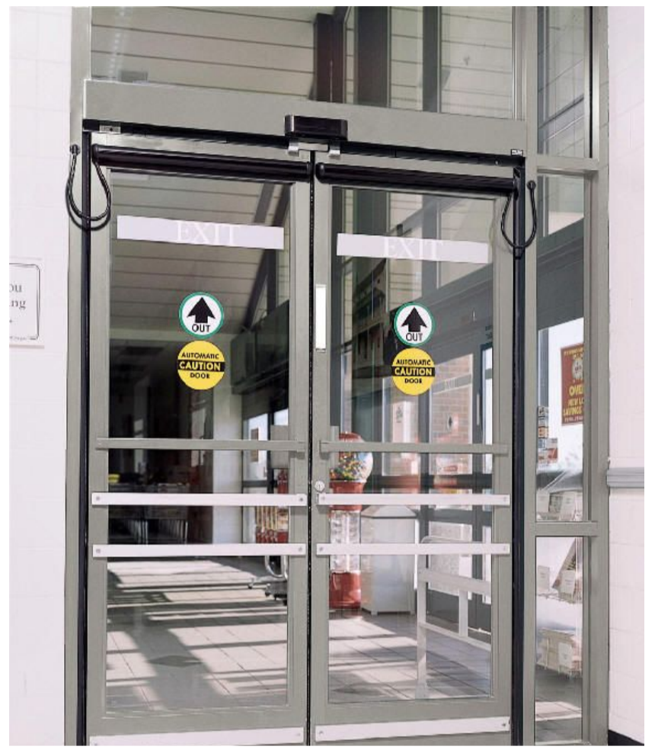

Slide 34
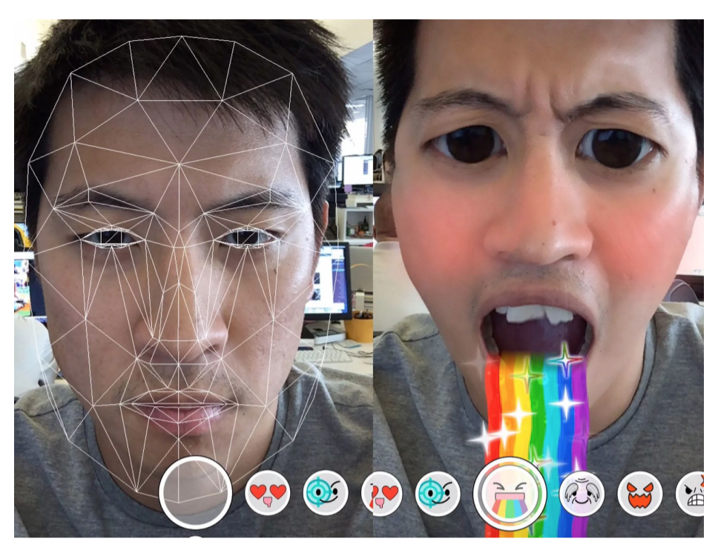

Slide 35
Dataset:
Prediction:

Slide 36
Dataset: examples of faces
Prediction: where to put the filter on your face

Slide 37
Now LET’S try! AI or NOT
Notes:
https://docs.google.com/drawings/d/14MishT_CR5fDTfQ5ZE77HXhf-75QRHh0besj59L6Aes/edit

Slide 38
Let’s talk about FAIRNESS
Notes:
Welcome back!
In this lesson, we are going to discuss fairness and what it has to do with classification by humans and by machines. Our goals are to learn about the potential for bias in AI and be able to use a fairness rubric to investigate bias in AI.

Slide 39
Key points
Throughout the lesson, these are the key points to emphasize…
Algorithmic bias creates repeated errors, misrepresentations, and inaccuracies that give unfair advantages to some and disadvantages to others.
Algorithmic bias risks harming disadvantaged users and stakeholders.
Algorithmic bias can be introduced into a computer system without the creator knowing.
There are ways to minimize (and in some cases remove) algorithmic bias.

Slide 40
OUTLINE
What do we mean by “fairness”?
Classification by humans and by machines
GOALS
Learn about the potential for bias in AI
Learn about and apply the fairness rubric
Notes:
Next, we are going to discuss fairness and what it has to do with classification by humans and by machines. Our goals are to learn about the potential for bias in AI and be able to use a fairness rubric to investigate bias in AI.

Slide 41
What does
FaiR
mean to you?
Notes:
First, let’s talk about “fairness” - what does it mean to be “fair” to you?
[wait for student responses]
Note that “fairness” has not been conclusively defined in the AI community.

Slide 42
What do we mean by “fair” ?
Fair = Does not create discriminatory or unjust impacts when comparing across different demographics (such as race, gender, age)
Fair = Absence or minimization of bias
Fair = Not favoring one over another
Notes:
Let’s look at how others might define “fair”. One group called FAT/ML which stands for “Fairness, Accountability, and Transparency in Machine Learning”, developed a road map for initial discussions of the fairness” of algorithmic decisions.
To them, “Fair” means an algorithm
does not create discriminatory or unjust impacts when comparing across different demographics (such as race, gender, age)
does not favor one group over another.
has an absence or minimization of bias.
There’s a related word “bias” …. What does bias mean to you?
[wait for student responses]

Slide 43
What do we mean by “bias” ?
Bias = giving advantage (or disadvantage) to one group over others.
Bias = prejudice in favor of or against one thing, person, or group compared with another, usually in a way considered to be unfair.
Notes:
When we talk about bias, we mean
giving advantage (or disadvantage) to one group over others.
Having a prejudice in favor of or against one thing, person, or group compared with another, usually in a way considered to be unfair.
So they are kind of opposites
One way to be unfair is to be biased.
When something is Biased, it is considered unfair.
(optional) Are there other ways to be unfair? Is it more than being unbiased?
[wait for student responses]
There are some conditions when giving everyone the same amount (being unbiased) is not considered fair. What if someone hasn’t had enough to eat for months while others ate yesterday? Would giving everyone the same amount of food be fair? Why or why not?
[wait for student responses]

Slide 44
Why should
we care?
Notes:
Why should we care about bias in AI?
[wait for student responses]
Right! Bias (in AI) impacts all kinds of things in everyday life. Things like
Who gets seen / recognized by machines?
Who gets paroled or held?
Who gets shown information or not?
Who gets loans or is denied?
Who gets interviewed for a job or passed over?

Slide 45
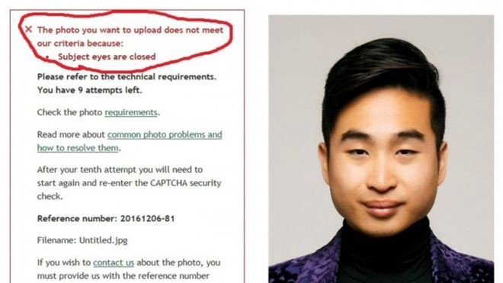
Case study 1: facial analysis
Notes:
Let’s look at some examples…
Here’s an example:
This person is applying for a job and is asked to submit a photo.
He submits a photo but gets the following message…. “The photo you want to upload does not meet our criteria because: Subject eyes are closed”
https://www.reuters.com/article/us-newzealand-passport-error-idUSKBN13W0RL

Slide 46
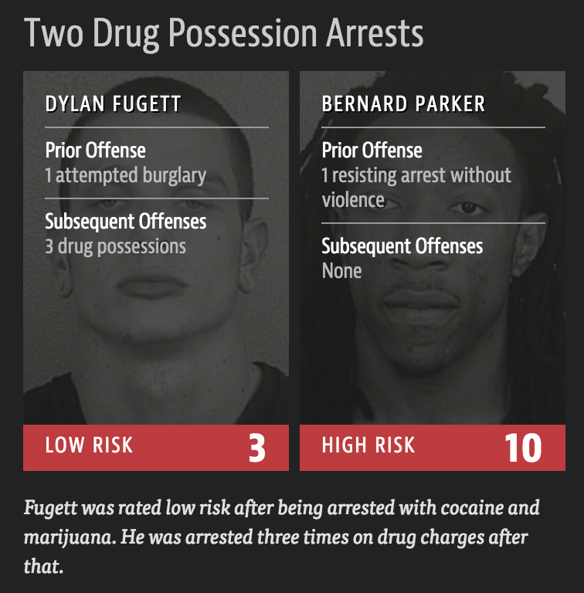
Case study 2: predictive policing
 | WHITE | AFRICAN AMERICAN
Labeled Higher Risk, But Didn’t Re-Offend | 23.5% | 44.9%
Labeled Lower Risk, Yet Did Re-Offend | 47.7% | 28.0%
Notes:
Here’s another example. A program was used to assess risk for re-offending, and thus whether or not a person was granted parole. There are many problems here - even though race was not used as a factor in deciding whether or not someone was paroled, things like zipcode were. But one’s zipcode in this case was a stand-in for race and the person who lives in a zipcode associated with a Black population was labeled as high-risk of reoffending.
Read more on ProPublica.org and
see the article: https://www.propublica.org/article/machine-bias-risk-assessments-in-criminal-sentencing
https://review.law.stanford.edu/wp-content/uploads/sites/3/2018/06/70-Stan.-L.-Rev.-1343.pdf
Life, Liberty, and Trade Secrets: Intellectual Property in the Criminal Justice System

Slide 47
Case study 3: word embeddings
airplane
boat
mouse
cat
dog
table
word2vec models are trained on current news articles
to numerically represent closeness of word meanings.
Notes:
In this example, an AI model called “Word2vec” was trained on a bunch of text data (such as articles and papers) to develop clusterings of words based on how words are used and where they appear in text. It arranges words in space based on these similarities. In this diagram we see the words cat, dog, and mouse clustered together which makes sense, they are all animals. Similarly, airplane and boat are close together because they are both vehicles.

Slide 48
Case study 3: word embeddings
man
woman
king
queen
“man” is to “king”
as “woman” is to “_________”
Notes:
One interesting discovery is that you can draw analogies using word2vec. For example, if you know the vector from man to king, you can apply it to woman and find that “queen” is an analogous term for a female ruler..
https://www.tensorflow.org/images/linear-relationships.png

Slide 49
Case study 3: word embeddings
man
man
woman
woman
king
queen
computer programmer
homemaker
biases in the data are replicated in the word representations,
for example for career choices
Notes:
But, as you can see here, this can be biased. Try “man is to computer programmer as woman is to ___” and you get homemaker! A lot of people were surprised to see sexist or racist results. But they are based of language in articles and texts.
ONE takeaway is that we expect AI algorithms to be better and more correct than humans, but they are trained on the same data that humans see to learn about the world and make decisions. And historically, these have been biased and this system reproduces that bias.

Slide 50
Any questions, comments?
Notes:
Instructor [Slide 35]: Are you surprised by this? Do you have any questions or comments?

Slide 51
KEY points to keep in mind
People are realizing the impact of bias on certain population and are taking a stand.
Big tech is getting out of the facial recognition business and will not sell it to police.
We need diversity in tech especially AI. The teams that make AI technologies need to look like the population the technology will serve.
Notes:
Instructor: However, it’s not a hopeless situation.
For one, big tech companies are realizing the impact of bias on certain populations, and are making changes and taking a stand against those biases.
For instance, Microsoft and Amazon, among other tech companies, announced they will get out of the facial recognition business or not sell the technology to the police.
Second, we can also increase diversity so the teams that make these technologies look like the population the technology will serve. For example, if Black and Asian people were on the teams creating and testing facial recognition or predictive policing software, then we think some of the biases with these technologies could have been avoided.
Finally, The MIT Media Labs and STEAM Ahead are investing time into teaching and exposing students to STEM (including AI) with the hope that they will go into the STEM field and create change.

Slide 52
REVIEW
Both humans and machines interpret the world through building knowledge structures.
Classification is key to building these structures.
Notes:
Let’s review… both humans and machines interpret the world and build knowledge structures. And classification is key to building these structures. Recall in PastaLand we built a decision tree that captured our classification of pasta. The features we chose might be good at representing one set of pasta but not another set…. AI does the same - it builds a representation based on data it was given.

Slide 53
Does
classification
=
stereotyping ?
Notes:
Does classification equal stereotyping?
[wait for student responses]

Slide 54
Two Key Fairness Questions:
“Are there particular groups which may be advantaged or disadvantaged by the algorithm or system you are building?”
“What is the potential damaging effect of uncertainty and/or errors to different groups?”
Notes:
As we saw before, something is considered “fair” when it does not create discriminatory or unjust impacts.
Here are two key questions to ask when you are creating with AI.
“Are there particular groups which may be advantaged or disadvantaged by the algorithm or system you are building?”
“What is the potential damaging effect of uncertainty and/or errors to different groups?”

Slide 55
AI Investigation
What did you investigate?
What did you find out?
Who was represented? Who was left out?
Was the result accurate? Is it fair?
Why do you think this happened?
What are the implications? (potential for harm)
What could be done about it?
Notes:
… and here’s a set of investigation questions we can use to determine if the AI system we are using is “fair” to us.
We will use this to determine whether some AI systems that we use are “fair”.
(Lingering question ---
How to adjust the words and questions here to make the rubric more accessible, appropriate and can be related to students?)

Slide 56
Systematic Error Systematic error (also called systematic bias) is consistent, repeatable error that is not due to random chance but to an aspect of a project that leads to a repeated error. Some examples: faulty equipment flawed experiment design selection bias representation bias algorithmic bias | Personal Bias Personal Bias (also called opinions and attitudes) are believes that a thing, action, or person is better than others. Personal bias comes from prior experience and cultural knowledge. People may be unaware of their bias. Personal bias can lead to: personal preferences stereotypes incorrect judgements selection bias representation bias interaction bias algorithmic bias | Societal Bias Societal bias occurs when social biases become the norm. Social biases are positive or negative beliefs and are based on culture, history, and the social environment. Societal bias can lead to: racial bias gender bias historical bias cultural bias algorithmic bias

Slide 57
Identify the bias in this example (A):
Google image search for “physicist”
Notes:
[Slides 41-44]: Now you will have a chance to use this fairness rubric to investigate 4 AI tools. Here’s the first one…
Do a Google image search for “physicist”
Use Google translate to translate ”She is a doctor. He is a nurse” from English to Hungarian then from Hungarian and back to English.
Explore the faces dataset from QuickDraw.
Do a Google search for images of “outdoor recreation.”
Okay - pick one and use the rubric in Google classroom to take notes on your investigation, then use the rubric to discuss your findings. (10 minutes)

Slide 58
Identify the bias in this example (B):
Google translate ”She is a doctor. He is a nurse” from English to Hungarian then from Hungarian and back to English.
Notes:
[Slides 41-44]: Now you will have a chance to use this fairness rubric to investigate 4 AI tools. Here’s the first one…
Do a Google image search for “physicist”
Use Google translate to translate ”She is a doctor. He is a nurse” from English to Hungarian then from Hungarian and back to English.
Explore the faces dataset from QuickDraw.
Do a Google search for images of “outdoor recreation.”
Okay - pick one and use the rubric in Google classroom to take notes on your investigation, then use the rubric to discuss your findings. (10 minutes)

Slide 59
Identify the bias in this example (C):
Explore the shoes database from QuickDraw.
https://quickdraw.withgoogle.com/data/shoe
Notes:
[Slides 41-44]: Now you will have a chance to use this fairness rubric to investigate 4 AI tools. Here’s the first one…
Do a Google image search for “physicist”
Use Google translate to translate ”She is a doctor. He is a nurse” from English to Hungarian then from Hungarian and back to English.
Explore the faces dataset from QuickDraw.
Do a Google search for images of “outdoor recreation.”
Okay - pick one and use the rubric in Google classroom to take notes on your investigation, then use the rubric to discuss your findings. (10 minutes)
https://www.youtube.com/watch?time_continue=2&v=59bMh59JQDo
https://qz.com/1064035/google-goog-explains-how-artificial-intelligence-becomes-biased-against-women-and-minorities/

Slide 60
Identify the bias in this example (D):
Google search for images of “outdoor recreation.”
Notes:
[Slides 41-44]: Now you will have a chance to use this fairness rubric to investigate 4 AI tools. Here’s the first one…
Do a Google image search for “physicist”
Use Google translate to translate ”She is a doctor. He is a nurse” from English to Hungarian then from Hungarian and back to English.
Explore the faces dataset from QuickDraw.
Do a Google search for images of “outdoor recreation.”
Okay - pick one and use the rubric in Google classroom to take notes on your investigation, then use the rubric to discuss your findings. (10 minutes)

Slide 61
Investigate 1 of these examples to find the bias:
Google image search for “physicist”
Google translate ”She is a doctor. He is a nurse” from English to Hungarian then from Hungarian back to English.
Explore shoes database from QuickDraw.
Google search for images of “outdoor recreation.”
Notes:
[Slides 41-44]: Now you will have a chance to use this fairness rubric to investigate 4 AI tools. Here’s the first one…
Do a Google image search for “physicist”
Use Google translate to translate ”She is a doctor. He is a nurse” from English to Hungarian then from Hungarian and back to English.
Explore the faces dataset from QuickDraw.
Do a Google search for images of “outdoor recreation.”
Okay - pick one and use the rubric in Google classroom to take notes on your investigation, then use the rubric to discuss your findings. (10 minutes)

Slide 62
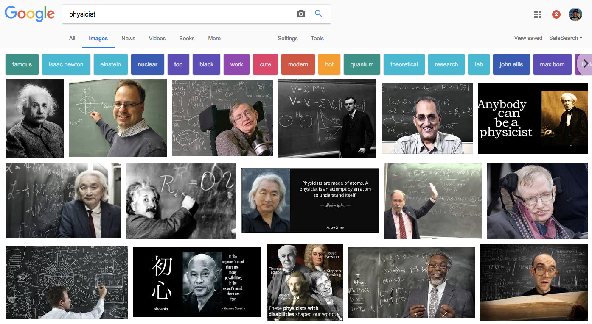
Historical / cultural bias
Notes:
[Slides 45-51]: Let’s discuss what you found out.
Go through each example and have students discuss what they found out and how they assessed the AI tool in terms of fairness. (10 minutes)
Historical/Cultural bias is bias that reflects our history or culture.
In this type of bias the algorithm incorrectly correlates ideas with gender, race, sexuality, income, etc.
This is an example of what comes up when you do a google image search for “physicist”
What’s the problem?
Why did this happen?
What’s a possible solution? Discuss.

Slide 63
Language / gender bias
Open Google translate; set input language to English, output language to Hungarian
Translate “She is a doctor, he is a nurse” to Hungarian
Notes:
[Slides 45-51]: Let’s discuss what you found out.
Go through each example and have students discuss what they found out and how they assessed the AI tool in terms of fairness. (10 minutes)
(Language) Gender bias: Translation (English -> Hungarian; Hungarian to English)
Hungarian Demo: https://www.google.com/search?q=Google+translate&ie=utf-8&oe=utf-8&client=firefox-b-1
Google translate could be using a semantic network similar to “Word2Vec” that we saw earlier.
In the texts it ingested, it was more likely that men were doctors and women nurses.

Slide 64
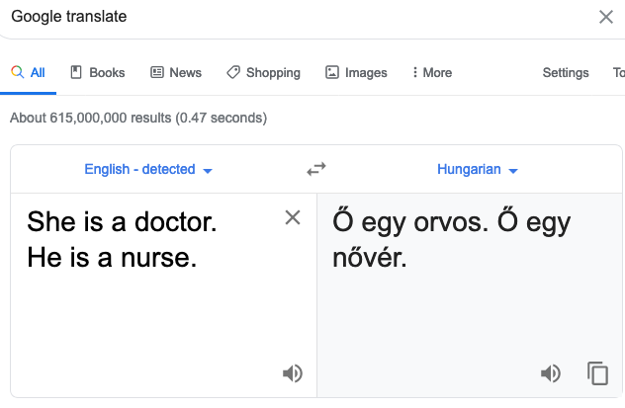
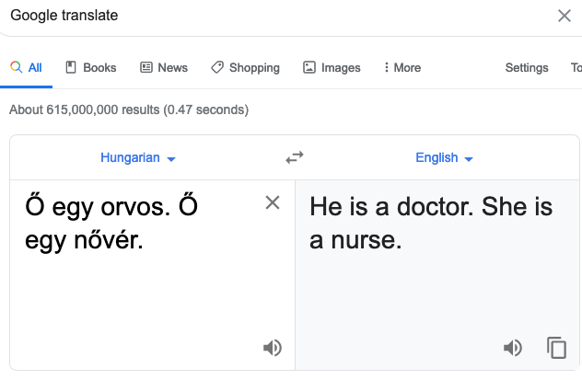
Language / gender bias
Notes:
[Slides 45-51]: Let’s discuss what you found out.
Go through each example and have students discuss what they found out and how they assessed the AI tool in terms of fairness. (10 minutes)
(Language) Gender bias: Translation (English -> Hungarian; Hungarian to English)
Hungarian Demo: https://www.google.com/search?q=Google+translate&ie=utf-8&oe=utf-8&client=firefox-b-1
Google translate could be using a semantic network similar to “Word2Vec” that we saw earlier.
In the texts it ingested, it was more likely that men were doctors and women nurses.

Slide 65
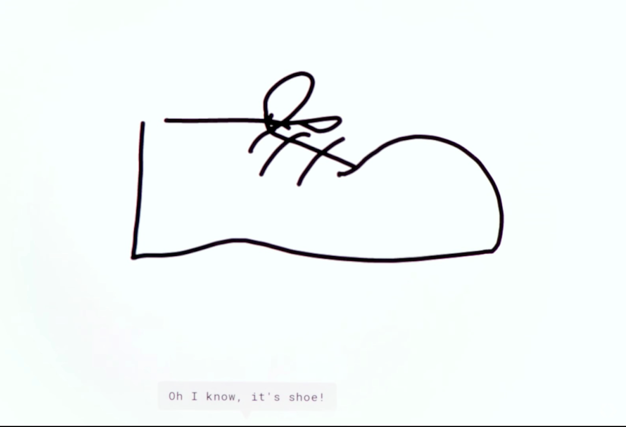
User Interaction bias
Draw a shoe
Notes:
[Slides 45-51]: Let’s discuss what you found out.
Go through each example and have students discuss what they found out and how they assessed the AI tool in terms of fairness. (10 minutes)
Interaction bias: The user biases an algorithm by the way we interact with it. As an example, Google asked users to draw a shoe. Users drew a man’s shoe, so the system didn’t know that high heels were also shoes.
Quick draw app and data set.
(Interaction) shoe data base (bring it into facets)

Slide 66
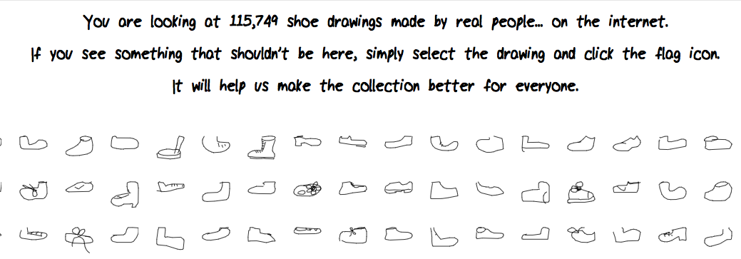
User Interaction bias
Example
Notes:
(Interaction) shoe data base (bring it into facets)

Slide 67



User Interaction bias
Will it recognize these as shoes?
Notes:
(Interaction) shoe data base (bring it into facets)

Slide 68

Representation bias
Notes:
[Slides 45-51]: Let’s discuss what you found out.
Go through each example and have students discuss what they found out and how they assessed the AI tool in terms of fairness. (10 minutes)
Google image search for “recreation”
Who is it showing participating in outdoor recreation?

Slide 69
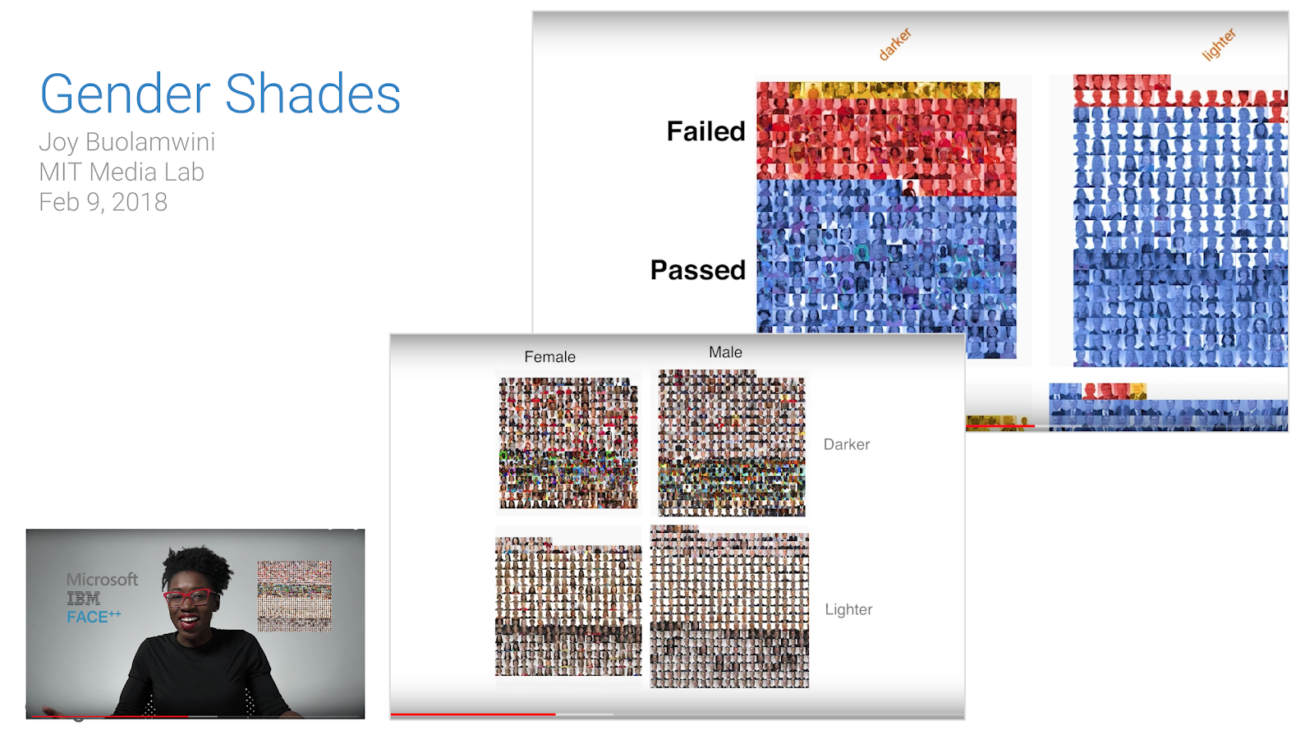
Selection bias
Notes:
Joy Buolamwini, a MIT researcher, uncovered bias in commonly used facial recognition systems. She found that the data used to train the facial recognition algorithm over-represents one population, making it operate better for them at the expense of others.
For example, if an image recognition is trained only on white people, will it recognize other people?
[wait for student responses]

Slide 70
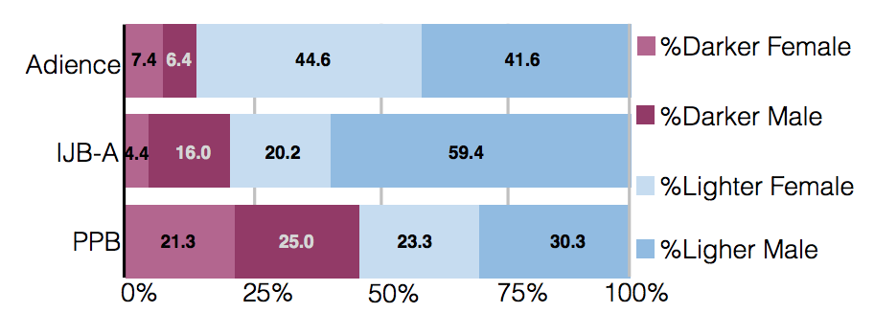
SELection bias
common facial analysis benchmarks are not representative
How well do commercial facial analysis programs work?
(Buolamwini & Gebru, 2018)
Notes:
Machine vision systems used in face detection applications (Adiance, IJB-A, PPB) are not trained w/ balanced data sets and therefore did not recognize dark skinned women.
Here are three different facial analysis data sets. We can see the Adience set contains fewer images of darker males and females.
Buolamwini and Gebru found that Machine vision systems used in face detection applications are not trained w/ balanced data sets and therefore did not recognize dark skinned women. This is called “selection bias”

Slide 71
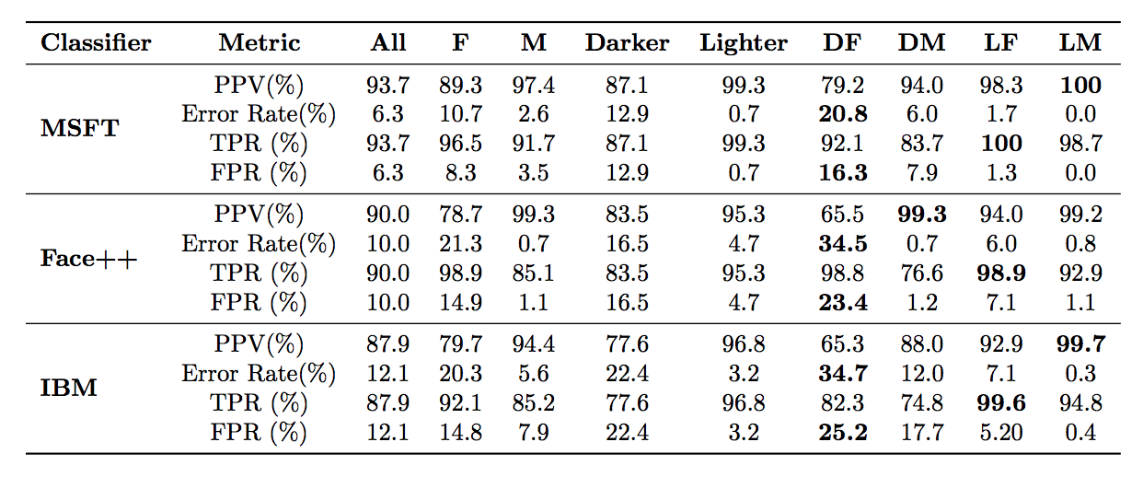
SELECTION bias
The error rate on darker female subset is much higher
How well do commercial facial analysis programs work?
(Buolamwini & Gebru, 2018)
Notes:
Here are three different classification algorithms (MSFT = Microsoft; Face++; and IBM) and how well they do on facial recognition (look at Error rate%). Note the performance (see error rate) is far worse on darker female subset of images.

Slide 72



Slide 73
AI videos of dead celebrities are horrifying many of their families
ChatGPT-maker OpenAI’s new tool lets users make realistic AI videos of dead public figures. A rush of crude and racist memes has followed.
October 11, 2025 at 6:00 a.m. EDT
Today at 6:00 a.m. ED

Slide 74
WHAT ARE THE COSTS AND BENEFITS OF AI?
Benefits of AI | Costs/problems with AI

Slide 75
WHAT ARE THE COSTS AND BENEFITS OF AI?
Benefits of AI | Costs/problems with AI
Could solve a math problem for you, could help you understand how to do the problem | Gives the wrong answer
Entertainment | Income inequality
Provide unavailable help to people | Only if it works correctly
Medical advances | Charges more according to your personal preferences
 | Contributes to global warming
Notes:
Created by intermediate students Saturday

Slide 76
WHAT ARE THE COSTS AND BENEFITS OF AI?
Benefits of AI | Costs/problems with AI
May create higher skill jobs | Take away jobs
Creative AI - produces interesting art | Spread misinformation (can affect politics, people, what else?)
Is a tool (like a telescope) that enhances human perceptions & understanding | Degrade our ability to think
Does it help or hurt in education? | Use (and magnify?) bias in data
Advances in medicine/science/technology | Use in war (drones, etc)
 | Contributes to economic inequality (AI pricing schemes)
 | Could be used to produce malware & hack computer systems
 | Threat to human survival

Slide 77
Mitigating / correcting bias
What are some relevant data sets?
Addressing Social Justice
Are you represented in the training set?
What are the implications?
How might you address the issue?
Notes:
Instructor [Slide 55]: There are ways we can correct or minimize this type of bias. We can seek to find more relevant data sets (for example, ones that have representation of the population) and we can investigate and fix representation in datasets.

Slide 78
4 ways of mitigating bias*
Learn from feedback and errors
Balance training data used to construct AI
Create new bias detection methods
Build open datasets and partnerships
Notes:
Instructor [Slide 56]: Here are things researchers are doing to mitigate or decrease bias.
Learn from feedback and errors (test your systems with many people)
Balance training data used to construct AI
Create new bias detection methods
Build an open datasets and partnerships

Slide 79
tons of Co₂
What it costs to train AI.
Notes:
Instructor: Welcome everyone, today we are going to talk about the environmental impact of training AI. We’ll talk about the title of this lesson (300 tons) in a moment. First, I have a question for you…

Slide 80
Key points
Throughout the lesson, these are the key points to emphasize…
Changing our behaviors can certainly help the environment, but our individual behaviors have a relatively small impact on the environment relative to the companies and governments training AI on big datasets.
To mitigate the environmental impact of AI, it is important to consider when training AI is necessary and understand that algorithms can be optimized to save some training time.
Notes:
For Teacher Reference (not student facing)

Slide 81
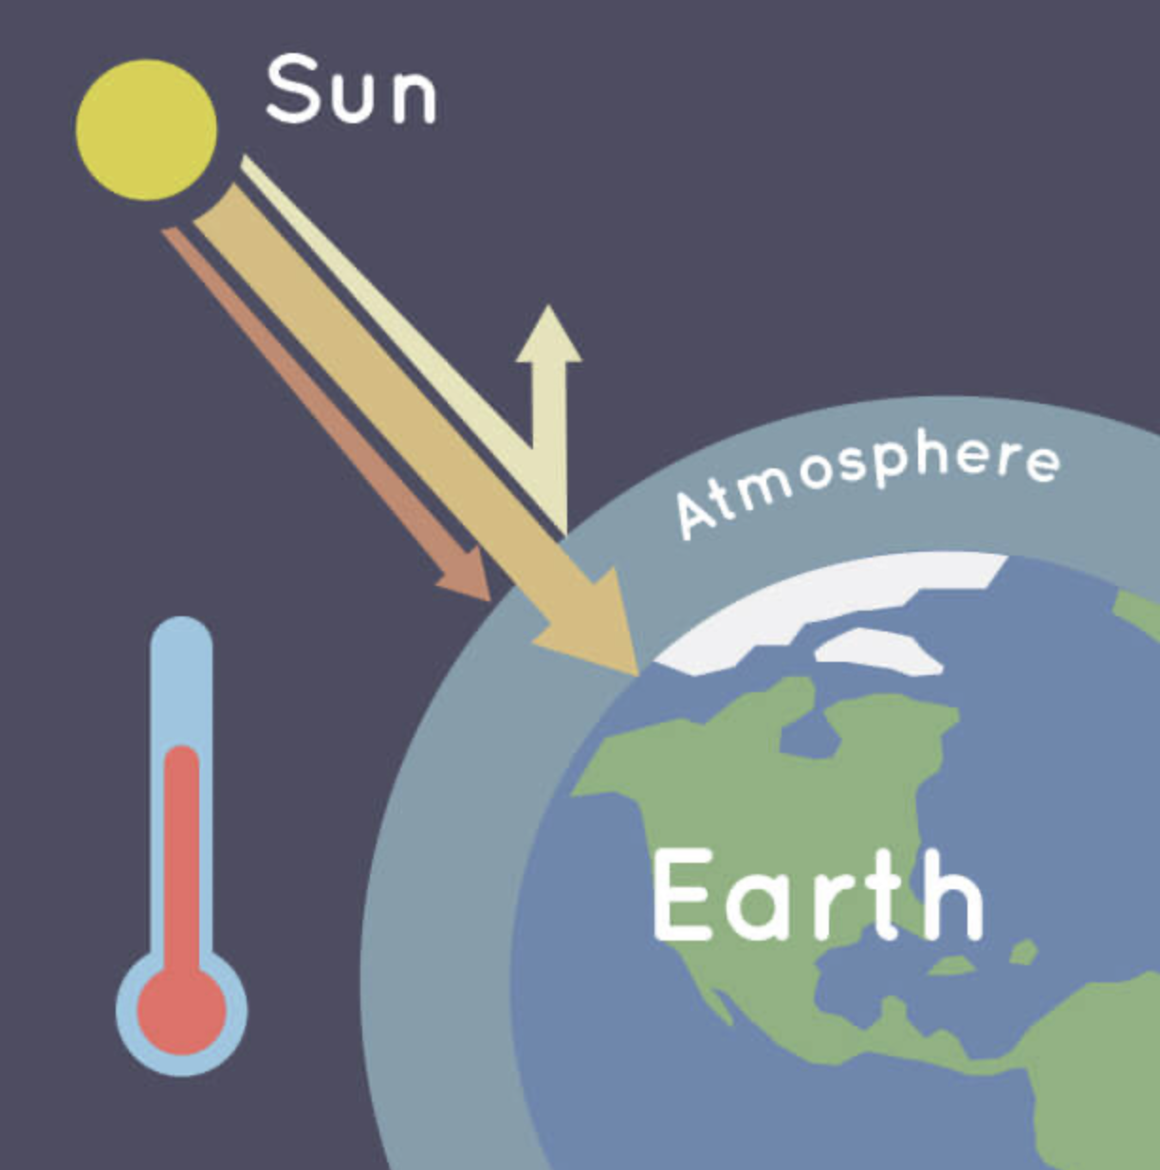
What is the greenhouse effect?
Notes:
Image credit: Credit: NASA/JPL-Caltech
Instructor: Has anyone heard about the term greenhouse effect the news, your science classes, or somewhere else? Can you tell me what they mean?
[Students may be more familiar with the phrase “global warming”. You may choose to modify this slide to ask “What is global warming?”
Answers in following slide]

Slide 82
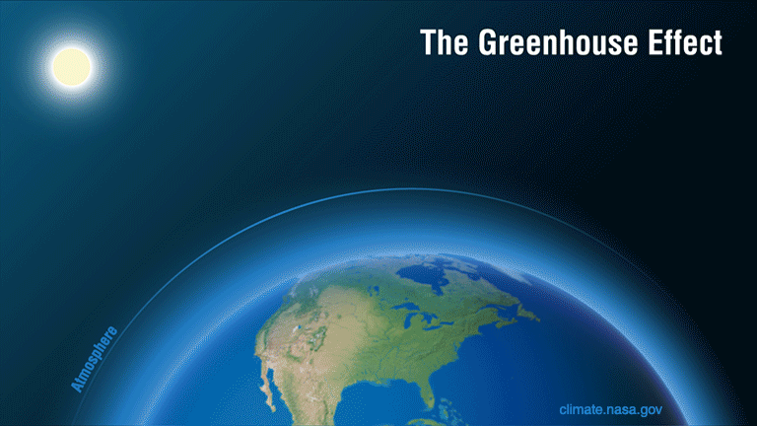
Notes:
Instructor: The greenhouse effect is the process by which the Sun’s heat is trapped by Earth’s atmosphere to warm up the temperature. (Sources: What is the Greenhouse Effect?, NASA: Weather, Global Warming and Climate Change)
It makes Earth a comfortable place to live.
However, when too much heat is trapped for a long time, the greenhouse effect causes the average temperature of the planet to increase, also known as global warming.

Slide 83
HAVE YOU HAD ANY EXPERIENCE WITH THE CONSEQUENCES OF global warming?
Notes:
Instructor: Have you (or anyone in your family) had any personal experience with the consequences of global warming?
Answers might include:
Elevated/lower temperatures
More natural disasters (fires, flooding, hurricanes, hirer tides)
Thank you for sharing. Do you think global warming is a good or a bad thing for the environment? Why or why not?
Answers might include:
Good make Earth warmer than space and habitable
Sea level to rise threatens cities and countries near the ocean.
Extreme drought and floods due to disruption of the water cycle threatens food distribution and human health.

Slide 84
To SUM UP
Greenhouse gas keeps Earth warm enough for plants and animals to live.
Too much global warming can be harmful.
Notes:
Instructor: Great points. To sum up, the greenhouse effect is necessary to some extent to keep Earth warm enough for animals and plants to live. However, human activities can release extra carbon dioxide that leads to global warming that can harm our planet in many ways. (One example is changes in the water cycle, which cause the sea level to rise and extreme weather to occur more frequently).
What human activities do you think can make global warming worse or more intense?
[Answers might include:
Burning fossil fuels like coal and natural gas
Deforestation through burning trees
Livestock farming
Fertilizers
… all of these are correct, but burning fossil fuels is the greatest contributor to global warming.
More info:
https://ec.europa.eu/clima/climate-change/causes-climate-change_en

Slide 85
training AI tools increases
global warming
Notes:
Instructor: One activity increases global warming is Training AI models. Why?

Slide 86
It costs 300 tons of carbon dioxide to train AI models like the one Google uses to make Google Translate.
Notes:
Instructor: Does anyone remember the Google translation activity we did in the Investigating Bias lesson? Remember the “She is a doctor, he is a nurse” example?
Yes, as we discovered, Google translate turned out to be biased about which roles can be played by which genders. As imperfect as Google translate is, it still takes a LOT of data to train its AI.
Using a lot of data takes a lot of time and energy to process (and crunch those numbers!).
It costs 300 tons of carbon dioxide (313.078 tons to be exact) to train AI models like the one Google uses to make Google Translate automatically translate text into almost any language (link to source, see information on “the Transformer'').

Slide 87
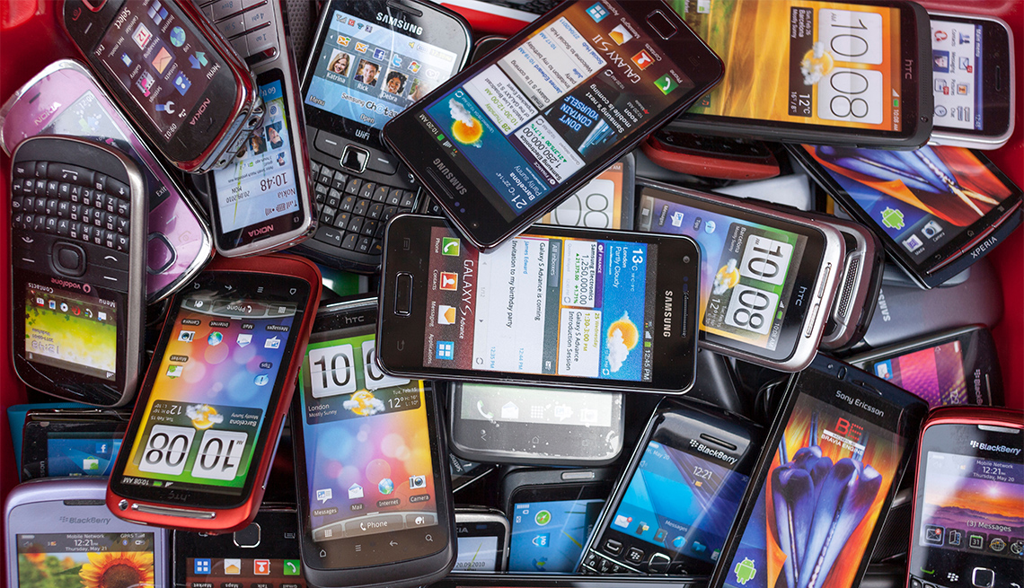
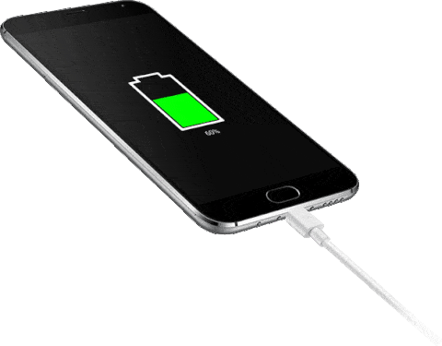
environmental impact of AI
Notes:
Instructor: To try to put that in perspective - think about the electricity a cell phone needs to charge. It would take about 36 million charging cell phones to produce that much carbon emissions. That’s a lot. Does anyone know of a city that size?
[Give students time to think and answer. Maybe even let them use the computers or cell phones to look up cities with a population of 36 million.]

Slide 88

environmental impact of AI
Notes:
Instructor: Yes! That’s like everyone in the metropolitan area of the largest city in the world Tokyo, Japan plugging in their cell phones for a full change at exactly the same time!
… or imagine it was just you charging your cell phone 36 million times. How long would that take?
[Give students time to think and answer.
Follow-up question:
How long does it take you to charge your phone? Multiply that times 36 million…

Slide 89
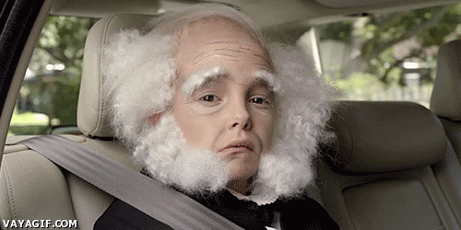
environmental impact of AI
If you live till you’re 90,
10-11 life times
1,000 Years
Notes:
Answers might be roughly around…
1000 years
If you live till you’re 90, then it will take you about 10 or 11 lifetimes
[See other numbers that might make 300 tons of carbon more meaningful to your students with this calculator: https://www.epa.gov/energy/greenhouse-gas-equivalencies-calculator
]
These numbers are huge! Why do you think training AI releases a lot of carbon dioxide?

Slide 90
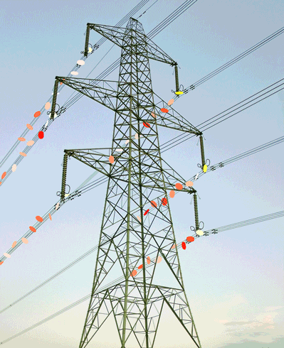
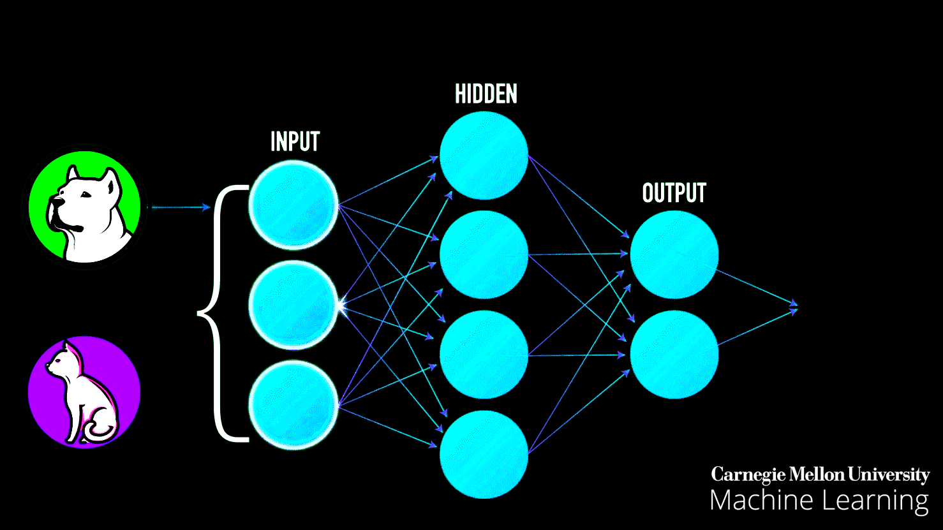
Notes:
[Answer: Computers - whether they use energy from an internal battery or not - eventually need to be plugged into a wall outlet in order to continue functioning. The electricity that runs from these outlets into our computers comes from electric cables that carry electricity generated by power plants.

Slide 91
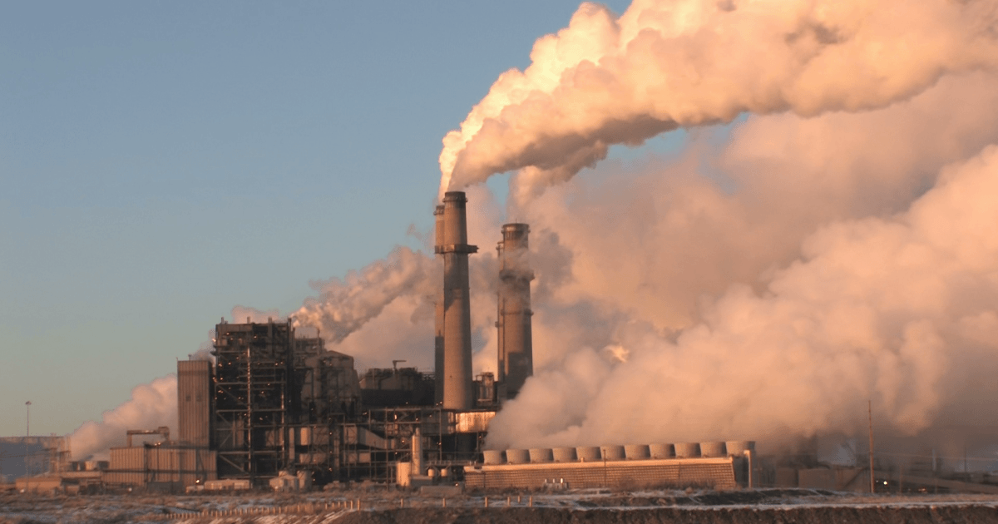
environmental impact of AI
Notes:
In the U.S., about ⅓ of our electricity is generated by coal power plants. Another ⅓ by natural gas. The remaining ⅓ is a combination of nuclear and green energy. Source: https://www.washingtonpost.com/graphics/national/power-plants/
Coal and fossil fuels contain a lot of carbon that interact with oxygen to form carbon dioxide (CO2) when they burn.
So, if AI is trained in the U.S., and many AI are, it is likely that it is drawing energy from power plants that are contributing to global warming.

Slide 92
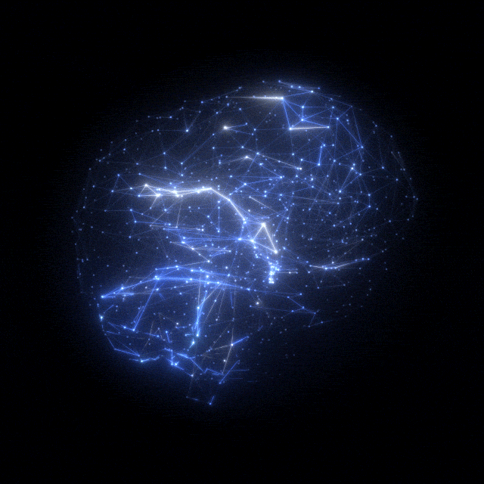
Complex Algorithms
Big data
Notes:
Instructor: This can become a problem when AI systems get bigger and more complex.
Complex algorithms demand bigger datasets demand more training time, and thus more electricity and power
… which puts an ever greater burden on our power plants.
It’s likely that Google's translator is one of these big AI systems with a 300 ton carbon footprint.

Slide 93
What should we do to lower the environmental impact of training AI?
DON’T USE UNNECESSARY ELECTRICITY
LEAVING THE LIGHTS ON OR THE WATER RUNNING IS A NO NO
CUTTING BACK ON CPU AND PHONE USAGE.
LESS AI = LESS CARBON FOOTPRINT
Notes:
Instructor: That’s a lot! Thinking about these numbers can feel overwhelming. How can one person (with such a small impact on the environment relative to a company like Google) make a difference? Well, there are actually some ways that we can address the problem of the environmental impact of AI. Before I give some of the answers that I have, what do you think? How do you think we can change the environmental impact of training AI?
[Give students time to think and answer. Consider having students quickly Turn and Talk to brainstorm some ideas. Other ideas for this moment in the discussion are described in the lesson plan.]

