Slide 1


Technical Writing
Presentation
Sharee Lunsford
Karen Glennon

Slide 2



What comes to mind when you think of Technical Writing/Presentation?

Slide 3








How comfortable am I with Technical Writing/Presenting?

Slide 4

TikTok Experiment
Divide into groups of 3-4
Let’s practice basics……

Slide 5

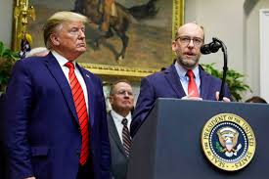


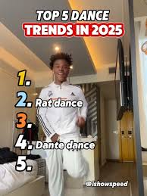





Political News
World Events
Health and Wellness
Tricks
Filter
What has been on your feed this week?

Slide 6
How much time do you spend on Social Media?
Then, have them check on their phones
how many daily hours they spend on particular social media apps by consulting their “digital wellbeing” (Android) or “battery usage” (iPhone) under settings.
write their comparisons down

Slide 7
Once they’ve had time in their groups to talk and write, ask the following questions in a class discussion:
What similarities did you notice about your TikTok/Instagram feeds?
What differences did you notice?
Why do you think your individual feeds are the way they are? How does your own social media usage dictate what you see on your own personal feed?
Which platform is better at delivering personalized content and why?
Do you see any dangers or possible avenues of misinformation?
Have you ever found yourself trapped in a TikTok rabbit hole? What did it feel like when you were there? How did you dig yourself out? (this can also be used as a journal or personal essay assignment after the discussion)
What can you do to protect yourself against misinformation campaigns and/or falling into rabbit holes? (this can also be used as a journal or personal essay assignment after the discussion)

Slide 8


Slide 9
Research Project / Inquiry
What is your general topic? (Weather, robots, ecosystems, etc)
What do you want to research specifically within this topic?
Research question What question will your research attempt to answer?
Main Ideas
Main Idea #1
Main Idea #2
Main Idea #3

Slide 10


Slide 11
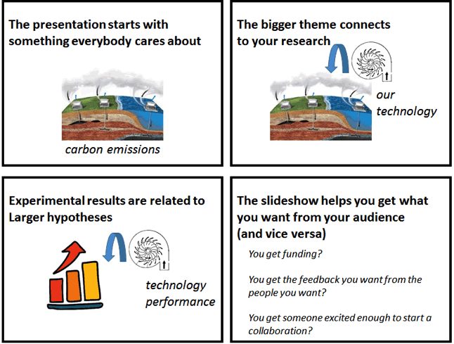

Slide 12


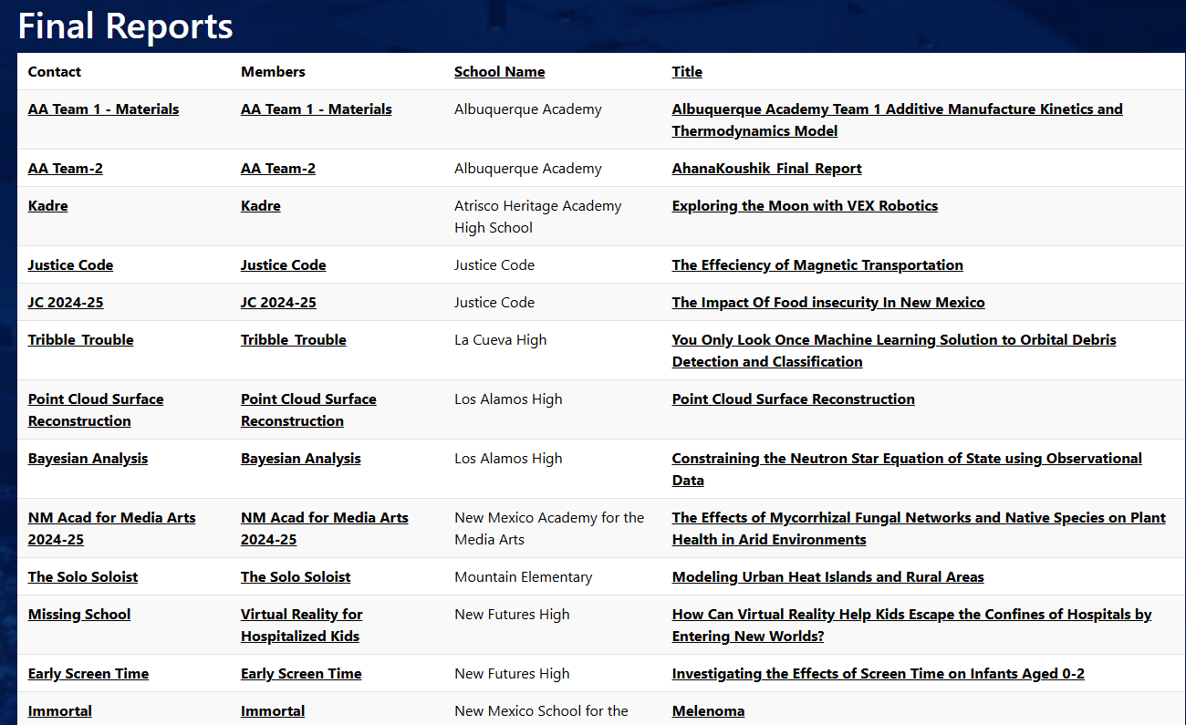


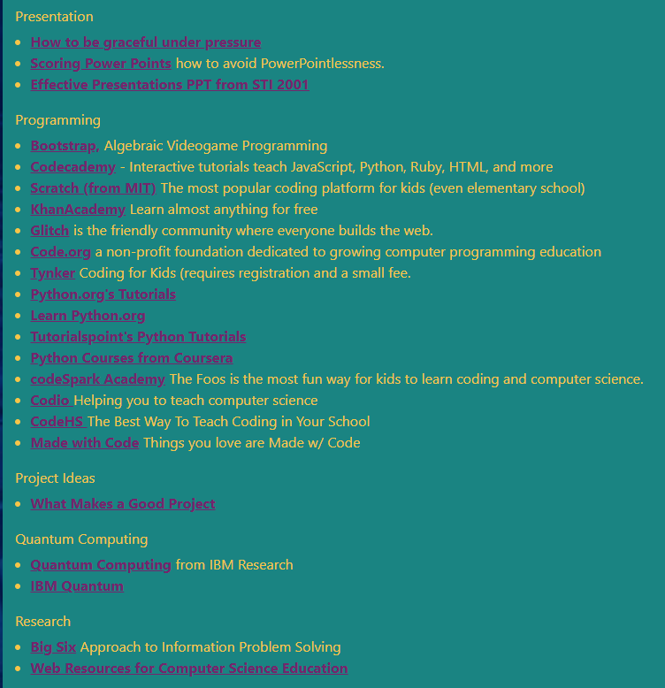


Supercomputing Website
Final Report
Archives
Resources

Slide 13


Slide 14
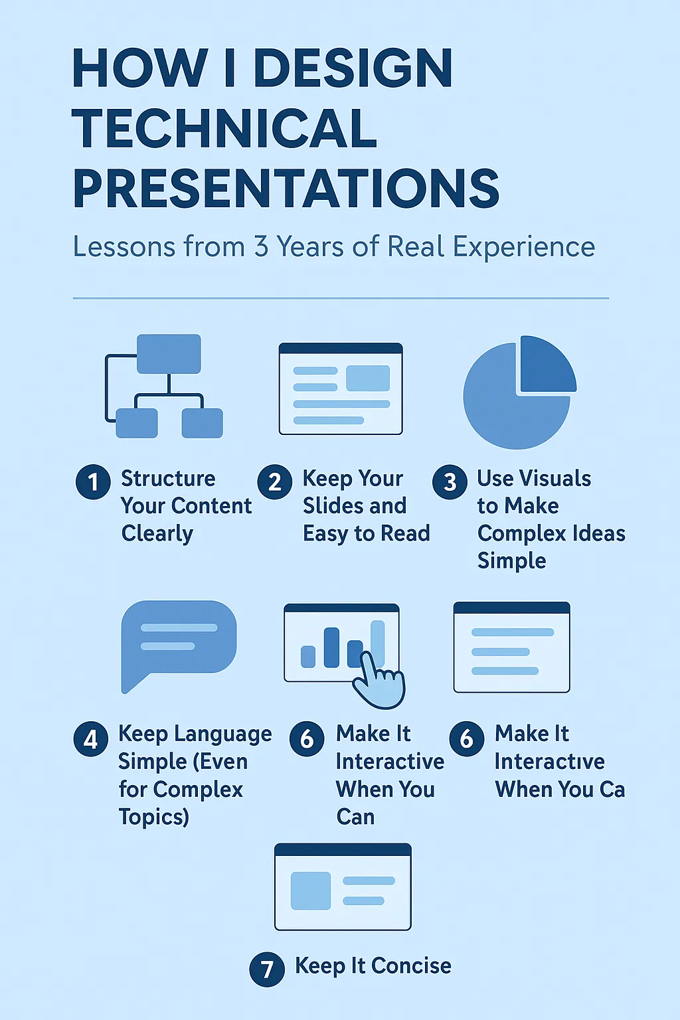

Slide 15
Criteria for Success
The presentation starts with the motivating problem for the research and why it’s being presented.
Every slide shows something relevant to the motivating problem.
Every slide shows no more information than necessary to convey the message.
Slide titles stand on their own; other text supports the visuals.
The audience takes away the presenter’s desired message.

Slide 16
Each Slide Should Convey a Single Point
Keep your message streamlined—make a single point per slide. This gives you control over the pace and logic of the talk and keeps everyone in the audience on the same page. Do not be afraid of white space—it focuses your audience’s attention.
The slide title should identify where you are on your roadmap and what topic the question the slide is answering. In other words, the audience should know exactly where in the presentation and what the slide answers just from the slide title.

Slide 17
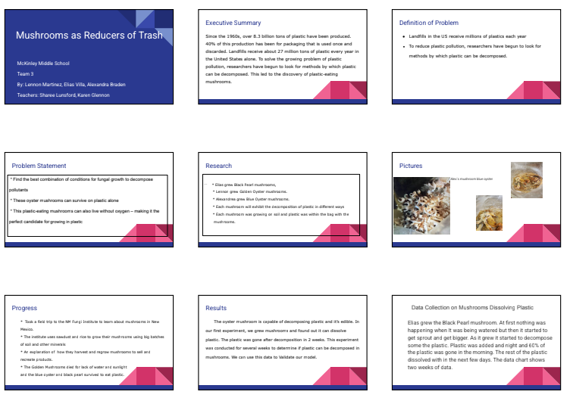
Good or Bad Presentation?
Mushrooms As Reducers of Trash

Slide 18


Slide 19


Slide 20
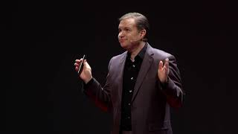

Slide 21


