Slide 1
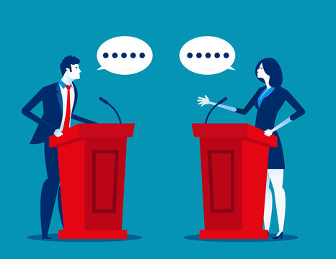
In the 1970’s calulators were rejected by Math teachers because they feared the students wouldn’t learn any math.

Slide 2
Why are Schools uncomfortable about Chat GPT?

Slide 3
Let’s Debate

Slide 4
Positions to take
Students won’t learn anything if they use Chat Gpt
Chatgpt promotes cheating
IF it’s ok to use YouTube to learn new things, why not Chat GPT

Slide 5
How ChatGPT Can Go Wrong 🤖❌
📅 Outdated Info – Doesn’t always know the newest news or events.
🌀 Making Stuff Up – Sometimes it gives answers that *sound right* but are wrong.
📝 Too General – If you don’t give details, it might give boring or confusing answers.
😎 Overconfident – ChatGPT can sound sure of itself, even when it’s wrong.
❓ Mixed-Up Questions – If your question isn’t clear, it might guess the wrong meaning.
💡 Tip: Always double-check answers with a teacher, book, or trusted website.

Slide 6
Maximizing ChatGPT Benefits
Use Clear Prompts
Providing clear, specific prompts ensures ChatGPT gives you relevant and accurate responses to your queries.
Ask Follow-Up Questions
Refine answers and discover deeper insights by asking follow-up questions to ChatGPT during your interactions.
Enhance Productivity and Creativity
Leverage ChatGPT for brainstorming, drafting, and problem-solving to boost your creativity and productivity in various tasks.
Notes:
Image source: Microsoft 365 content library
To get the most out of ChatGPT, start by providing clear, specific prompts to guide its responses. Experiment with follow-up questions to refine answers and uncover deeper insights. Lastly, leverage ChatGPT for brainstorming, drafting, and problem-solving to enhance productivity and creativity in your tasks.

Slide 7

Engaging with CHAT GPT
Prompts where students are using the Socratic Method.

