Slide 1
Why Vis?
David H Rogers,
Scalable Data Analysis and Visualization
Sandia National Laboratories
dhroger@sandia.gov
July 19, 2012
SAND Number: 2012-5928C

Slide 2
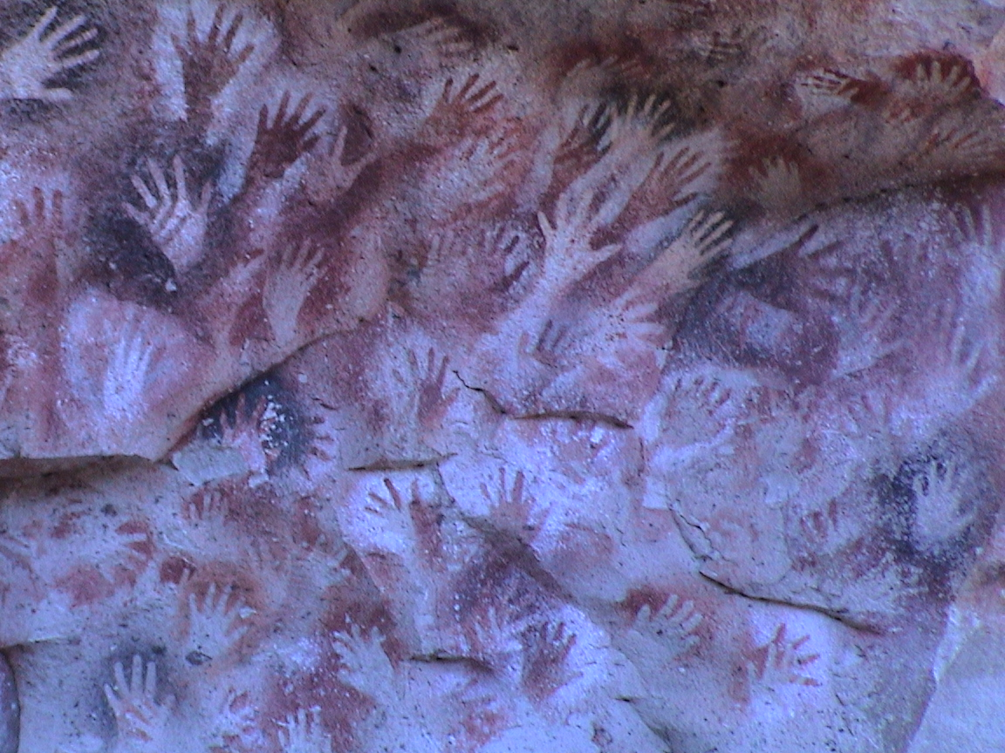

Slide 3
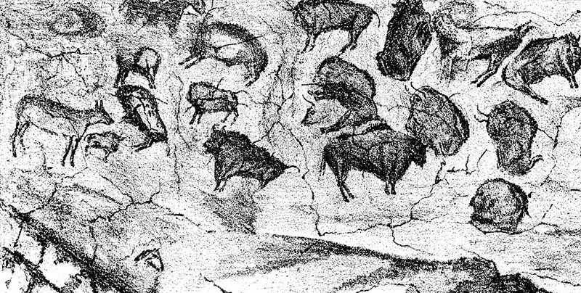

Slide 4
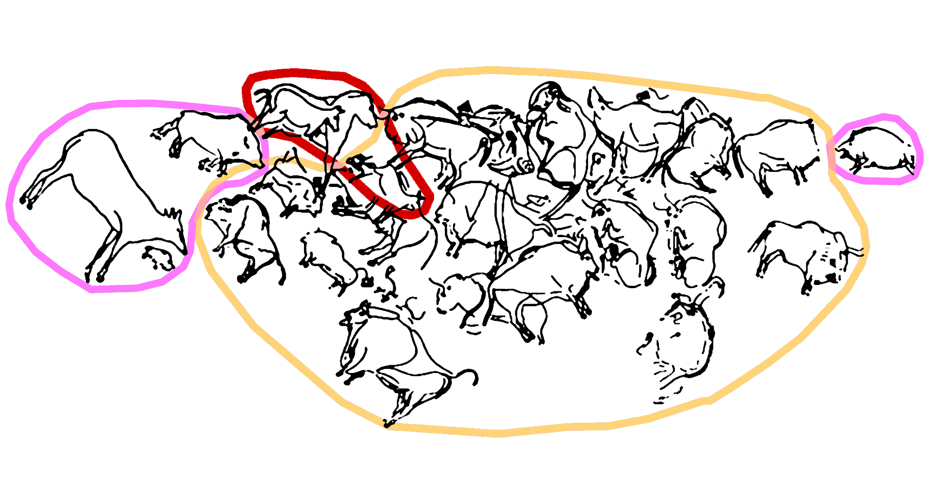

Slide 5
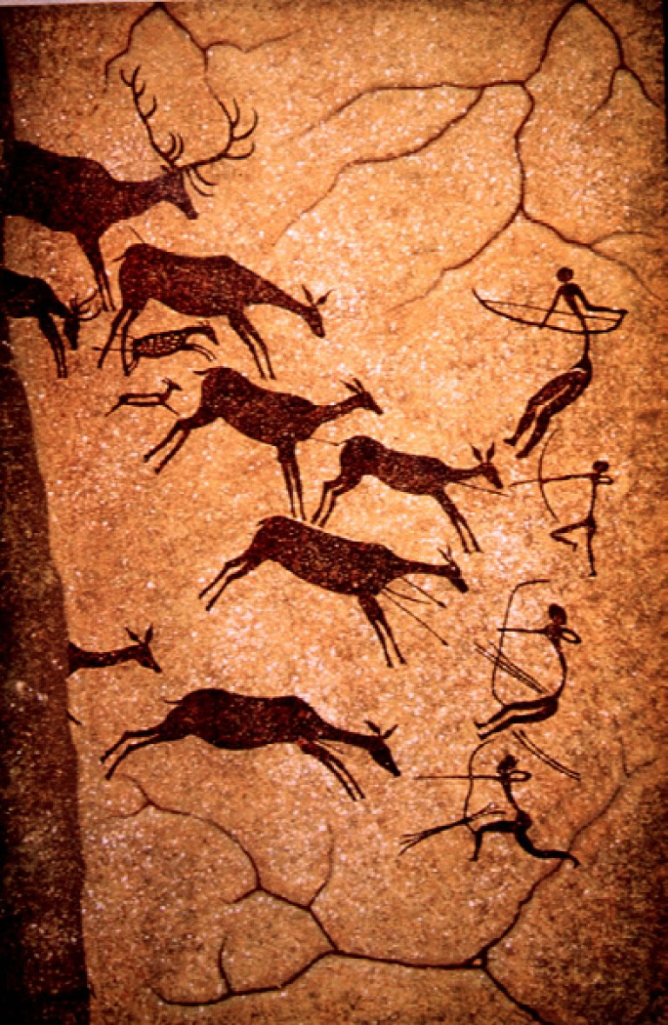

Slide 6
What’s the Goal of Visualization?
“It’s stories, all the way down.”
David Rogers
“Simple design. Intense content.”
Edward Tufte

Slide 7


Slide 8


Slide 9

Chris Jordan, Plastic Cups Depicts 1 million plastic cups – the number used on airline flights in the US every six hours.

Slide 10
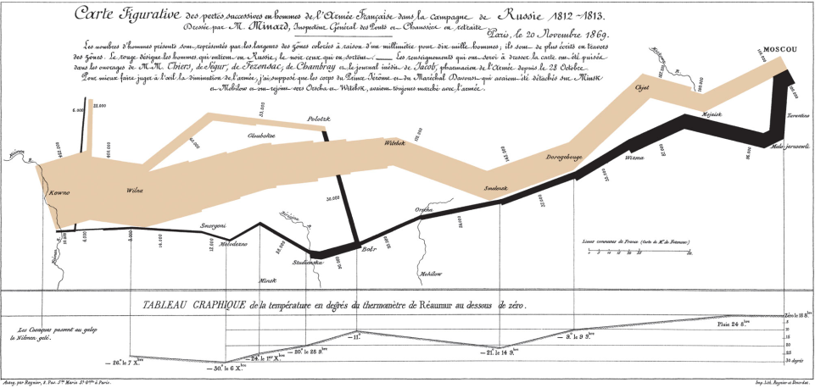
The Story of Napoleon’s March
Charles Minard’s story of Napoleon’s March to Moscow, War of 1812. Band shows size of the army along the advance and retreat routes, superimposed over a map, with temperature and time scales below. Tufte, The Visual Display of Quantitative Information

Slide 11
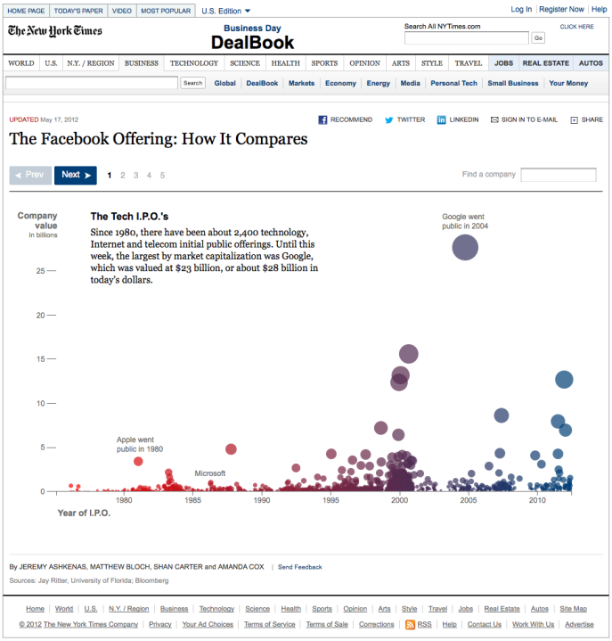

Slide 12
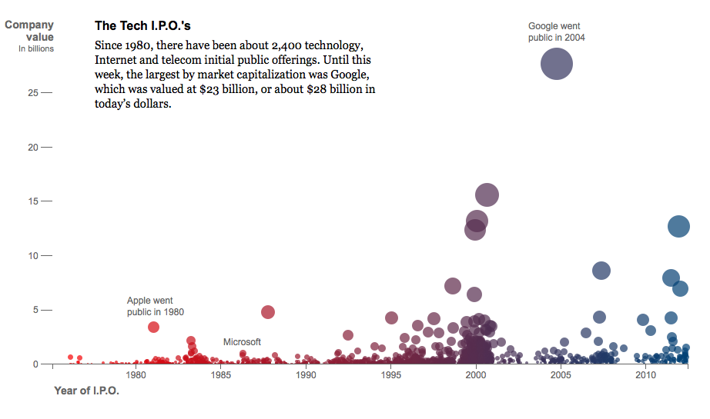

Slide 13
Why is it challenging?

Slide 14
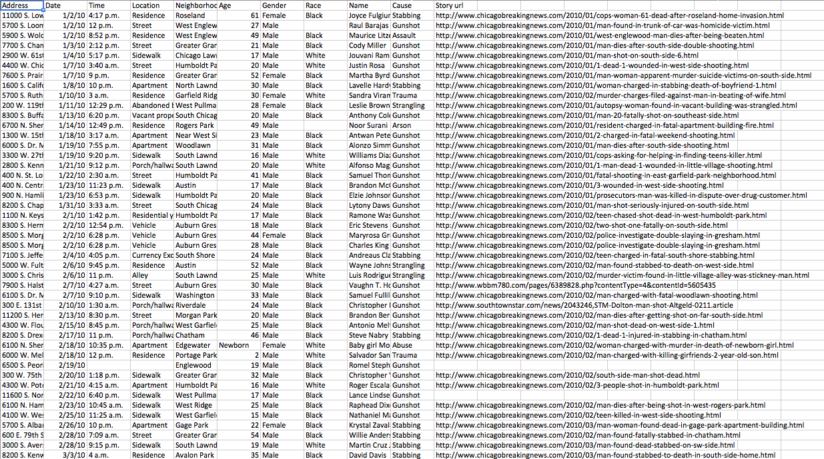
Because …

Slide 15
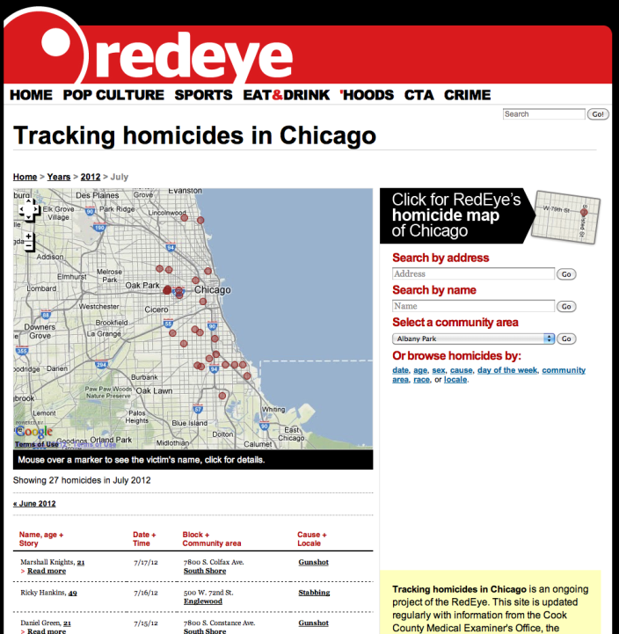
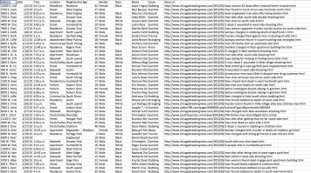
http://homicides.redeyechicago.com

Slide 16
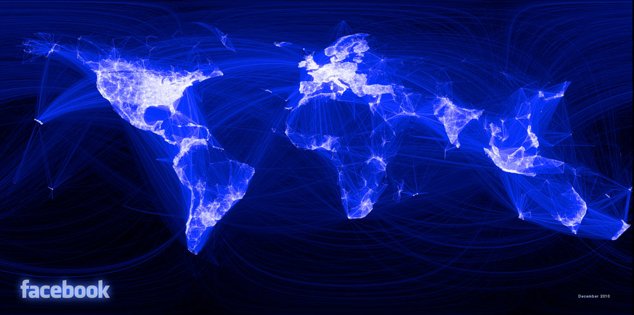
Mapping of intensity of Facebook friends between pairs of cities, with the connections drawn as great arcs.
After a few minutes of rendering, the new plot appeared, and I was a bit taken aback by what I saw. The blob had turned into a surprisingly detailed map of the world. Not only were continents visible, certain international borders were apparent as well. What really struck me, though, was knowing that the lines didn't represent coasts or rivers or political borders, but real human relationships. Each line might represent a friendship made while travelling, a family member abroad, or an old college friend pulled away by the various forces of life.
Paul Butler, in a blogpost: http://www.facebook.com/notes/facebook-engineering/visualizing-friendships/469716398919

Slide 17
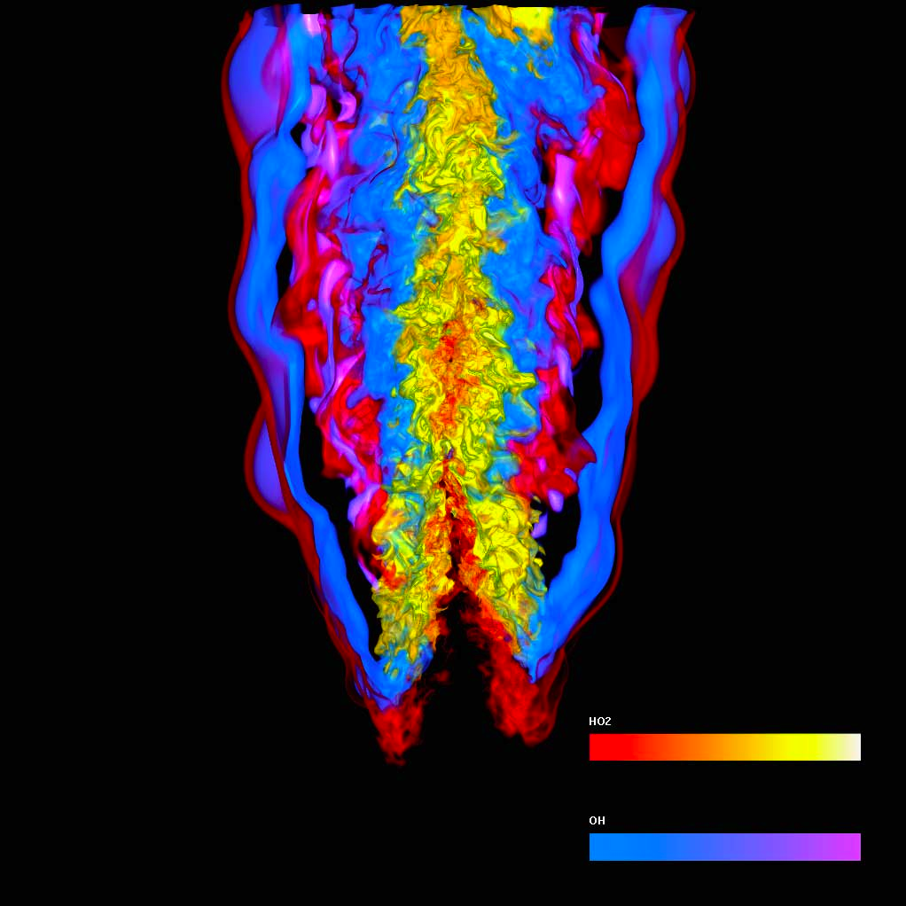
Combustion Analysis (UC Davis)
In-Situ Visualization for Large-Scale Combustion Simulations, Yu, Wang, Grout, Chen, Ma IEEE Computer Graphics
An Exploratory Technique for Coherent Visualization of Time-Varying Volume Data, Tikhonova, Correa, Ma, EuroVis 2010Combu

Slide 18
Visualization is a continuous cycle
Visit your Data
Try Something
Look at it
Does it tell a story?

Slide 19
What can you do?

Slide 20
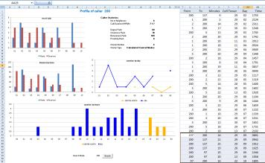
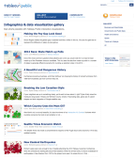
What’s out there = crazyfantastic
Excel
  Don’t cringe – it’s pretty good!
Tableau software
  Free software to play with data
  Create interactive, online pages
  Totally awesome!
Python
  NodeBox
  SciPy
Fun sites
  http://flowingdata.com

Slide 21

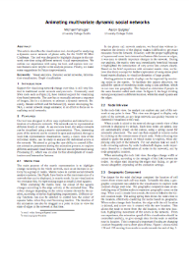
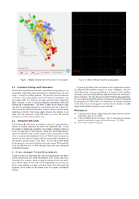
Excel = Simple!
A 2008 Contest Entry for the VAST contest used Excel as a data analysis tool
Excel wasn’t used in the final visualization (see paper), but it was instrumental in getting a quick handle on the data
http://vac.nist.gov/2008/entries/UCD-Phone/index.html

Slide 22
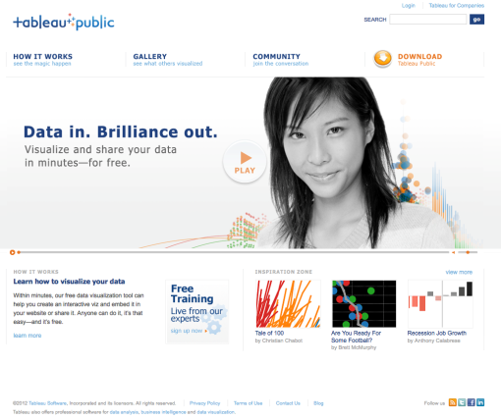
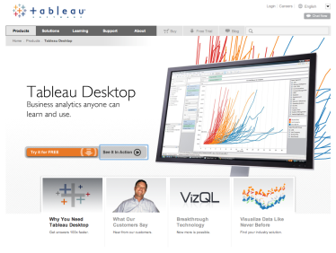

Tableau = powerful
Public, free version available
  $1000 for paid version
Flexible, web publishing
Quick way to play with data
Helps you develop your story
Helps others participate
Now, a tour …
http://www.tableausoftware.com

Slide 23
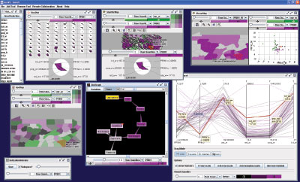
Python = powerful, flexible, nerdy
SciPy
  Quick, science-y vis
  Advanced vis (maps, etc.)
NodeBox
  Beautiful, easy to use
  Constrained
  Very unconstrained, too
Everything else
  GeoViz Toolkit

Slide 24
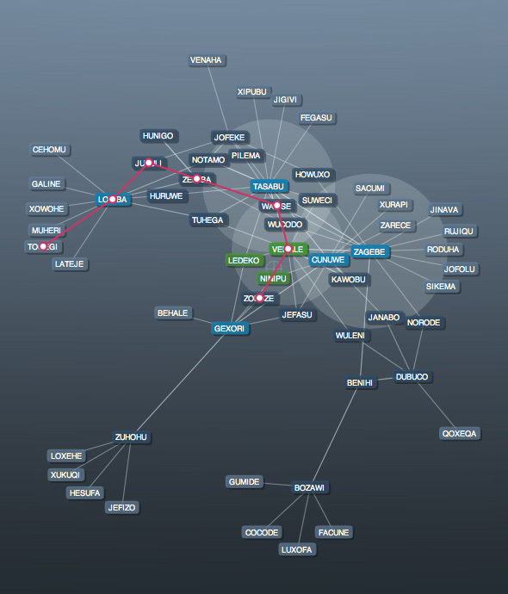
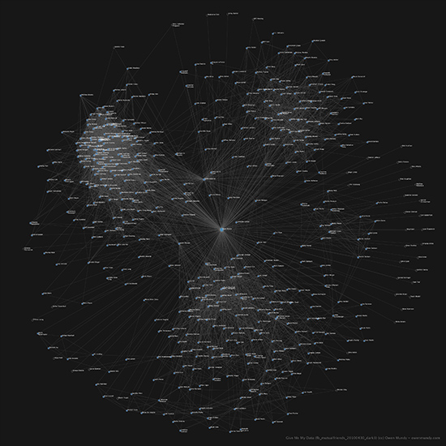
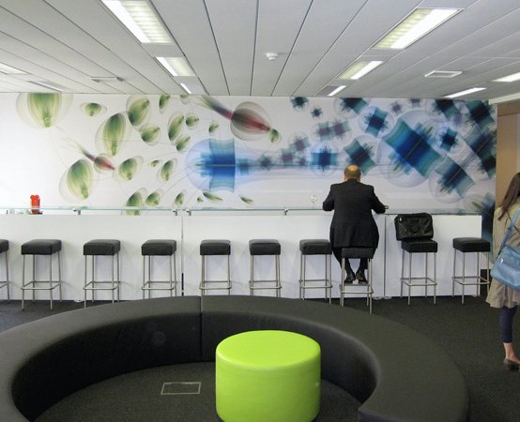
NodeBox = Power + Beauty
Python development environment
Powerful set of capabilities, plus design
Here’s an example …

Slide 25
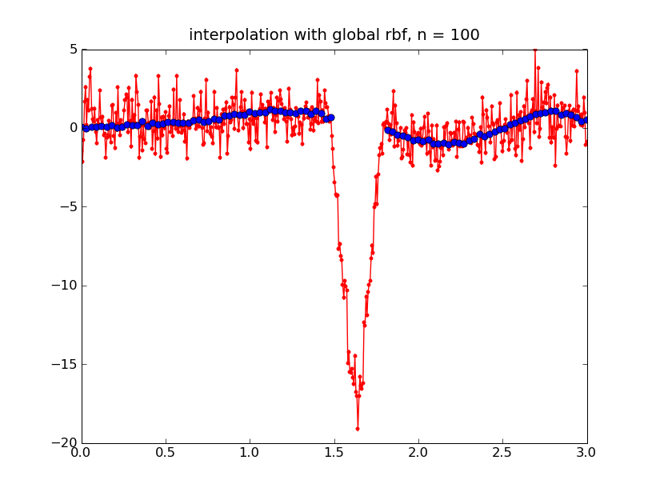
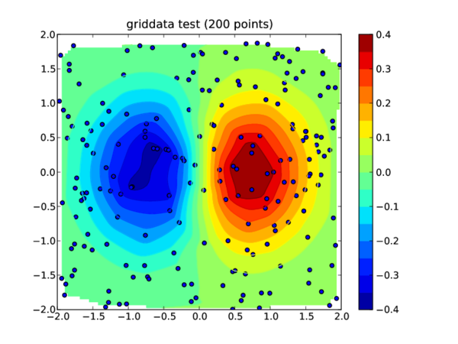
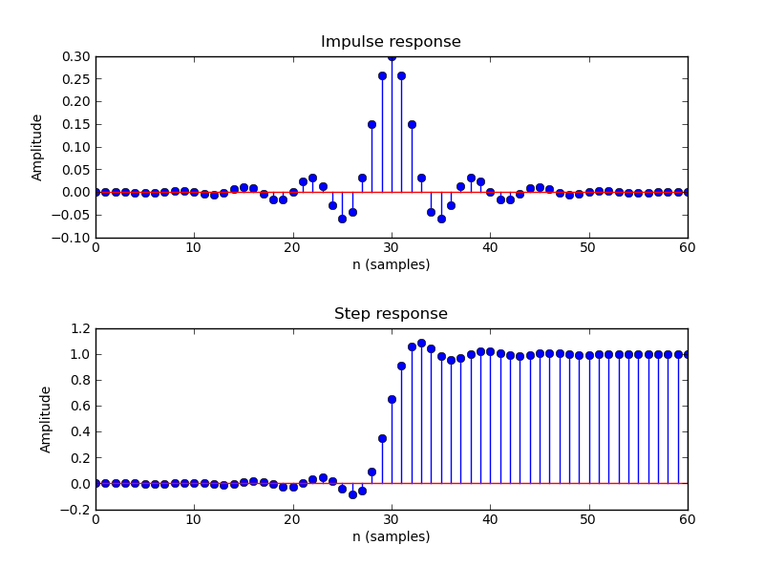
SciPy = Science stuff
Built in analytics
Flexible
A Million Billion packages

Slide 26
Where to turn
A piece of paper
Excel
Tableau
NodeBox, SciPy (Python)
Books
  Anything by Tufte (take his course)
  Visualize This: The FlowingData Guide to Design, Visualization and Statistics
Other stuff
  Udacity course on statistics
  http://flowingdata.com

Slide 27
Questions?
Sandia National Laboratories is a multi- program laboratory operated by Sandia Corporation, a wholly owned subsidiary of Lockheed Martin company, for the U.S. Department of Energy’s National Nuclear Security Administration un- der contract DE-AC04-94AL85000.
SAND Number: 2012-5928C

