Slide 1

Raising the Bar on
Computer Science,
Math & Science in our Schools
The Supercomputing Challenge!

Slide 2
Objectives
Promote science, math, and computing
Advance scientific inquiry and process
Encourage teamwork
Support independent research
Reward excellence:
  Cash, trophies, plaques, scholarships
Prepare students for careers
Engage students in project-based learning

Slide 3
Time Line
July: Summer Teacher Institute
September: Students/teachers register, courses
October: Teams form, Project Proposal due, Kickoff Conference
November: Proposal Reviews
December: Interim Reports due
January: Peer Review
February: Project Evals
April: Final Judging, Awards Ceremony

Slide 4
Summer Teacher Institutes
Professional development in science, mathematics, and computing
Offered most summers, since 1995
Prepares teachers to lead Challenge teams
Stipends, textbooks, graduate credit
Camaraderie, supportive community

Slide 5
Participation from 1990 to 2025
Students enrolling in the Challenge
Notes:
The recruitment and marketing of the Supercomputing Challenge in 1990 produced more participation than expected with 235 students registering. Continued marketing produced increased participation for several years to the point that the sponsors could not support the cost of the expansion. We determined that students were not serious about their participation as completion rates for teams were in the 50% down to 33% in 1994-96. Several schools had many teams registered but few finished. At the beginning of the 1996 Challenge year, schools were only allowed to register five teams per school, putting the onus on the schools to find students that would commit to the program. That reduced the participation and then a $20 registration fee (per student) was instituted. After four years that was raised to $40 per student. These changes resulted in manageable participation numbers of around 300 and the team competition percentages rose to 60%. Just before the Covid pandemic, the competition rate reached 87%. The Covid pandemic affected our recruiting efforts and participation dropped to about 150 students but the completion rate continued to be around 70%. Post Covid participant numbers are starting to increase and we hope to continue to grow back to the 300 student level.

Slide 6
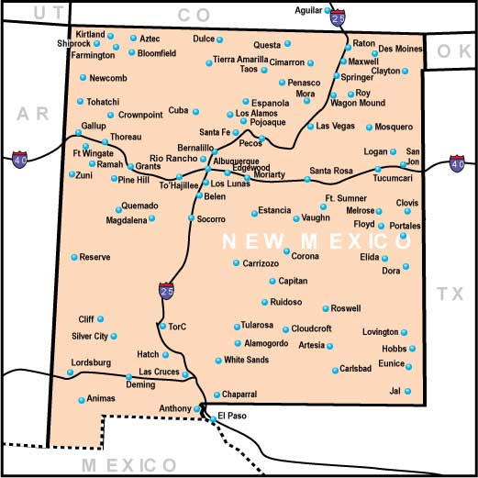
Map of schools since 1990

Slide 7
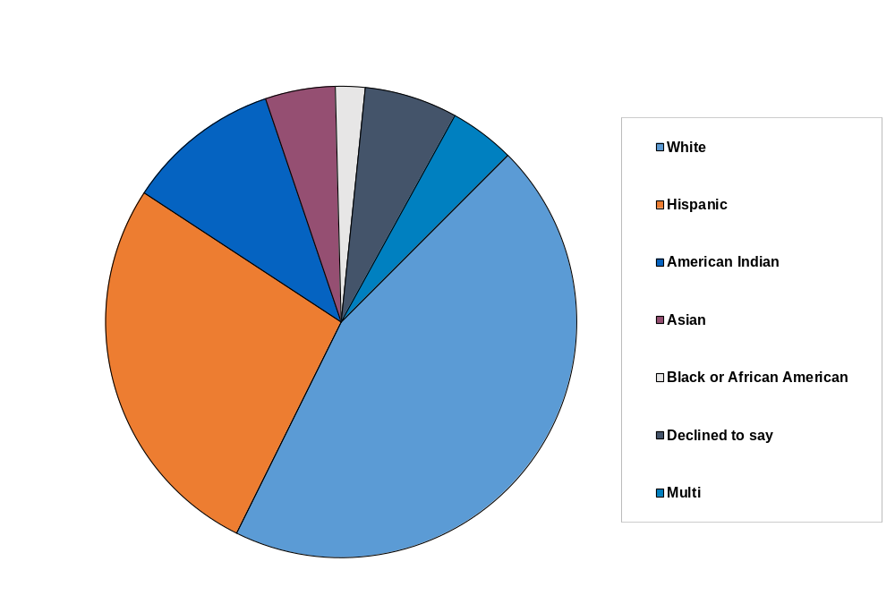
Ethnicity since 1990

Slide 8
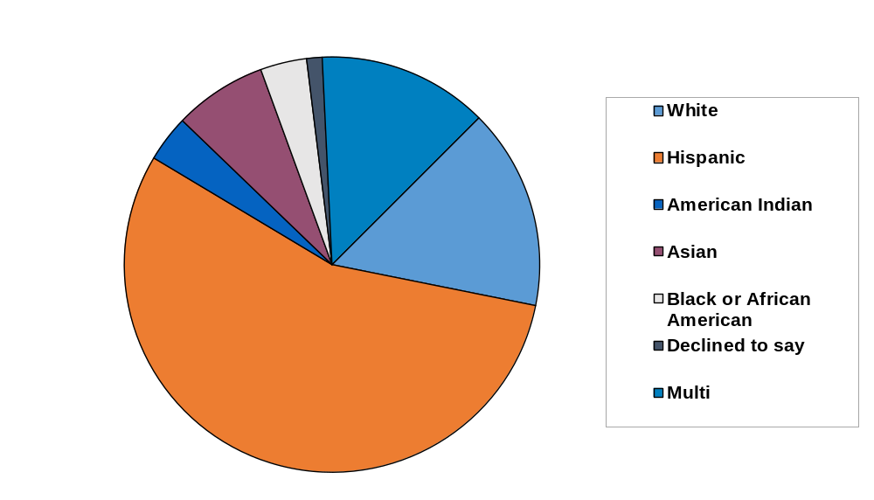
Ethnicity in 2025-2026

Slide 9
Gender Gap Closing

Slide 10
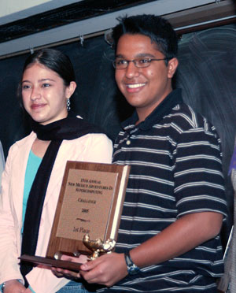
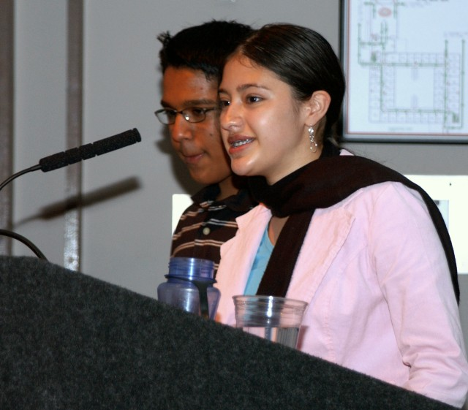
2004-2005 Winners
Notes:
Punit Shah and Karalyn Baca

Slide 11
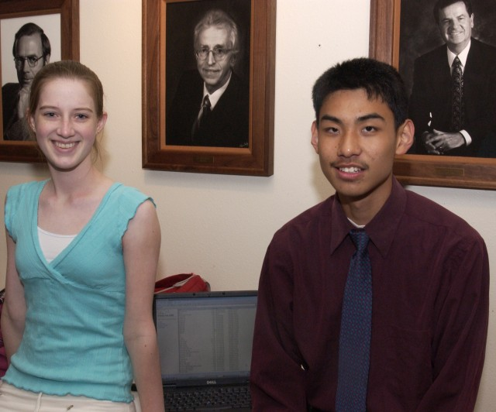
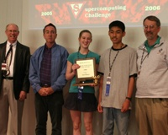
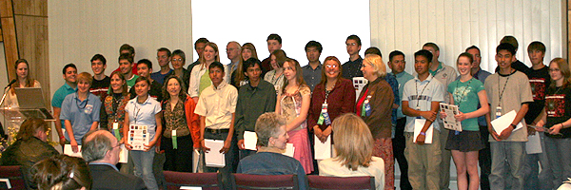
2005-2006 Winners & Finalists
Notes:
Kristin Cordwell and Chen Zhao. Now Kristin Cordwell is the CFO and Head of Strategy for Onyx by J.P. Morgan.

Slide 12
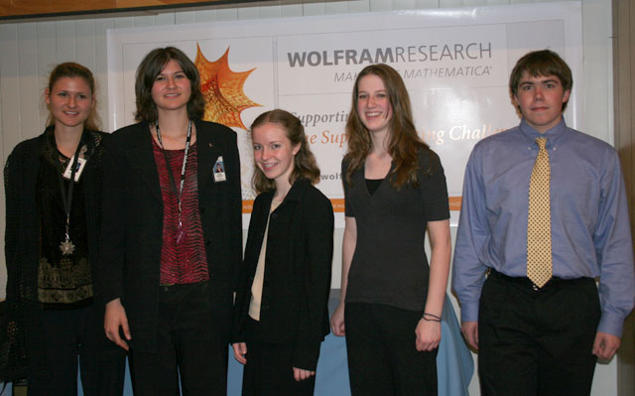
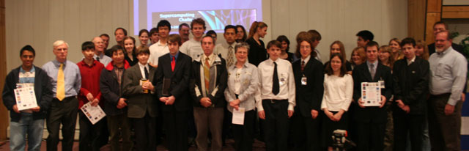
2006-2007 Winners & Finalists
Notes:
Erika got Kristin to be on her team and added Daniel. Three students from three different schools. They took first place. The team almost disintegrated the weekend before the final report was due. They pulled it together and came through with flying colors.

Slide 13
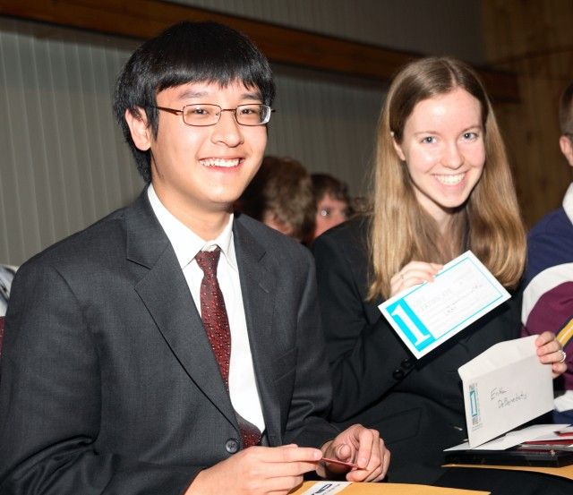
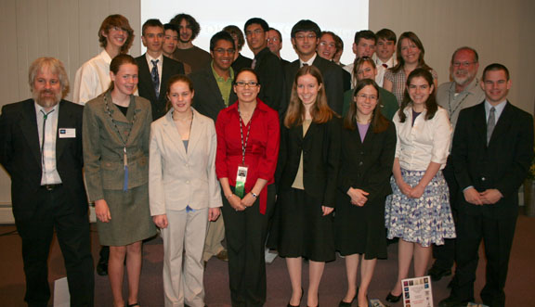
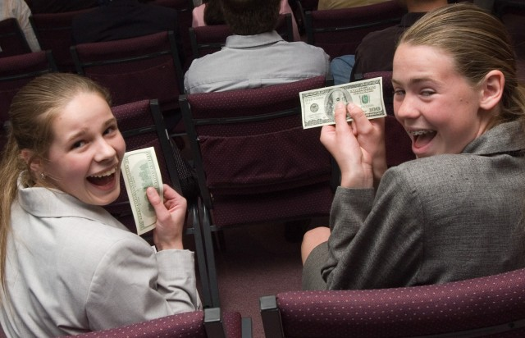
2007-2008 Winners & Finalists
Notes:
Erika is back with Tony Huang as a teammate and took first again. Middle school students Rachel and Jessie show off the $100 bills they earned for the best technical poster.

Slide 14
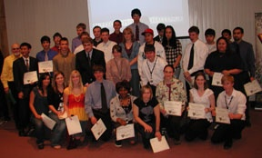
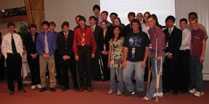
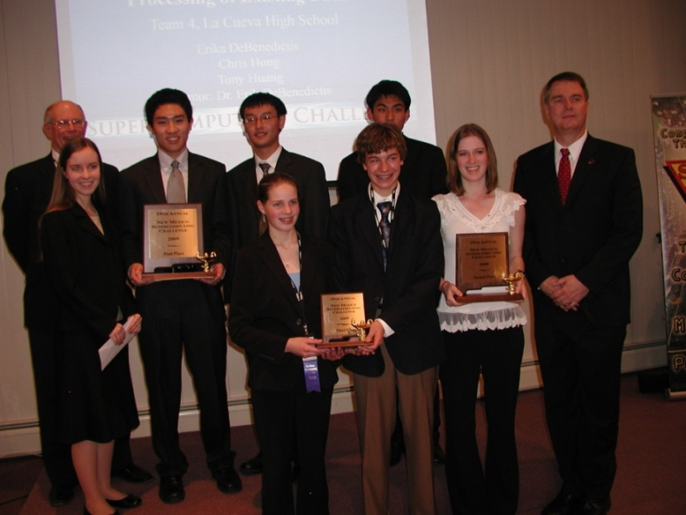
2008-2009 Winners & Finalists
Finalists Scholarship winners
1st-3rd Places
Notes:
Erika is back again, this time with Chris Hong and Tony Huang as teammates and they took first place. Kristin and Chen Zhao took second place. A middle school team of Rachel Robey and Gabe Montoya took third place. Erika went on to Cal Tech and MIT and is now a computational physicist and synthetic biologist.

Slide 15
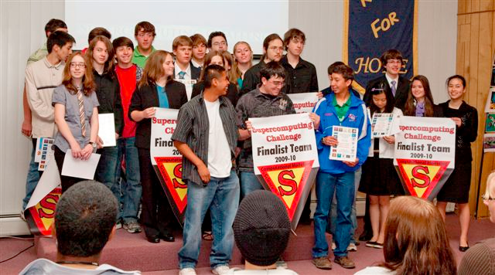
2009-2010 Finalists
Notes:
Teams get banners to hang in their schools.

Slide 16
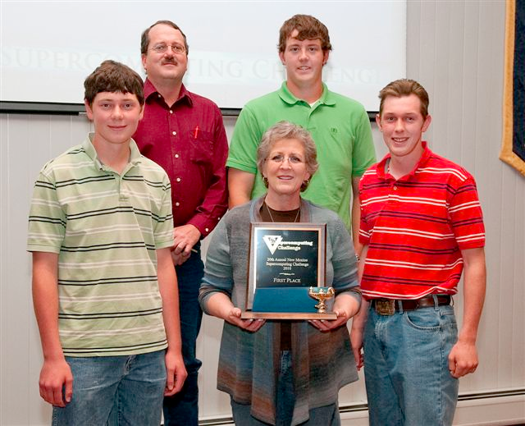
2009-2010 Winners
Notes:
A team from Melrose High School that rose out of the Expo to present to the Finalist Judges and took first place for their simulation of grassland wild fires, and how to fight them, in the eastern New Mexico area.

Slide 17
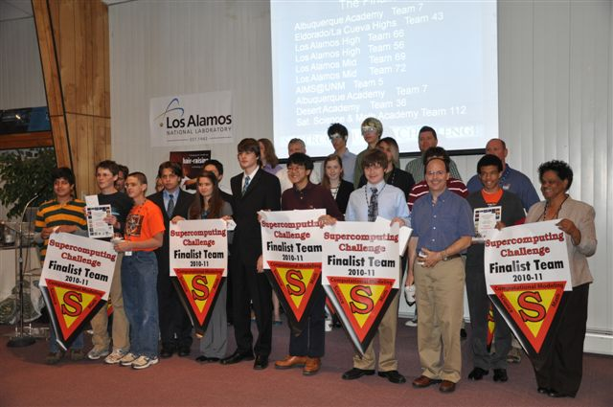
2010-2011 Finalists

Slide 18
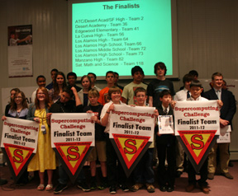
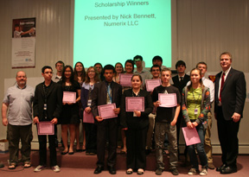
2011-2012 Finalists
and Scholarship Winners

Slide 19
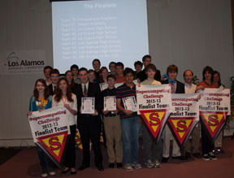
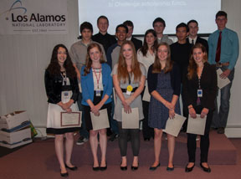
2012-2013 Finalists
and Scholarship Winners

Slide 20
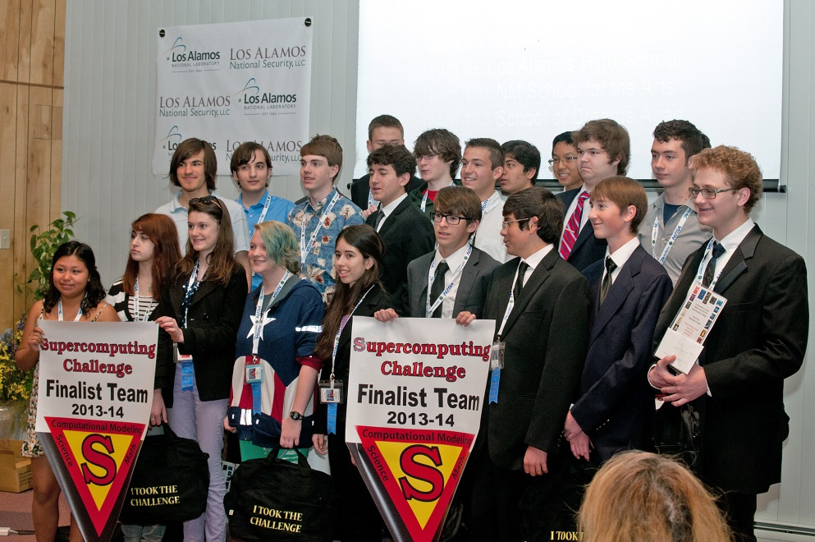
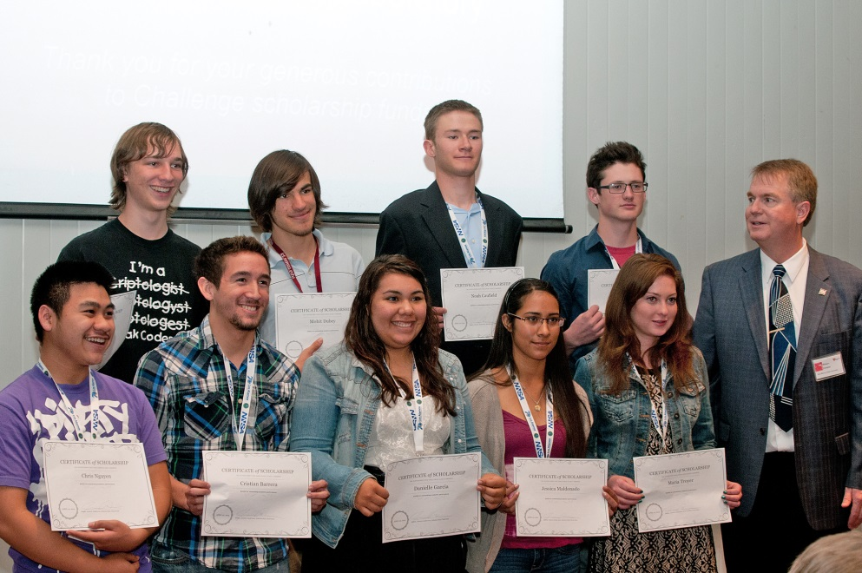
2013-2014 Finalists
and Scholarship Winners

Slide 21
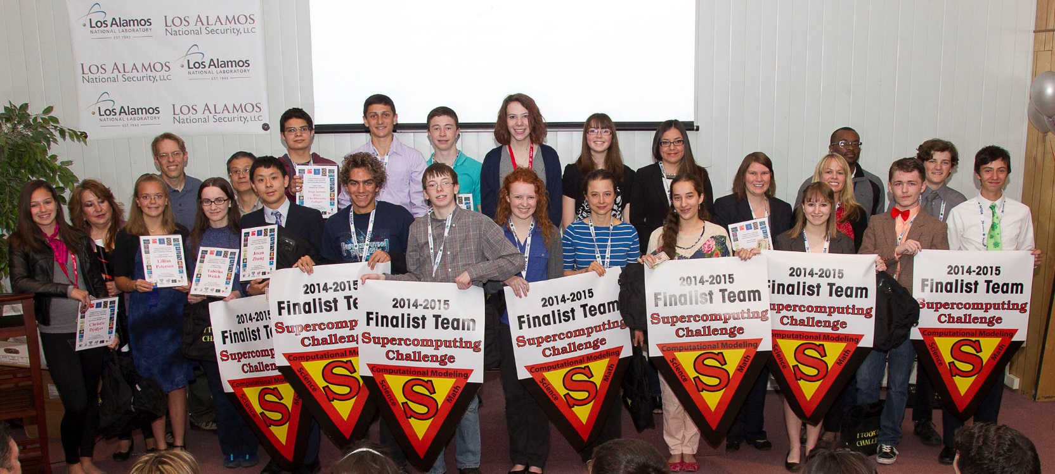
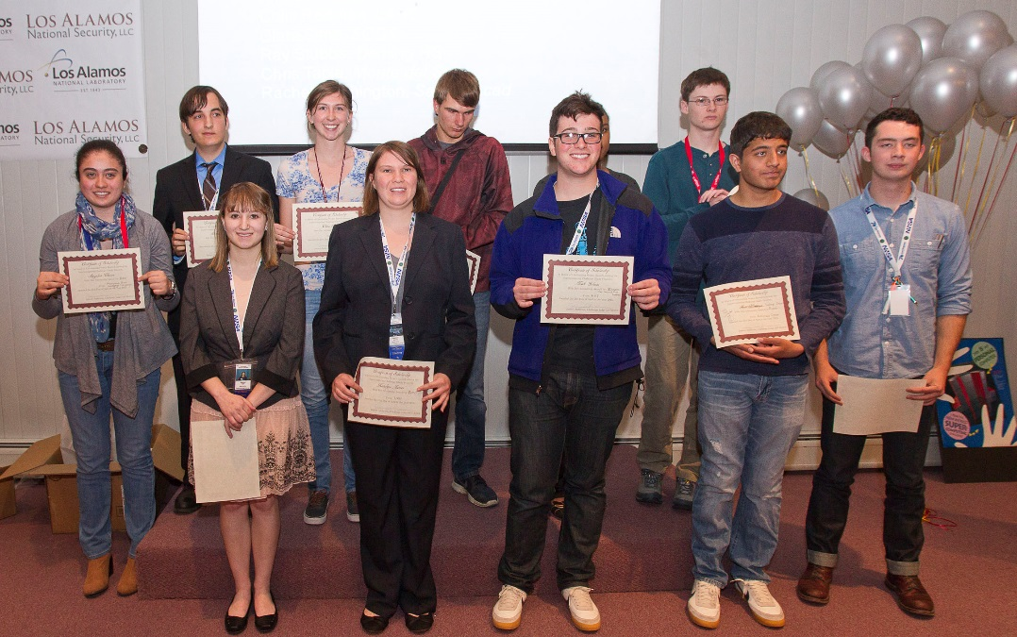
2014-2015 Finalists
and Scholarship
Winners

Slide 22
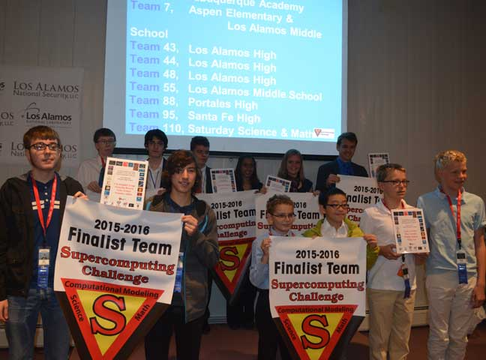
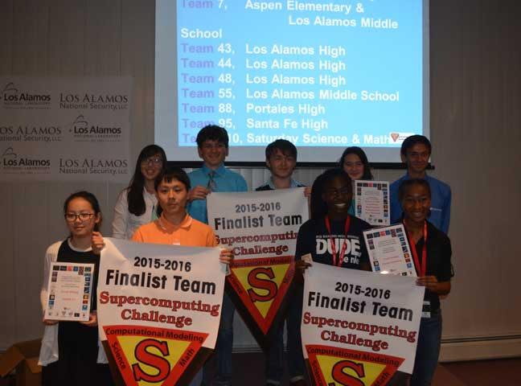
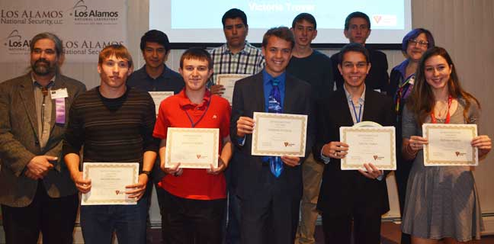
2015-2016 Finalists
and Scholarship Winners

Slide 23
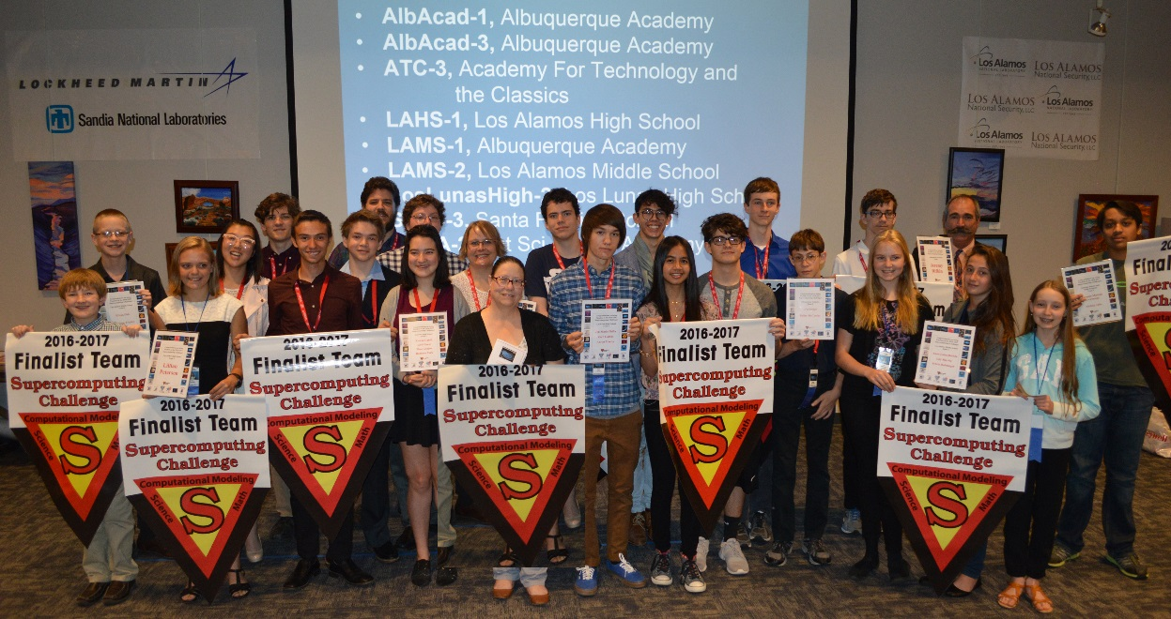
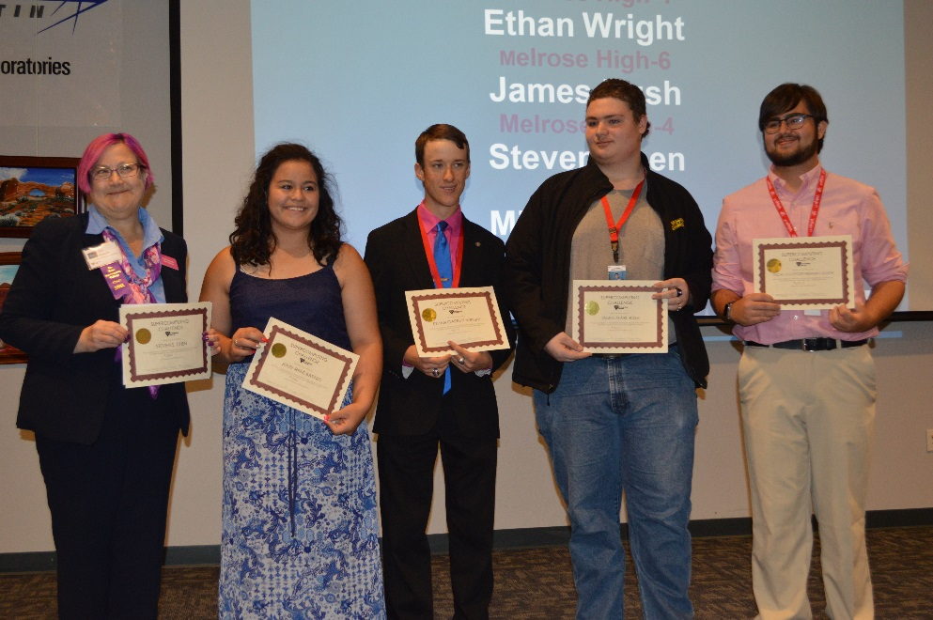
2016-2017 Finalists
and Scholarship Winners

Slide 24
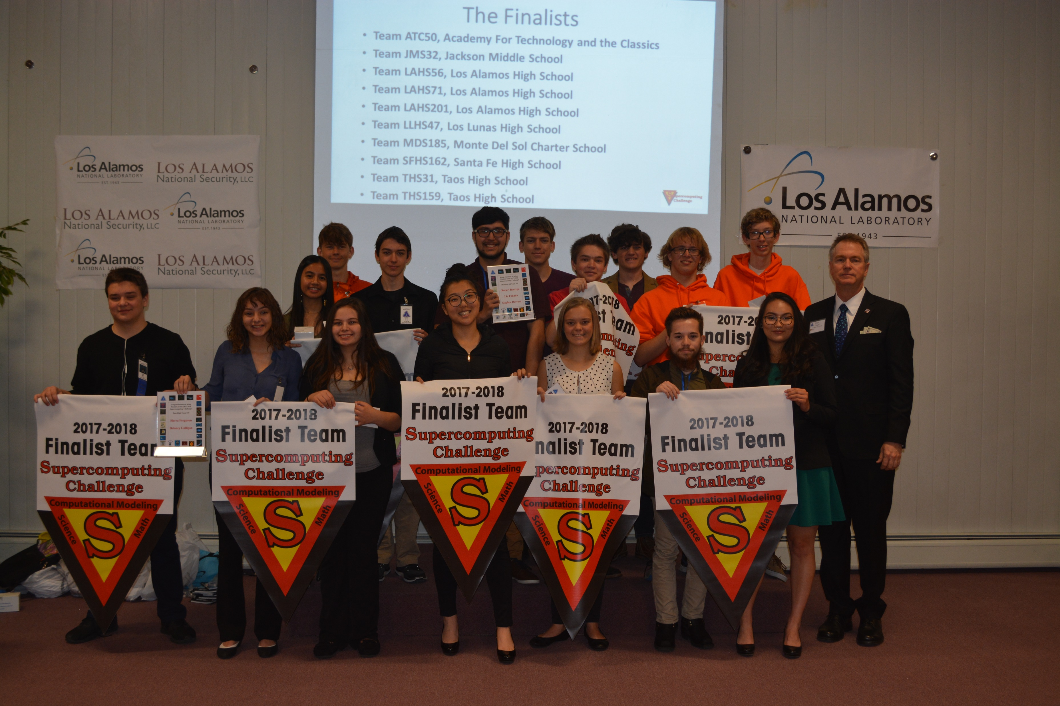
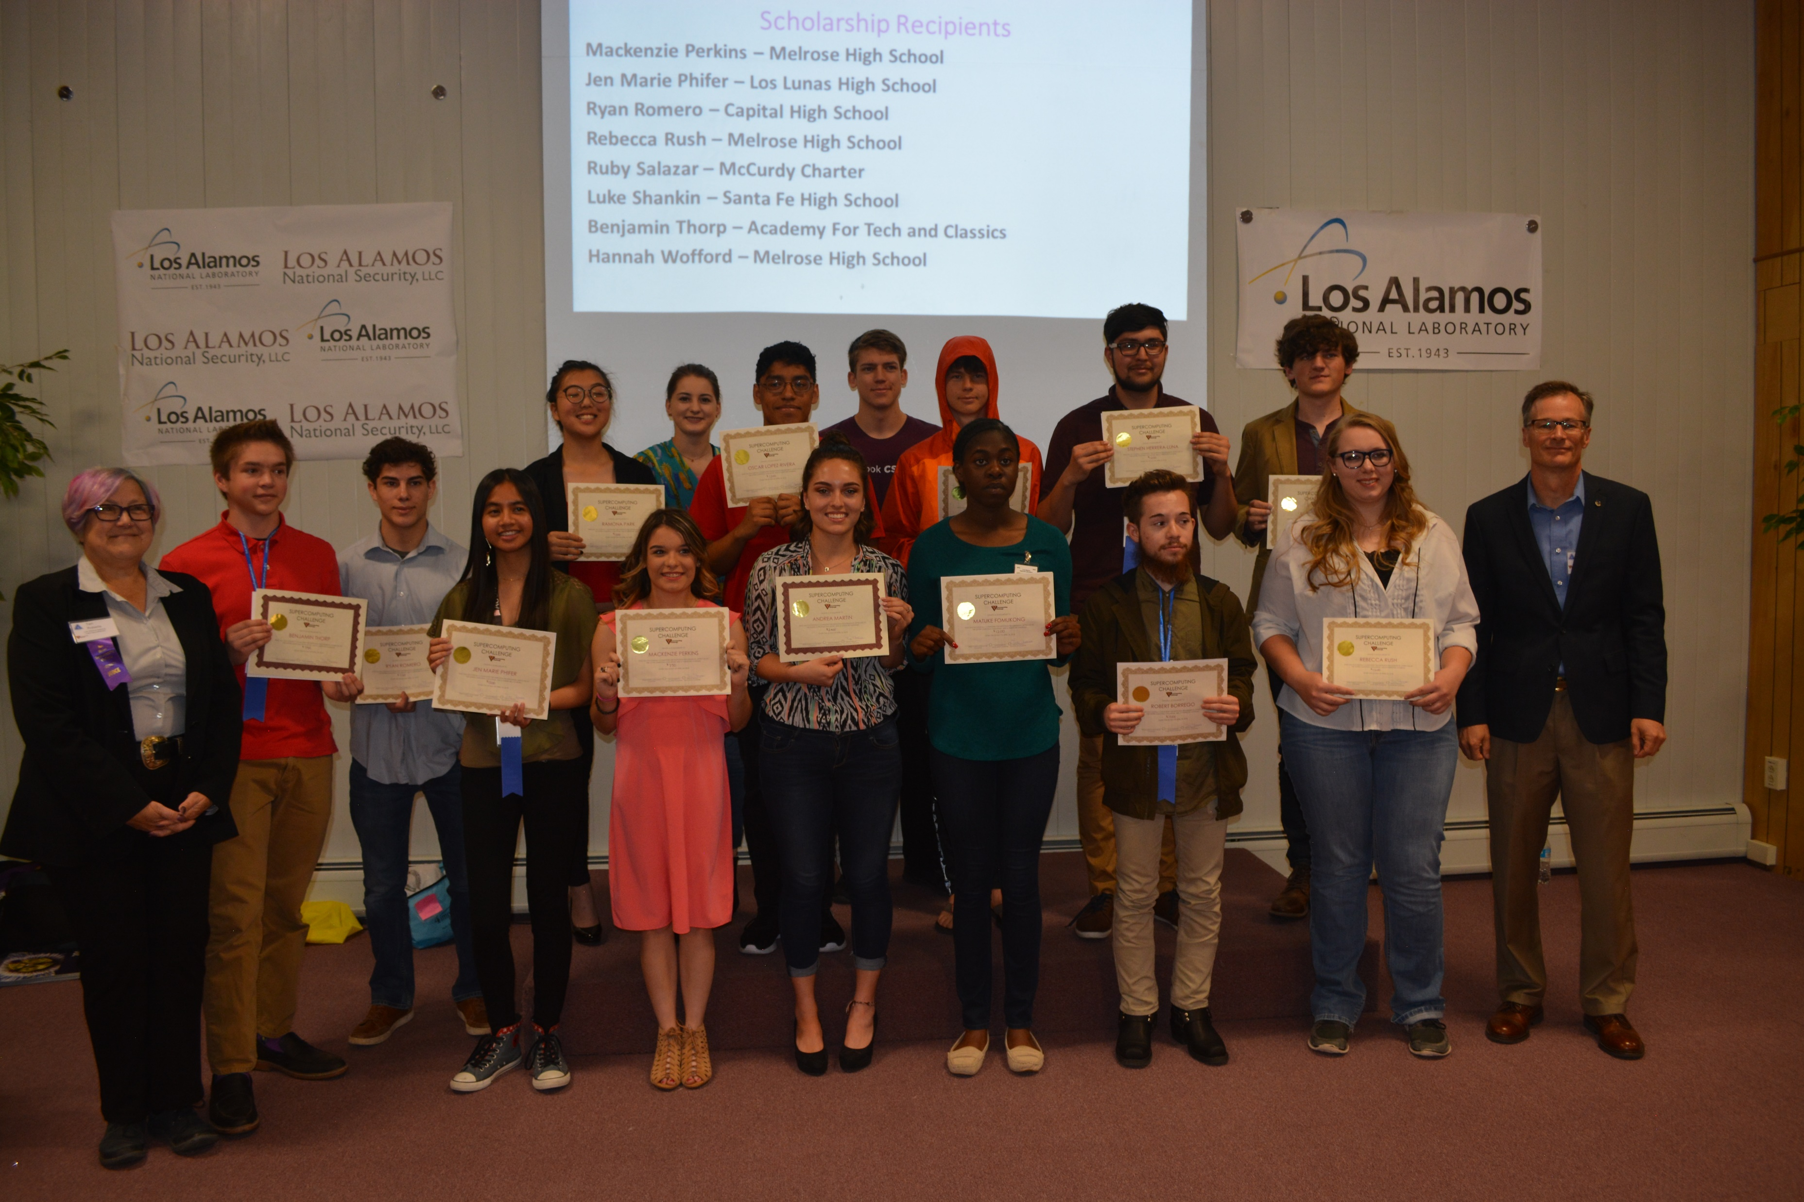
2017-2018 Finalists
and Scholarship Winners

Slide 25
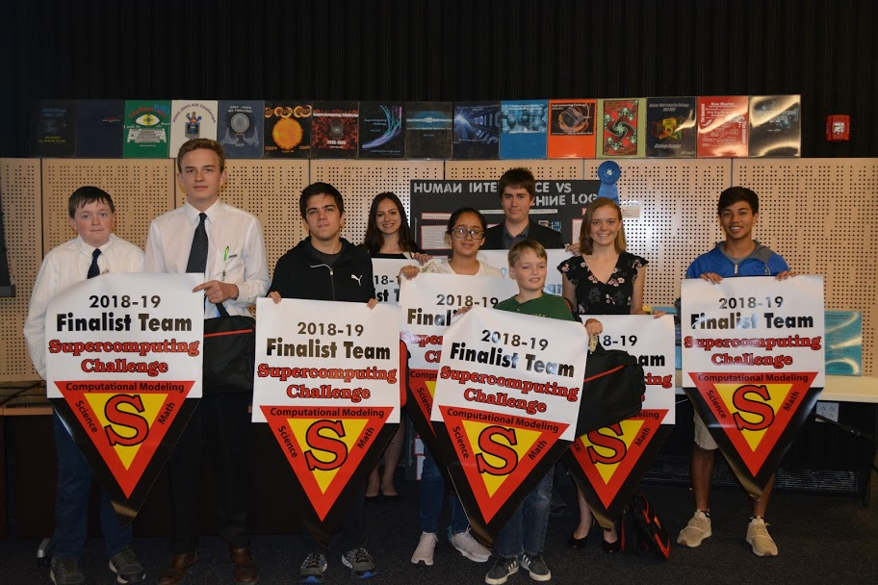
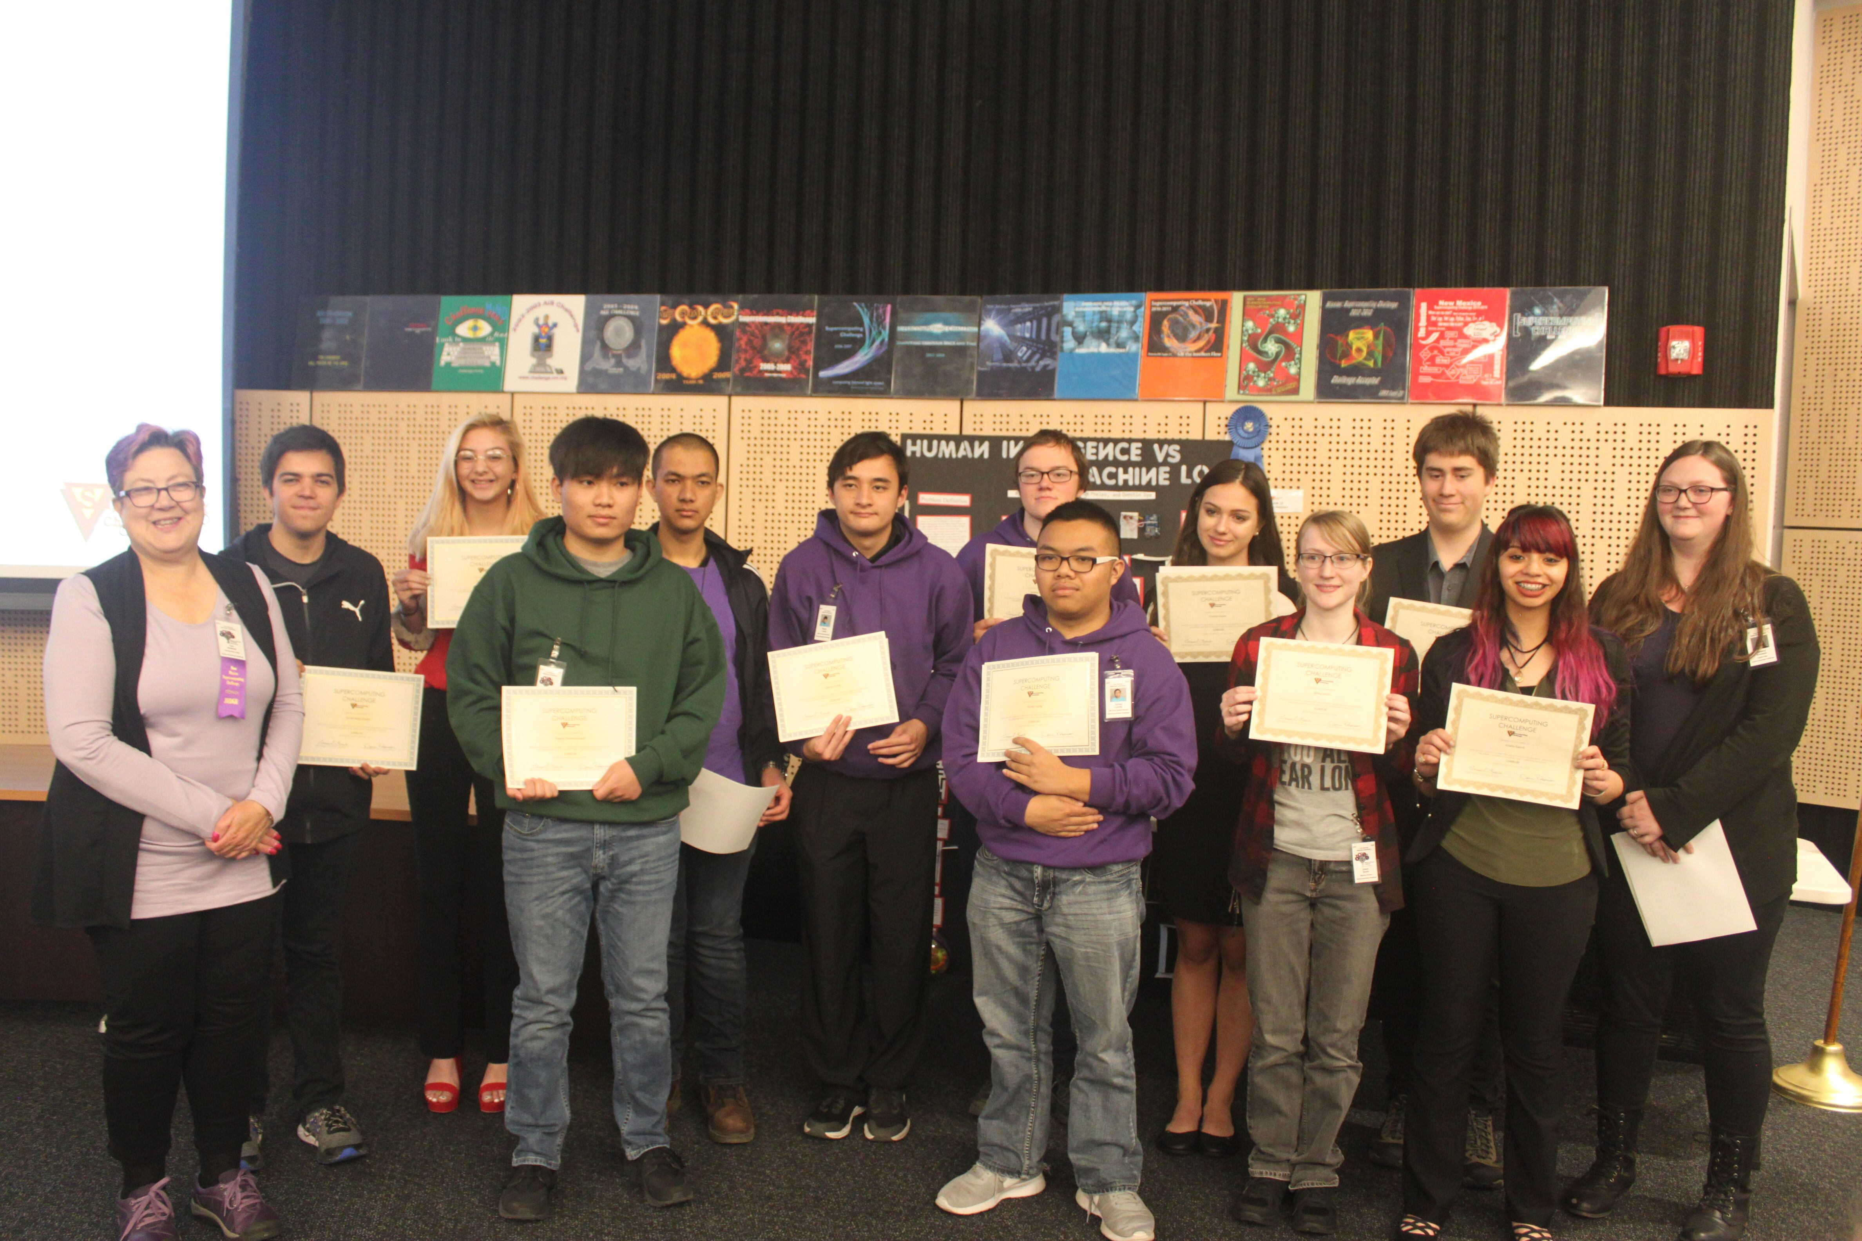
2018-2019 Finalists
and Scholarship Winners

Slide 26
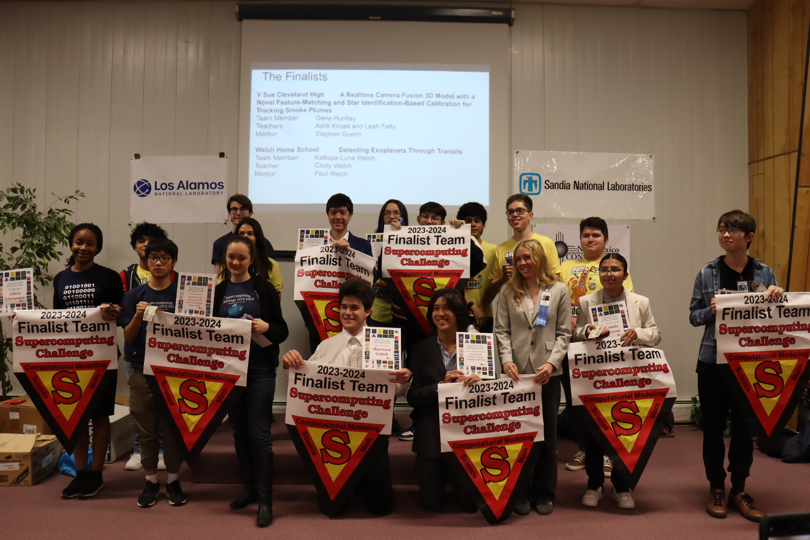
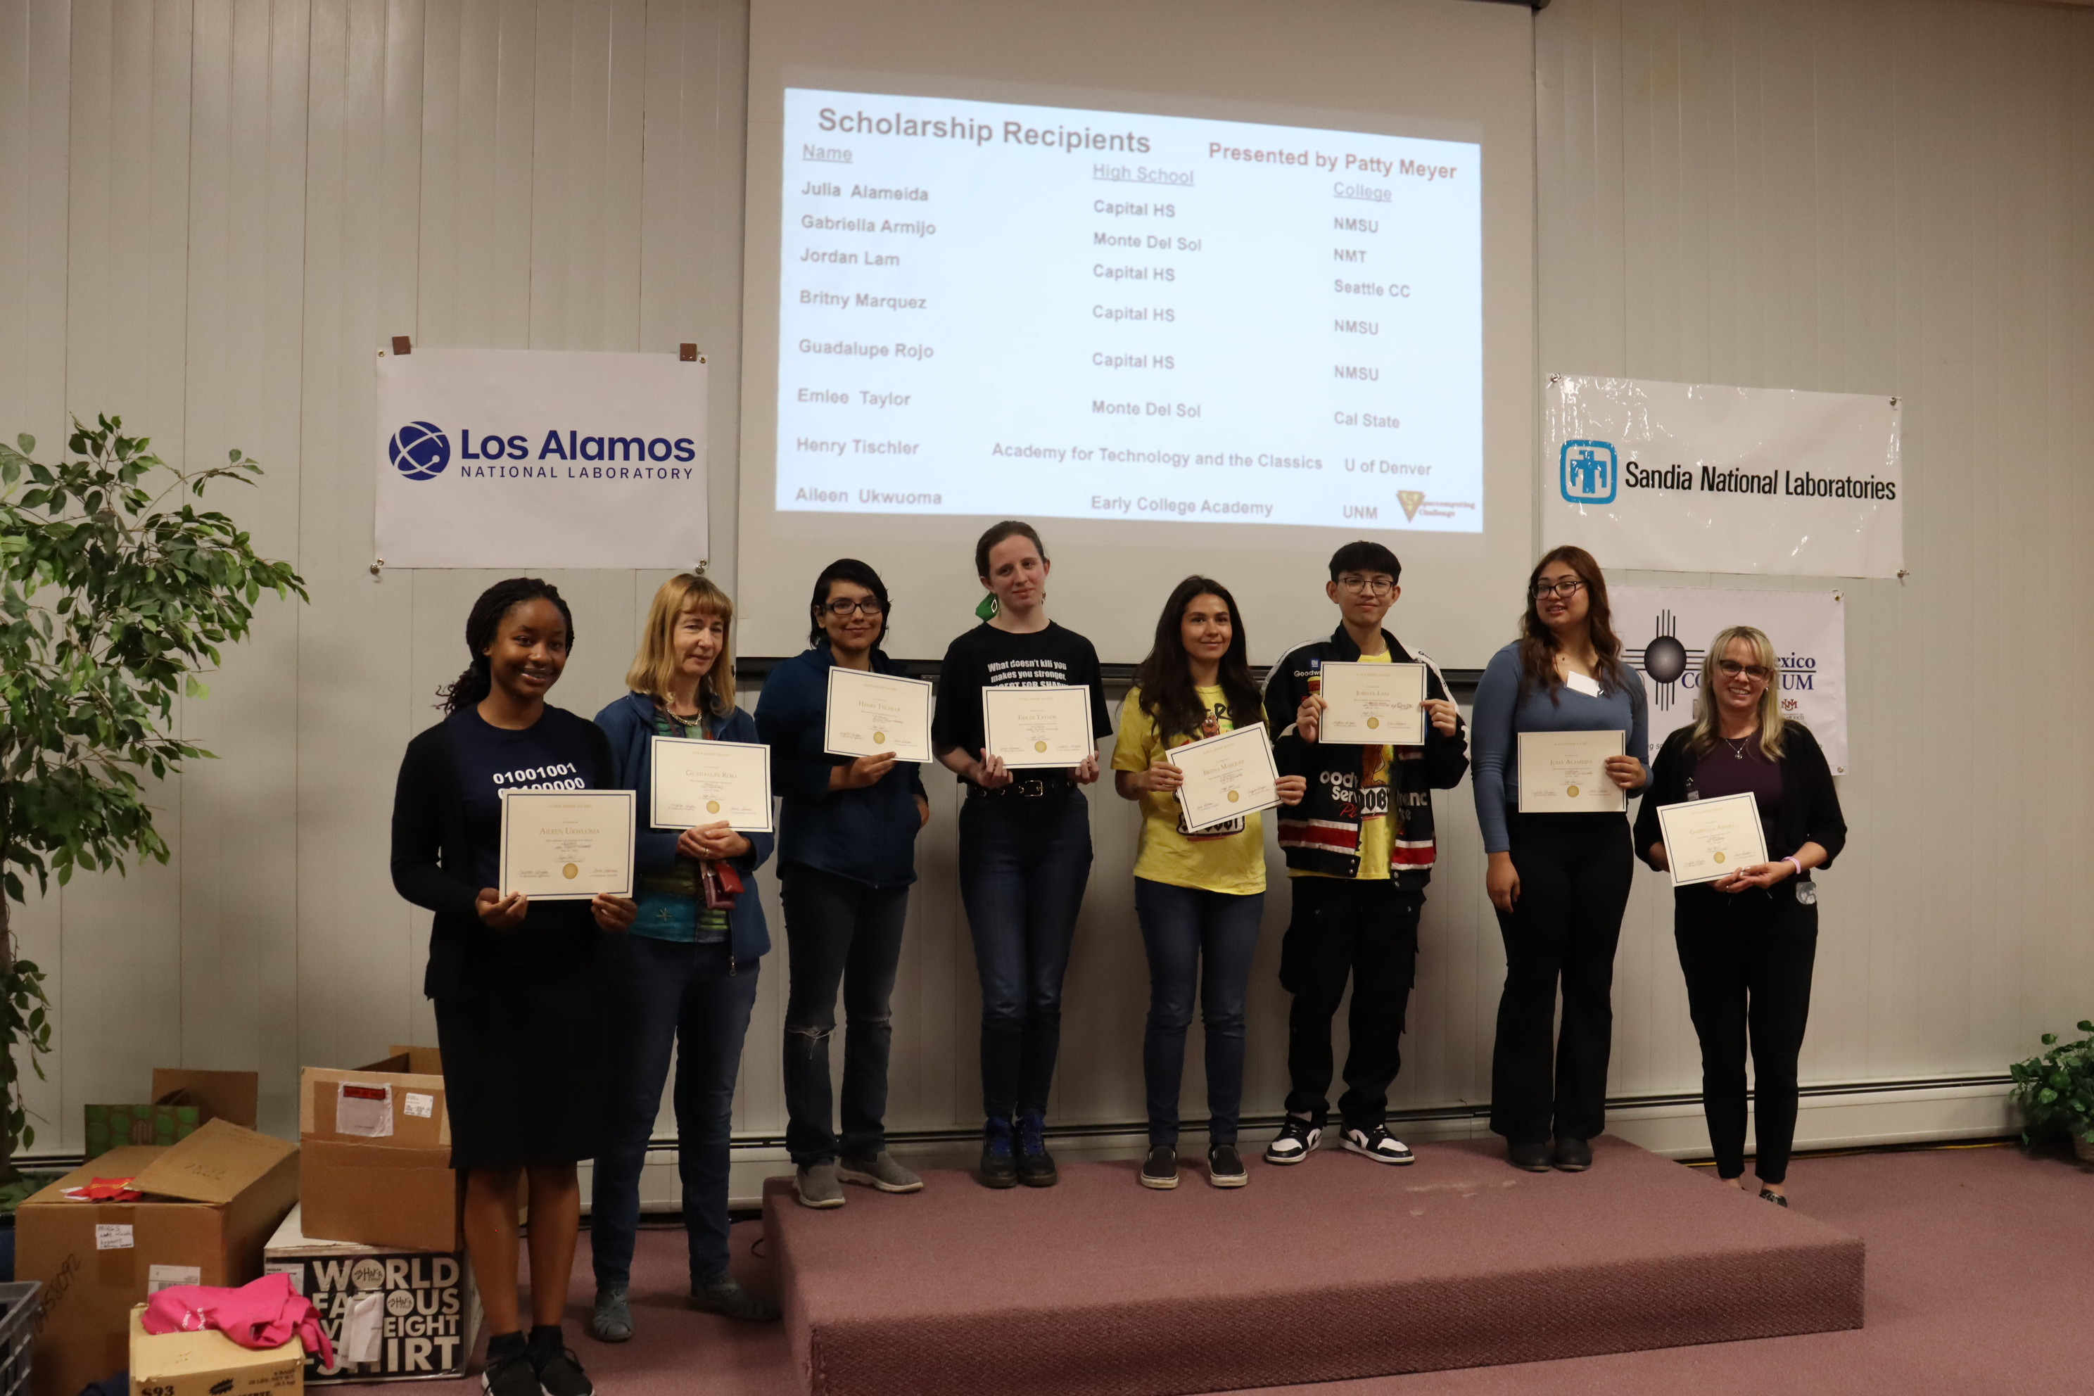
2023-2024 Finalists
and Scholarship Winners

Slide 27
Superintendent endorsement
Rigor
Relevance
Relationships
Notes:
On 9/6/05, Patricia Miller <patriciam@gmail.com> wrote:
There are three big "themes" in public school education at this time: rigor, relevance and relationships. The need to provide rigor is part of the reason NM has followed the national trend of requiring Algebra I, Geometry, and Algebra II, as well as three science classes, for graduation. In times past students could take any number of math courses that counted for mathematics credit, this is no longer the case. The quest for relevance is the increased demand to answer the perennial student question, "What will I ever use this for?" With lower achieving students relevance can be provided by giving them additional elective opportunities to see how they will use the required core knowledge. With the higher achieving students this is provided at the end of the high school career as they take AP or career/vocational classes, have work experiences, or begin taking concurrent credit classes at a college or university. Relationships between students and caring adults are taking on a new urgency as students become even more isolated as the average size of high schools increase. The "call" is to ensure that every student has at least one adult on the high school campus that the student knows will be his/her advocate and champion if there are problems. Schools are attempting to address this in a variety of ways, including the "teachers as advisers" program and with a renewed emphasis on extra- and co-curricular participation by 100% of students.
The Challenge is an opportunity for students to compete in a "real-world" scenario where they can solve actual problems in a way that accurately reflects the world of work. The Challenge also meets every one of the three items that are primary efforts in high school reform: rigor, relevance and relationships. Because the problems posed are real and require workforce skills and resources, they are all relevant and rigorous. Since every team has mentors and one or more coaches, it is all about relationships. I realize the Challenge has been around longer than this high school reform movement, but it also meets all of the requirements for an effective intervention in all three areas.
There is also a very practical reason I support the challenge, I've seen the benefits to a number of different teams. These benefits even include the external reinforcement of scholarship funds. As a former coach, and as the parent of a student who participated, I love the opportunities students receive in the scholarship realm. All of my team members have been able to go on to college and all of them have received great scholarships, partially through their participation in the Challenge.
I hope this information helps,
Patricia D. Miller, NBCT
Superintendent
Fort Sumner Municipal Schools
PO Box 387
Fort Sumner, NM 88119
Phone: 505.355.7734
Fax: 505.355.7716
Email: pmiller@ftsumnerk12.com
Web Site: www.ftsumnerk12.com

Slide 28
Challenges for the Challenge
Maintaining student involvement
Maintaining teacher involvement
Providing ongoing teacher professional development
Notes:
Maintaining student involvement to see the project through to completion
Maintaining teacher involvement from year to year
Keep the teachers learning, give them credit for staying up to date.

Slide 29
Primary Sponsors
Los Alamos National Laboratory
State of New Mexico
Triad National Security, LLC
Gold Partners
Sandia National Laboratories, Westwind
Silver Partners
Gulfstream Group & bigbyte.cc
Bronze Partners
New Mexico Technology In Education (NMTIE), Simtable/Redfish Group
Educational Partners
CCL/NetLogo, CNM, CNM Ingenuity, ENMU, MIT Starlogo Nova,
NM EPSCoR, NMHU, NM Tech, NMSU, NNMC, San Juan College,
UNM

Slide 30
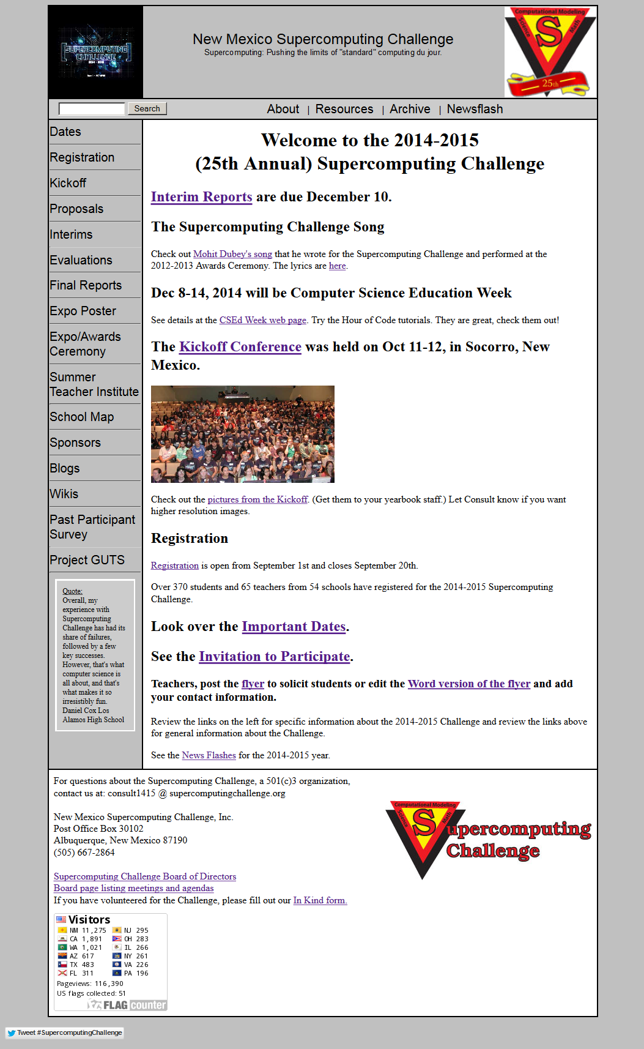
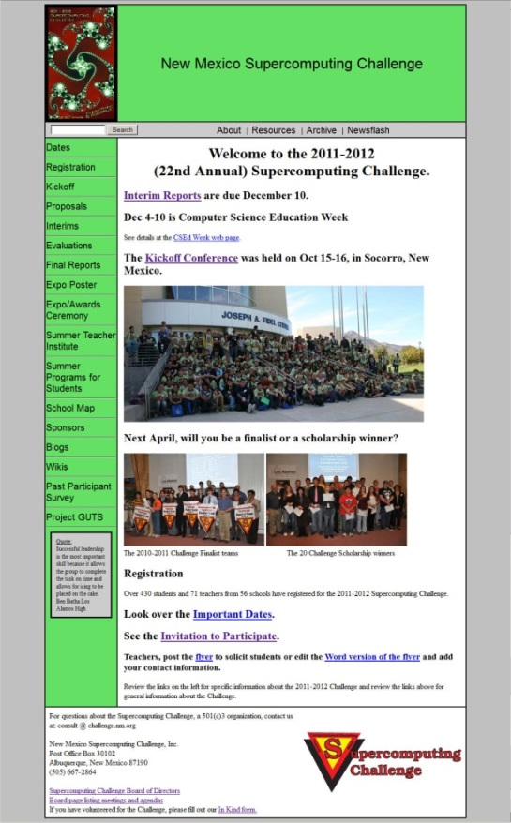
Challenge
Web page
https://supercomputingchallenge.org
Notes:
Talk about the different links: About, Resources, Archive, Sponsors …

Slide 31
How can YOU help?
Project Advisor (mentor)
Contributor
Sponsor
Judge
Mid/High School Teacher
Mid/High School Student
Connect us with principals/superintendents
Other

Slide 32
Visit us
https://supercomputingchallenge.org
consult@supercomputingchallenge.org
Let’s talk:
  David, 505-412-2558

Slide 33
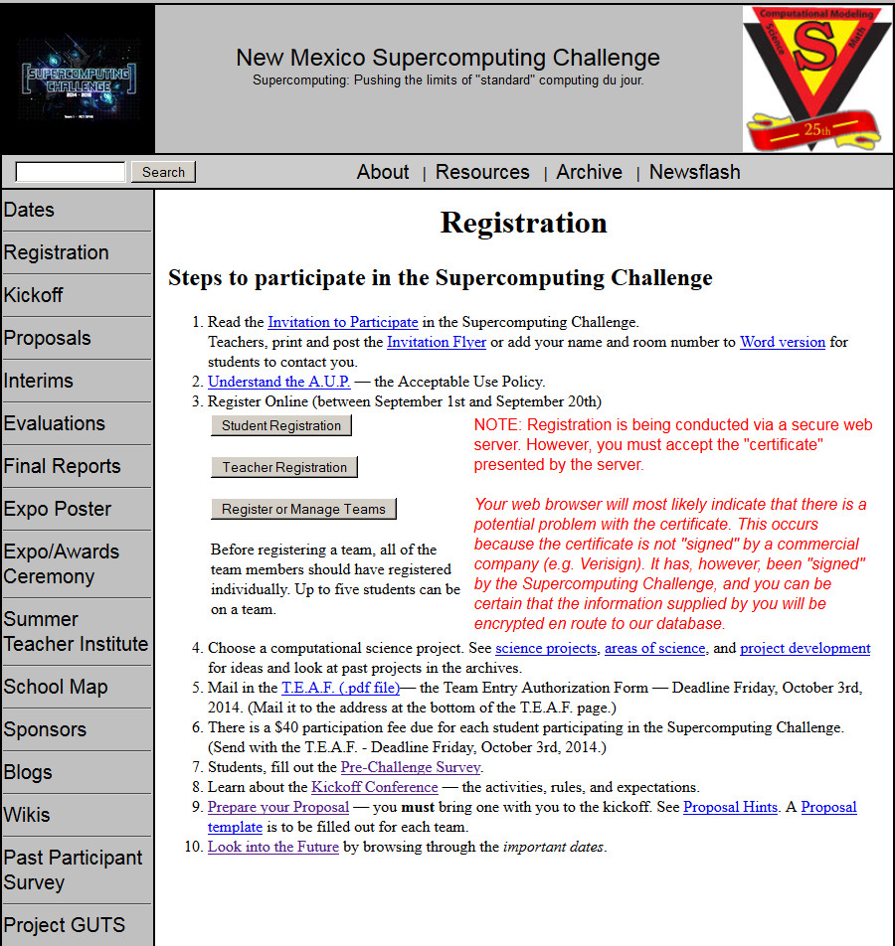
Time Line
September: Teams form and register

Slide 34
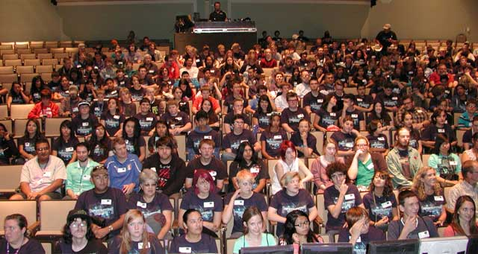
Time Line
October: Kickoff Conference

Slide 35
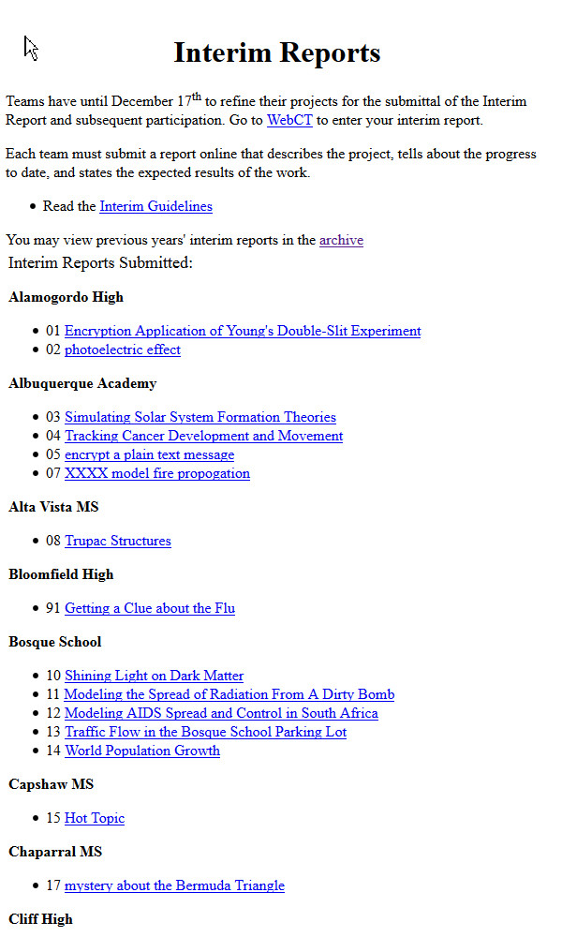
Time Line
November: School Visits
December/January: Interim Reports due

Slide 36

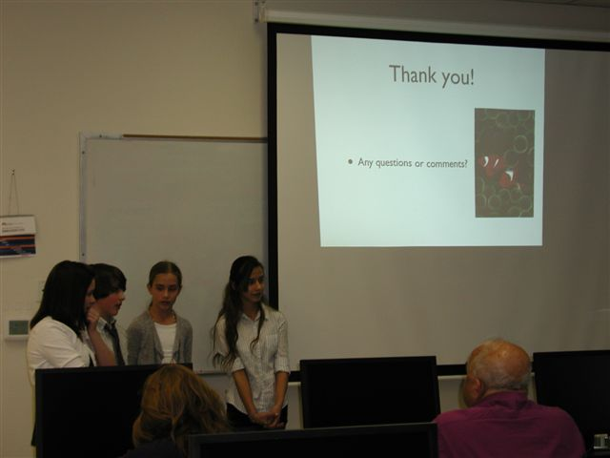
Time Line
January: Peer Reviews
February: Project Evaluations

Slide 37
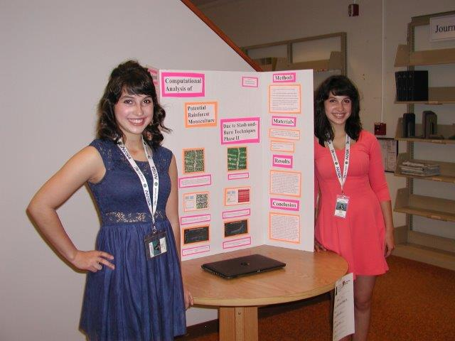
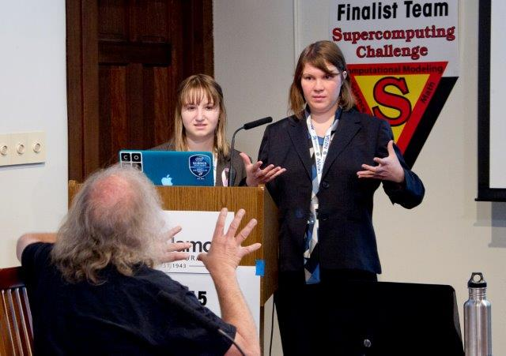
Time Line
April: Final Judging

Slide 38
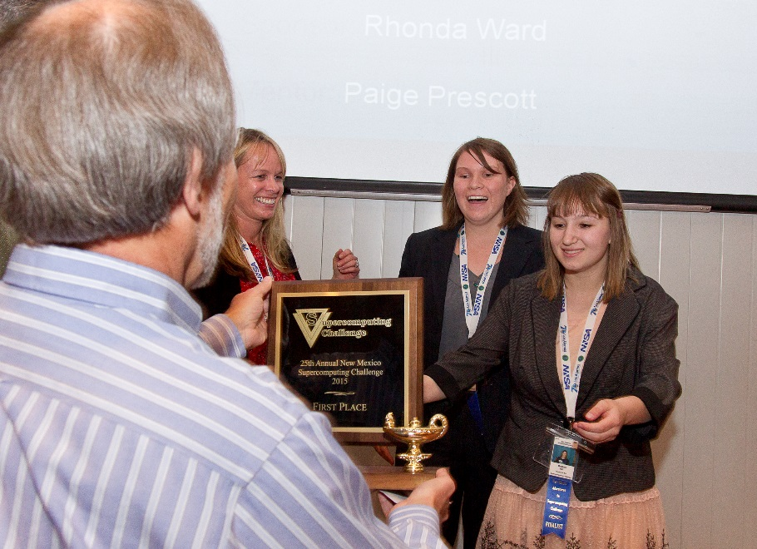
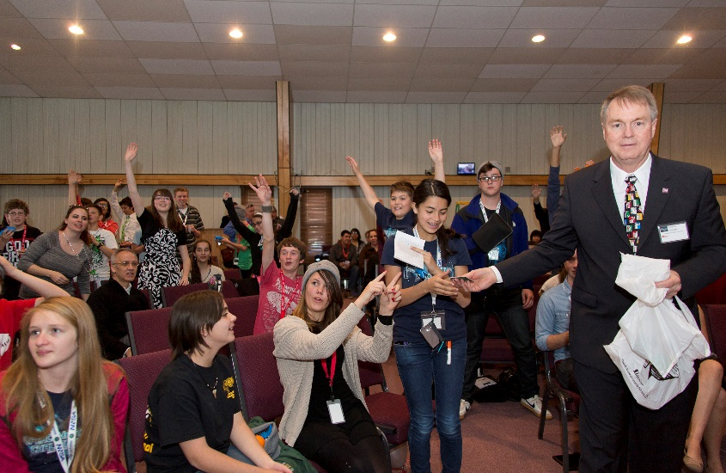

Time Line
April: Awards Ceremony

Slide 39
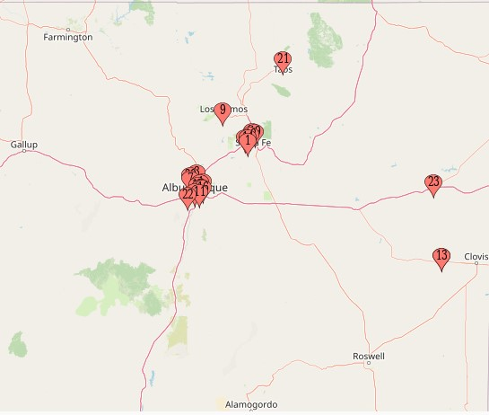
2022-23 Participation Map

